Slide 1
Year 2– Multiplication and division
Session 4 – The 5 times table.

Slide 2
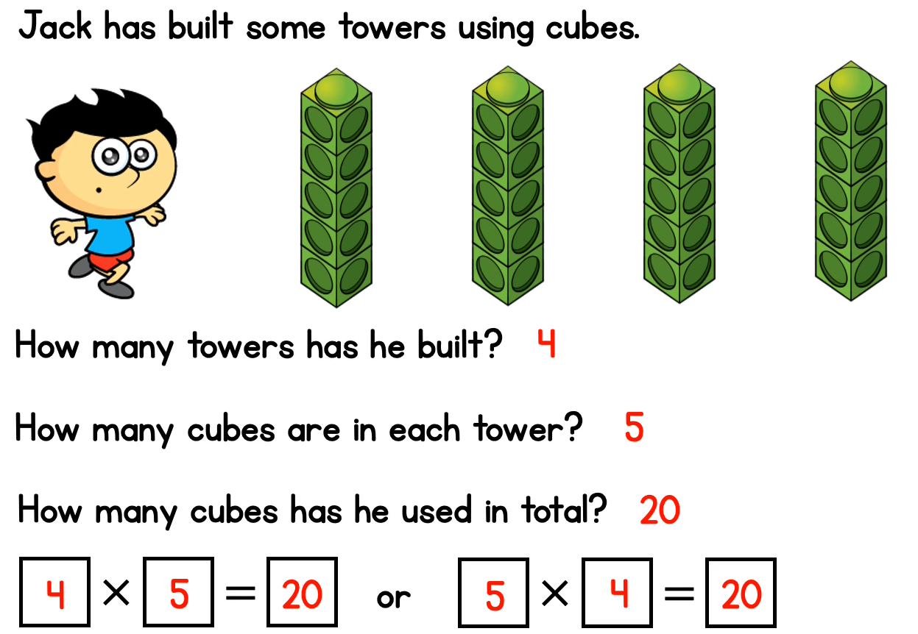
5
10
15
20
4
5
20
4
5
20
5
4
20
Or we could swap this to make another calculation

Slide 3
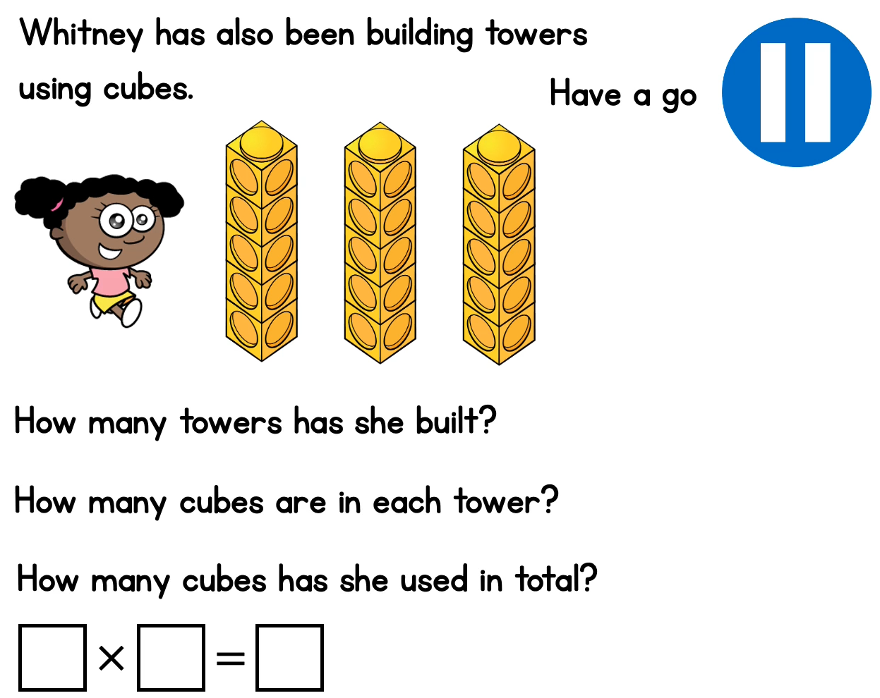
Can you fill in the missing details for Whitney’s towers?

Slide 4
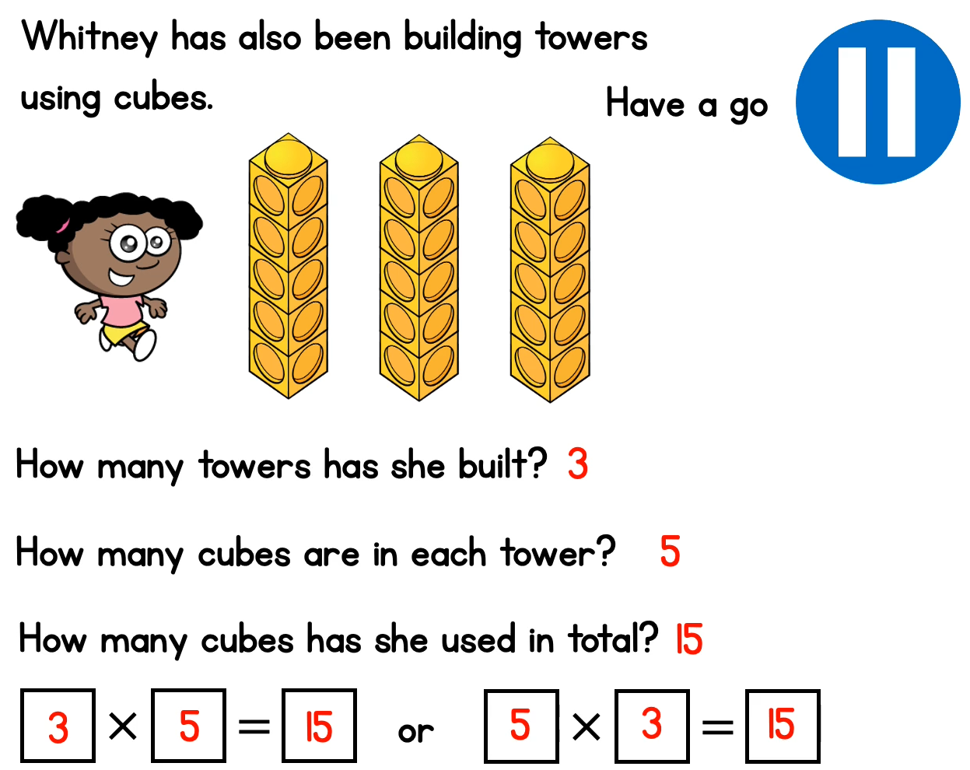

Slide 5
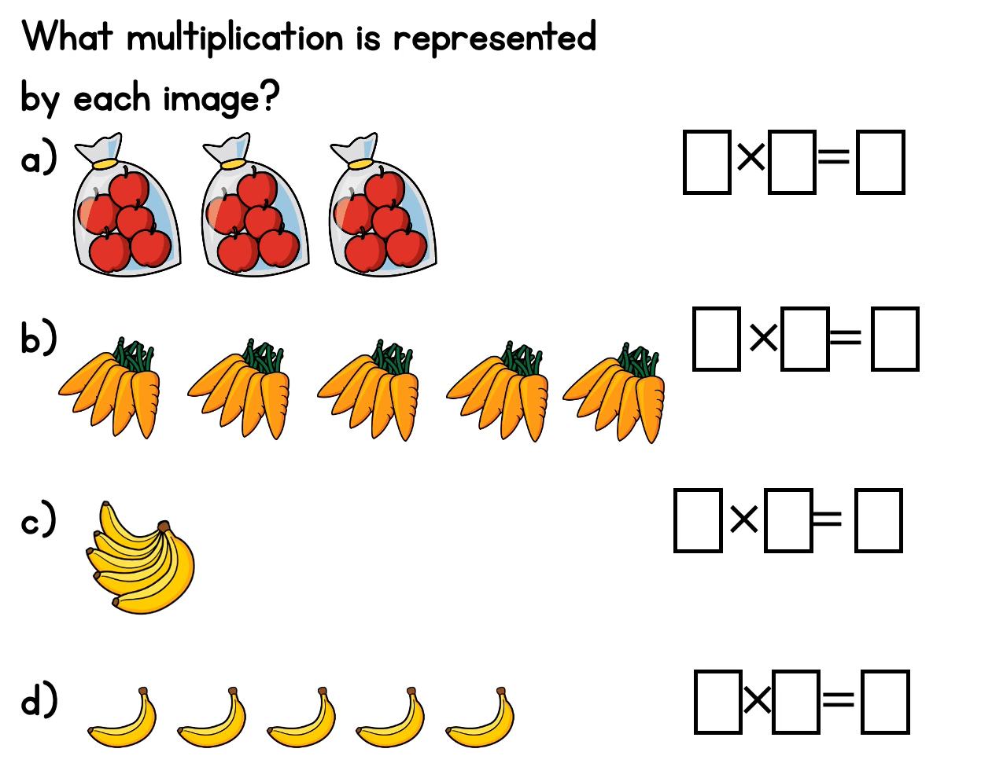
Remember to count how many groups first. Then, how many are in each group.

Slide 6
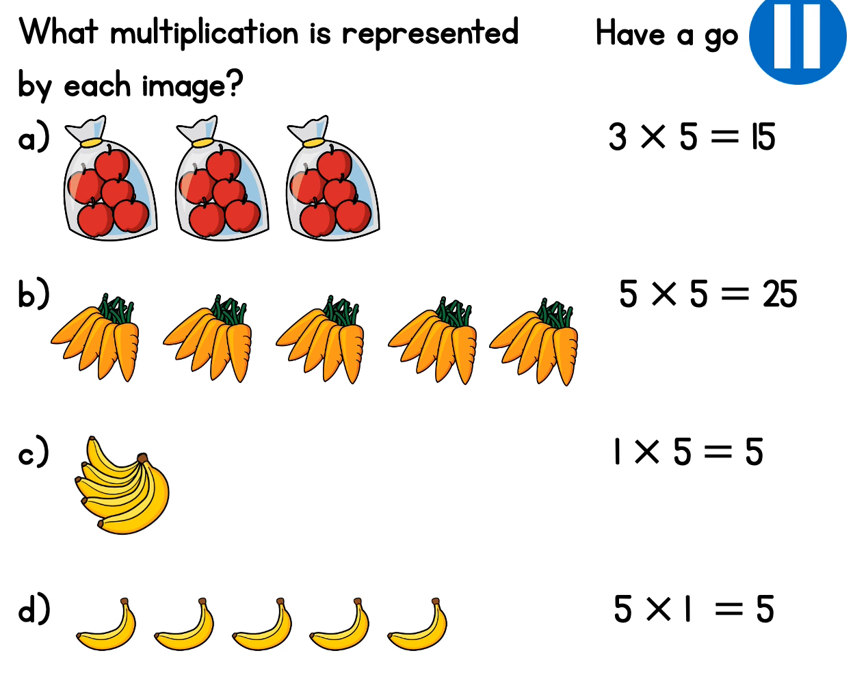
5 x 3 = 15
5 x 5 = 25
5 x 1 = 5
1 x 5 = 5
Can we find the other linked multiplication fact for each of these number sentences?

Slide 7
We’re getting good at our 2 times table now!
Let’s see if we can use counting in twos to answer these questions speedily.
3 x 5 =
15

Slide 8
2 x 5 =
10
6 x 5 =
30
4 x 5 =
20
8 x 5 =
40

