Slide 1
Monday 13th July2020
Reading and comprehension

Slide 2
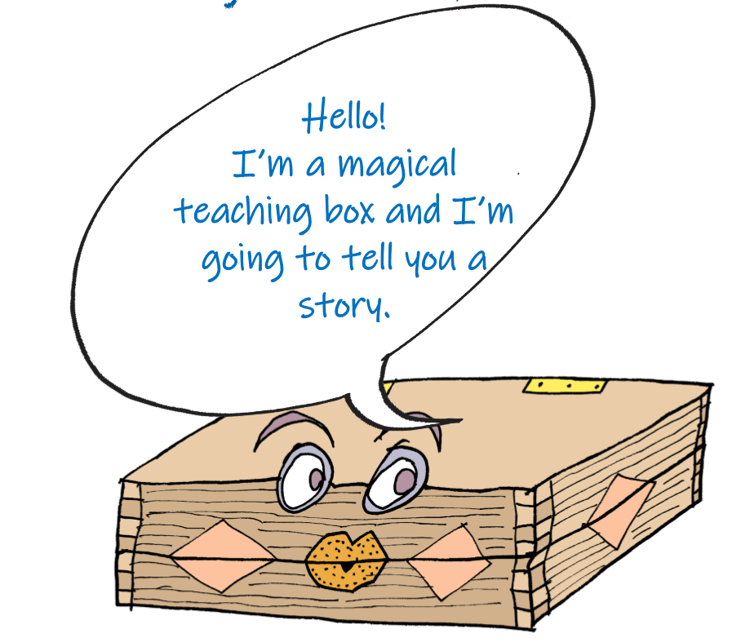
Today we are going to be reading a story from Ancient Greece.
This story has been told for hundreds of years!

Slide 3
For the next few days we will be
reading….
Pandora’s box

Slide 6
What do you think the box looked like?
What colour was it?
What shape?
Did it have decorations?
Draw your ideas now.

Slide 7
What do you think was in the box?

Slide 8
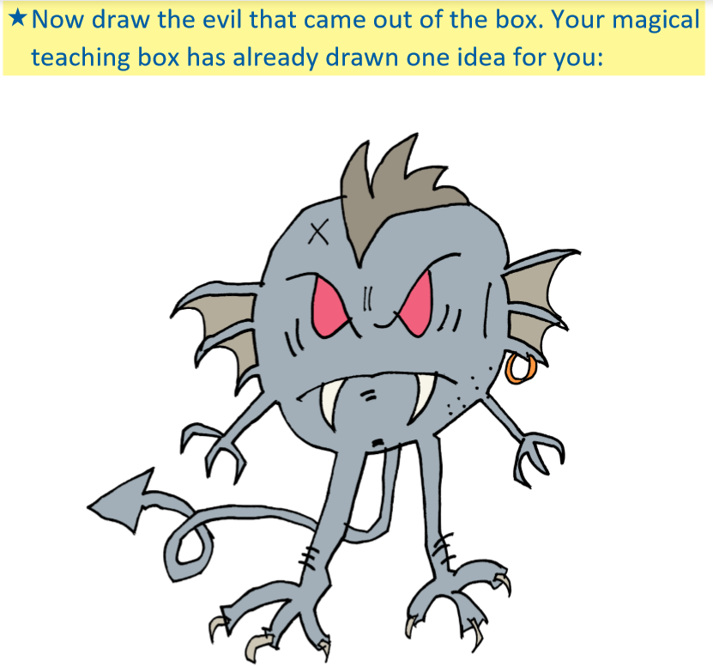

Slide 9
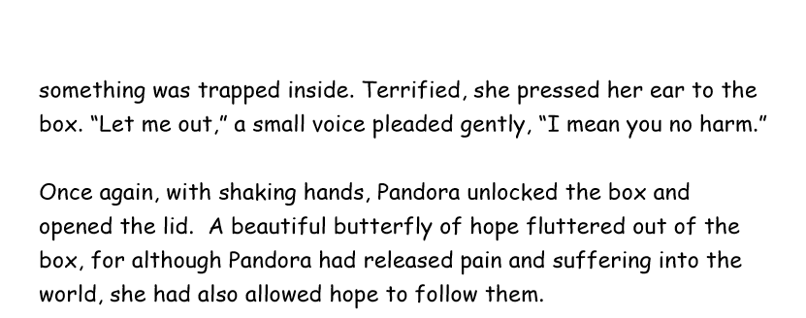

Slide 10
Answer the comprehension questions in full sentences Remember to use the text to help you.

