Slide 1
Tuesday 28th April 2020
English –Reading comprehension
Notes:
© Copyright Showeet.com – Free PowerPoint Templates. Photo credits: Pixabay (CC0 Public DomainFree for commercial use No attribution required)

Slide 2
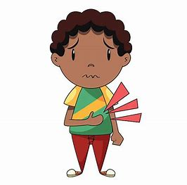
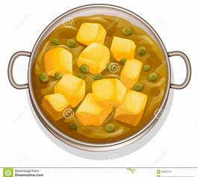
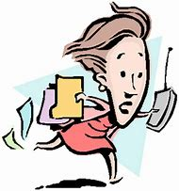
Let’s warm our brains up with a quick quiz about yesterday’s spelling lesson.
Which words are spelt correctly!
hungrea or hungry
curree or curry
Hurry or huree
Remember our rule… we usually use y for an ee sound
at the end of a word.

Slide 3
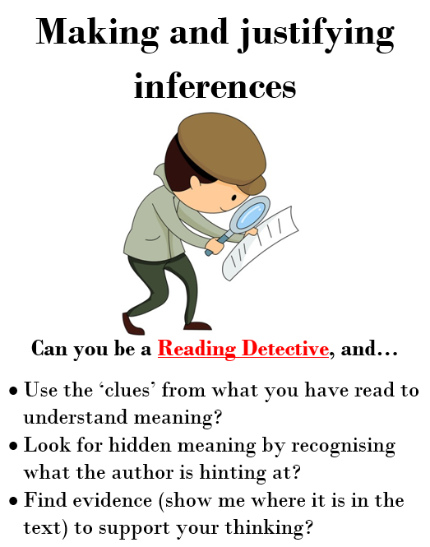
Today, we are focusing on reading comprehension skills.
Today we are focusing on inference skills. We use inference when the answer is in the text but we need to think a bit
Deeper as it is not as obvious.
This is Derek. He is our reading character to help us infer.
He is a detective who searches for
clues.
Notes:
© Copyright Showeet.com – Free PowerPoint Templates

Slide 4
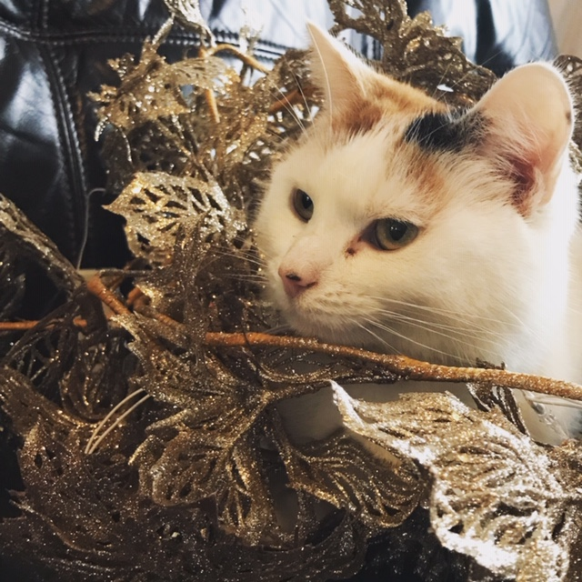
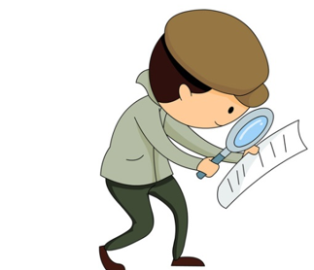
Read this short passage.
Tilly the cat sat quietly on the fence,
her tail twitching excitedly.
She could see the little bird just in front her! What a delicious treat it would be! Suddenly, she sprang forward leaping and grapping with her paws but she was too late. The little bird flew away happily. Tilly, slunk back to the house, her head and her tail hanging low.
Derek will help us answer these inference questions. Remember, the answer is there, you just have to find the clues.!
What is Tilly doing? Tilly is hunting or she is trying to catch the bird.
Notes:
© Copyright Showeet.com – Free PowerPoint Templates

Slide 5
Read this short passage.
Tilly the cat sat quietly on the fence, her tail twitching excitedly. She could see the little bird just in front her! What a delicious treat it would be! Suddenly, she sprang forward leaping and grapping with her paws but she was too late. The little bird flew away happily. Tilly, slunk back to the house, her head and her tail hanging low.
Derek will help us answer these inference questions. Remember, the answer is there, you just have to find the clues.!
What is Tilly planning to do with the bird?
Wash it ☒ Tuck it up in its nest ☒ Show it to Stig ☒ eat it ☑

Slide 6
Read this short passage.
Tilly the cat sat quietly on the fence,
her tail twitching excitedly.
She could see the little bird just in front her! What a delicious treat it would be! Suddenly, she sprang forward leaping and grapping with her paws but she was too late. The little bird flew away happily. Tilly, slunk back to the house, her head and her tail hanging low.
How did Tilly feel when the bird flew away? How do you know? She felt sad/disappointed/upset. You can tell because Her head and tail were hanging low. Slunk is a slow walk so she could of been walking slow because she was sulking.

Slide 7
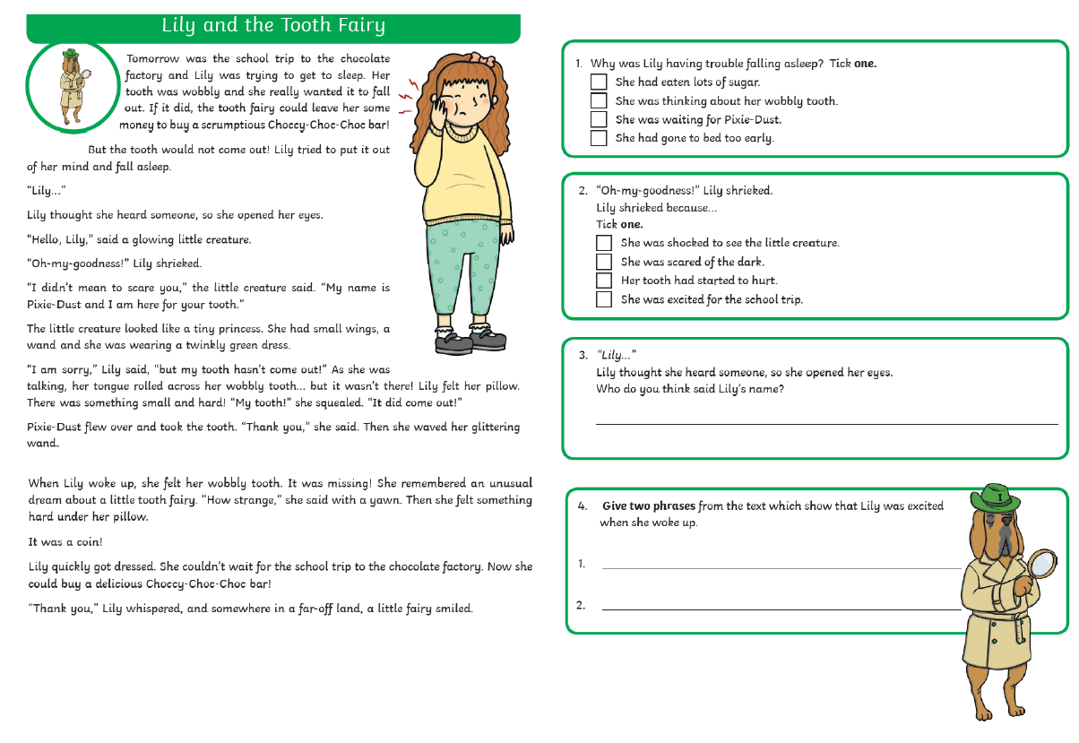
Now, use your inference skills to tackle the reading comprehension task.
It should look like this. If you need an adult to help you read, that’s totally okay! ☺ We are practising finding the answers.
If you can’t print, don’t worry, read on the screen and write your answers in your book.
Answers will
be uploaded on
Friday.
Notes:
© Copyright Showeet.com – Free PowerPoint Templates

