Slide 1
Year 2– Addition and subtraction
Session 1 – Adding and subtracting tens.

Slide 2
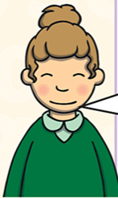
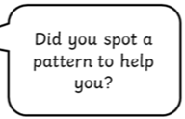
Over then few weeks, we are going to be practising our addition and subtraction skills.
We are going to re-cap our Year 2 learning so that we are experts at it ready for Year 3!
Building patterns
Let’s think about it like this…..
We know that
1 one + 3 ones = 4 ones
So we know that
1 ten + 3 tens = 4 tens
We write 4 tens like this… 4 0 = 40
4 tens 0 ones

Slide 3
Can you use your number knowledge to complete the pattern for adding ten?

Slide 4
Building patterns
Let’s think about it like this…..
We know that
4 ones - 2 ones = 2 ones
So we know that
4 tens - 2 tens = 2 tens
We write 2 tens like this… 2 0 = 20
2 tens 0 ones

Slide 5
Can you use your number knowledge to complete the pattern for subtracting ten?

Slide 6
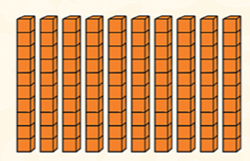
The ones digit is always zero and the tens digit changes by 1 each time.
This is because we are adding tens.
Tens don’t have any ones!

Slide 7
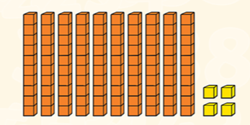
The ones digit stays 4 each time and the tens digit changes by 1 each time.
This is because we are adding tens.
Tens don’t have any ones!

Slide 8
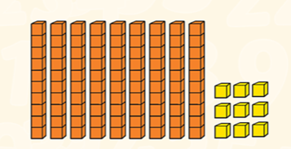

Slide 9
66
36 + 30 =
3 tens
I’m going to draw 3 circles to help me with my counting in tens
46
66
56
36

Slide 10
61
21 + 40 =
4 tens
I’m going to draw 4 circles to help me with my counting in tens
21
51
31
61
41

