Slide 1
Year 2– Measures
Session 4 – Introducing capacity and volume

Slide 2
Capacity.
Capacity is the amount that a container can hold.
The capacity of a container cannot change.
If a container is full to the top we say that is at full capacity.

Slide 3
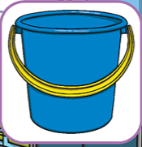
Look carefully at these containers.
Which one can hold the most water?
The bucket can hold the most water.
It has a larger capacity.

Slide 4
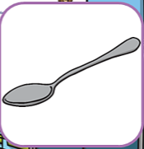
Look carefully at these containers.
Which one can hold the most water?
The jar can hold the most water.
It has a larger capacity.

Slide 5
Volume.
Volume is the amount that is currently inside the container.
This volume can change when things are added to or removed from a container.

Slide 6
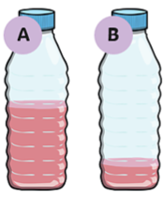
Look carefully at these containers.
They are exactly the same size so that have the same capacity.
Do they have the same volume of liquid inside them?
less
more
A holds ________ than B
Both bottle have different volumes of liquid inside them.
A holds more than B.

Slide 7
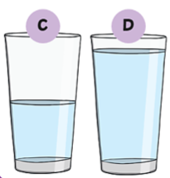
Look carefully at these containers.
They are exactly the same size so that have the same capacity.
Do they have the same volume of liquid inside them?
less
more
C holds ________ than D
Both glasses have different volumes of liquid inside them.
C holds less than D.

Slide 8
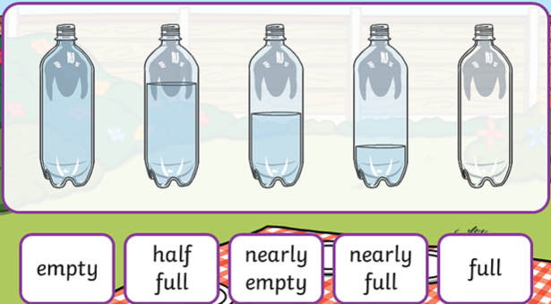
Match the bottle that best describes the volume of water inside it.

Slide 9
Match the bottle that best describes the volume of water inside it.

Slide 10
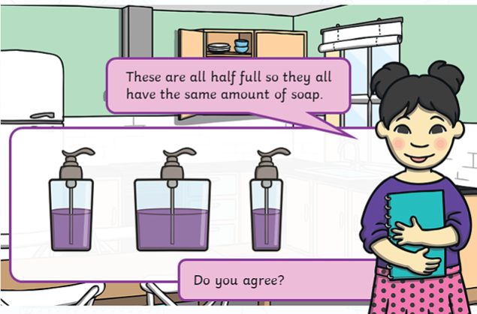
The bottles are all different sizes so they do not hold the same volume of soap.

