Slide 1
Year 2– Addition and subtraction
Session 8 – Number bonds to 100.

Slide 2
We know that number bonds are two numbers that we can add together to make a given total.

Slide 3
Let’s warm up our brains…
Number bonds to 10
8 + _____ = 10
6 + _____ = 10
0 + _____ = 10
______ + 3 = 10
_____ + 5 = 10
Number bonds to 20
11 + _____ = 20
8 + _____ = 20
13 + _____ = 20
______ + 10 = 20
_____ + 14 = 20

Slide 4
I know that there is 10 in each row. I am going to count in tens to help me.
10
20
30
40
10
20
30
40
50
60
40
60

Slide 5
I know that there is 10 in each row. I am going to count in tens to help me. Then I can add on the ones.
10
20
30
40
40 + 3
10
50 + 7
20
30
40
50
43
57

Slide 6
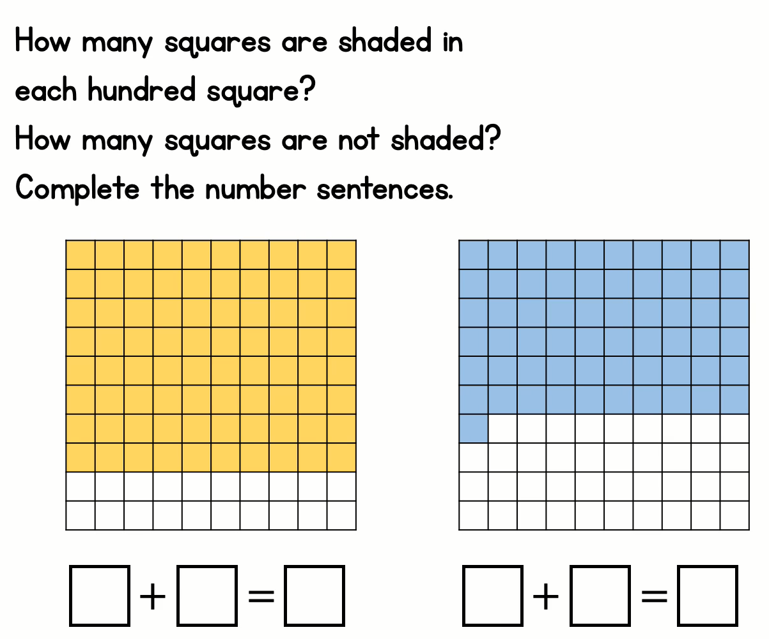
Your turn…. Find the answers and then check with my answers which will appear.
80
20
100
61
39
100

Slide 7
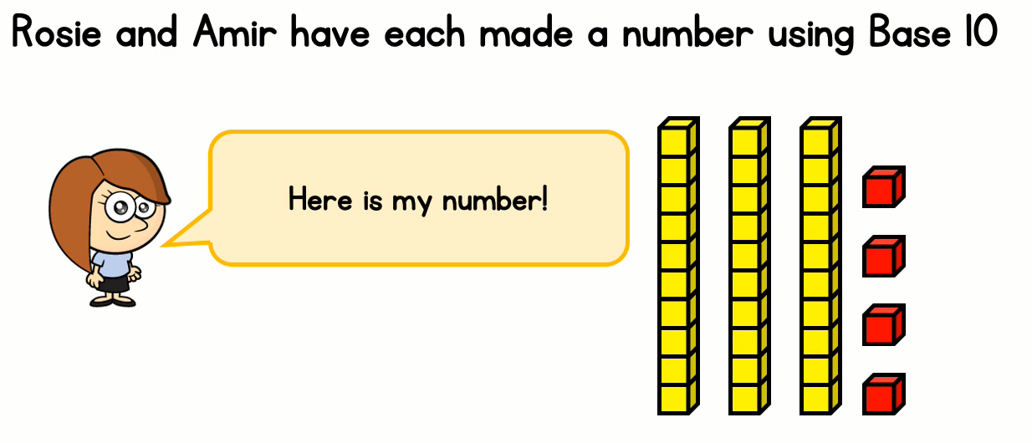
Rosie has 34.
I’m going to use my ones to finish
building a ten first. Rosie has
4….
Now I have 40 altogether. I can count in tens until I reach 100.
So Amir made has 67.
50
60
70
80
90
100

Slide 8
Bar Models to show number bonds to 100
This is my whole.
This is one part of my whole.
This is another part of my whole.
When these two parts are added together they have to make the whole number at the top.
To work out my missing number I could….
Colour in 33 squares and then count the blank squares.
Or……….

Slide 9
Bar Models to show number bonds to 100
This is my whole.
This is one part of my whole.
This is another part of my whole.
When these two parts are added together they have to make the whole number at the top.
To work out my missing number I could….

