Slide 1
Year 2 - Time
Session 2 – 5 mins

Slide 2
Today we are learning to tell the time to the nearest 5 minutes from half past to the nearest hour

Slide 3
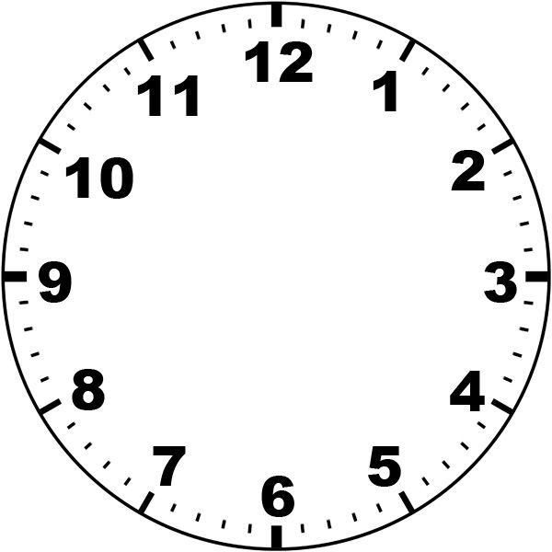
When the minute hand (long hand) is on these numbers:
The 12 represents 60 minutes o’clock
The 11 represents 55 minutes - 5 to
The 10 represents 50 minutes – 10 to
The 9 represents 45 minutes - quarter to
The 8 represents 40 minutes - 20 to
The 7 represents 35 minutes – 25 to

Slide 4
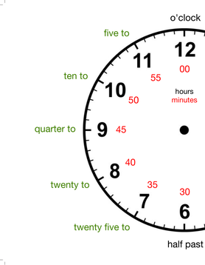

Slide 5

The minute hand (long hand) is pointing on the 7. The 4 represents 25 to
The hour hand (short hand) is still on the 3 but near 4
So the time here is 25 minutes to 4

Slide 6
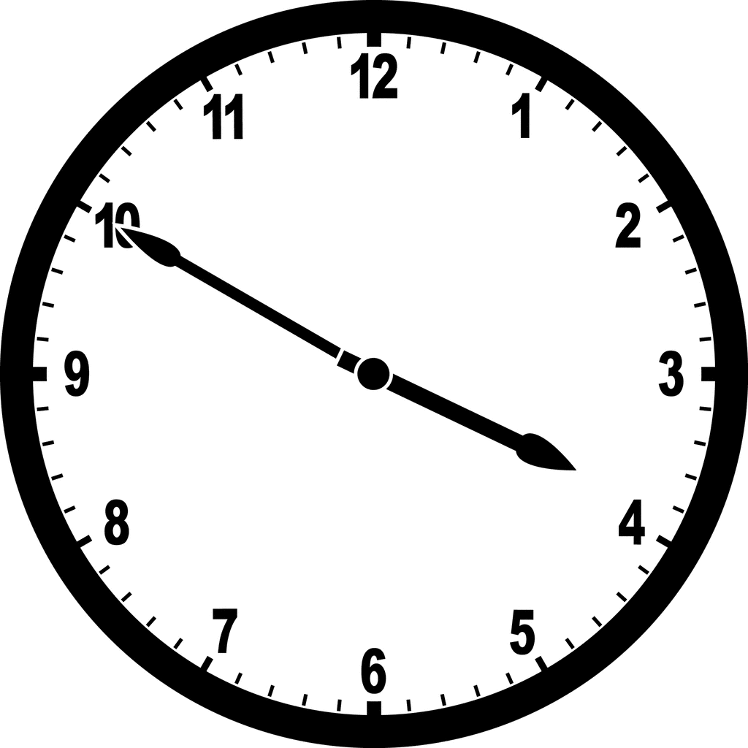
The minute hand (long hand) is pointing on the 10. The 4 represents 10 to
The hour hand (short hand) is near 4
So the time here is 10 to 4

