Slide 1
Wednesday 1st July2020
Reading and comprehension

Slide 2
Today we are going to be reading a traditional tale.
A traditional tale is a story that has been passed down through families.
Most fairy tales are classed as traditional tales. They are stories that many people know.

Slide 3
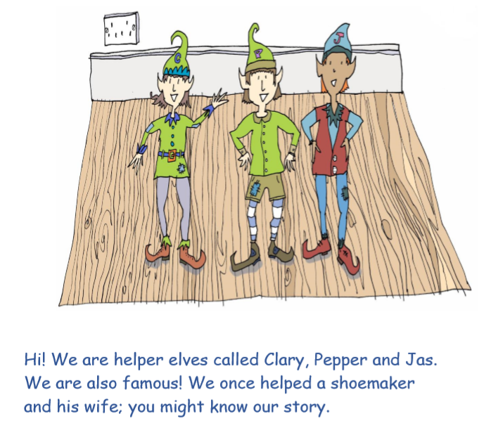
For the next few days we will be
reading….
The Elves and the shoemaker

Slide 5
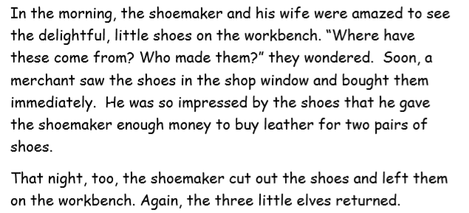

Slide 6
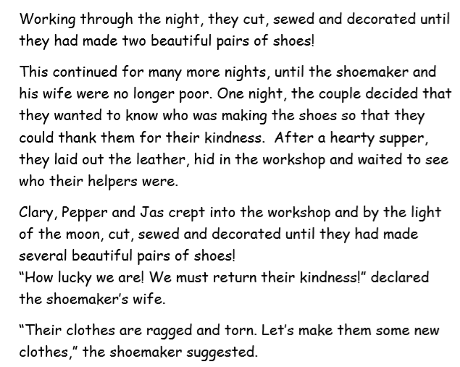

Slide 7
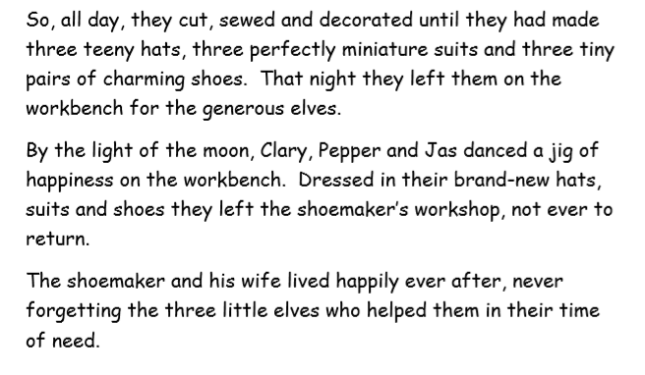

Slide 8
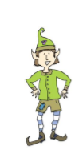
Pepper the elf is always
asking questions.
He is going to ask us some questions
about the story for us to answer in
full sentences.

Slide 9
Answer Pepper’s questions in full sentences Use the text to help you.

