Slide 1
Year 2– Geometry
Session 7 – properties of 3D shapes.

Slide 2
How is this shape different to a square?
This is a cube
Height
Depth
Width
This is a 3D shape. This means it is not a flat shape.
It has height, width and depth.

Slide 3
Properties of a 3D shape
Today we are going to learn to label
Vertices
Edges
Faces

Slide 4
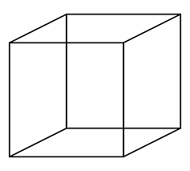
Vertices
Vertices are where edges meet at a point to make a corner.
We need to be careful to remember the ones we may not be able to see in a picture.
A cube has 8 vertices.

Slide 5
Edges
Edges are where two faces meet.
We need to be careful to remember the ones we may not be able to see in a picture.
A cube has 12 edges.

Slide 6
Faces
A face is a 2D shape that makes up one surface of a 3D shape.
We need to be careful to remember the ones we may not be able to see in a picture.
A cube has 6 faces. Each face is a square.

Slide 7
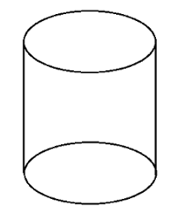
Can you count the vertices, edges and faces of this 3D shape?
This is a cylinder
Vertices
There are no vertices as there is no where 2 edges meet at a point.
Edges
There are 2 edges. One around the top and one around the bottom.
Faces
There are 3 faces. A circle at the top. A circle at the bottom and a rectangle that is wrapped around the middle.

Slide 8
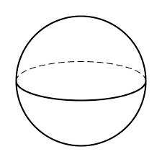
Can you count the vertices, edges and faces of this 3D shape?
This is a sphere
Vertices
There are no vertices as there is no where 2 edges meet at a point.
Edges
There are no edges.
Faces
There is 1 face that goes all the way round.

Slide 9
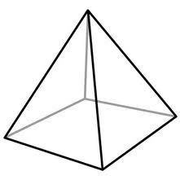
Can you count the vertices, edges and faces of this 3D shape?
This is a square based pyramid.
A pyramid is one shape at the bottom which then meets at a point at the top.
Vertices
There are 5 vertices.

Slide 10
Can you count the vertices, edges and faces of this 3D shape?
This is a square based pyramid.
Vertices
There are 5 vertices.
Edges
There are 8 edges.

Slide 11
Can you count the vertices, edges and faces of this 3D shape?
This is a square based pyramid.
Vertices
There are 5 vertices.
Edges
There are 8 edges.
Faces
There 5 faces.

Slide 12
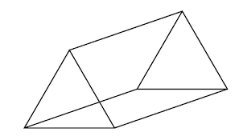
Can you count the vertices, edges and faces of this 3D shape?
Triangular prism
A prism is a 3D shape which has the same 2D shape going all the way through.
Vertices
There are 6 vertices.

Slide 13
Can you count the vertices, edges and faces of this 3D shape?
Triangular prism
Edges
There are 9 edges

Slide 14
Can you count the vertices, edges and faces of this 3D shape?
Triangular prism
Faces
There are 5 faces.
2 triangular faces and 3 rectangle faces.

