Slide 1
^{Tuesday 19th May 2020}
English - Spelling
Notes:
© Copyright Showeet.com – Free PowerPoint Templates. Photo credits: Pixabay (CC0 Public DomainFree for commercial use No attribution required)

Slide 2
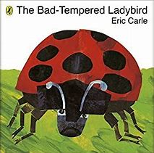
This week all our work is going to be around this book…
It is a very simple story but it was one of my favourites when I was little. My Grandma would read it to me all the time so today - if you press the
Sound buttons - I will read it to you. (If you want me to, you can always ignore the sound buttons and read it on your own). (No laughing at me though! ☺ Miss Lacey)

Slide 3
Before we start…we need to understand something about ladybirds.
Ladybirds eat aphids.
Aphids are tiny bugs that eat the leaves of plants and flowers.
Farmers and gardeners
love ladybirds because
they eat the aphids and
stop them from killing
the plants.

Slide 4
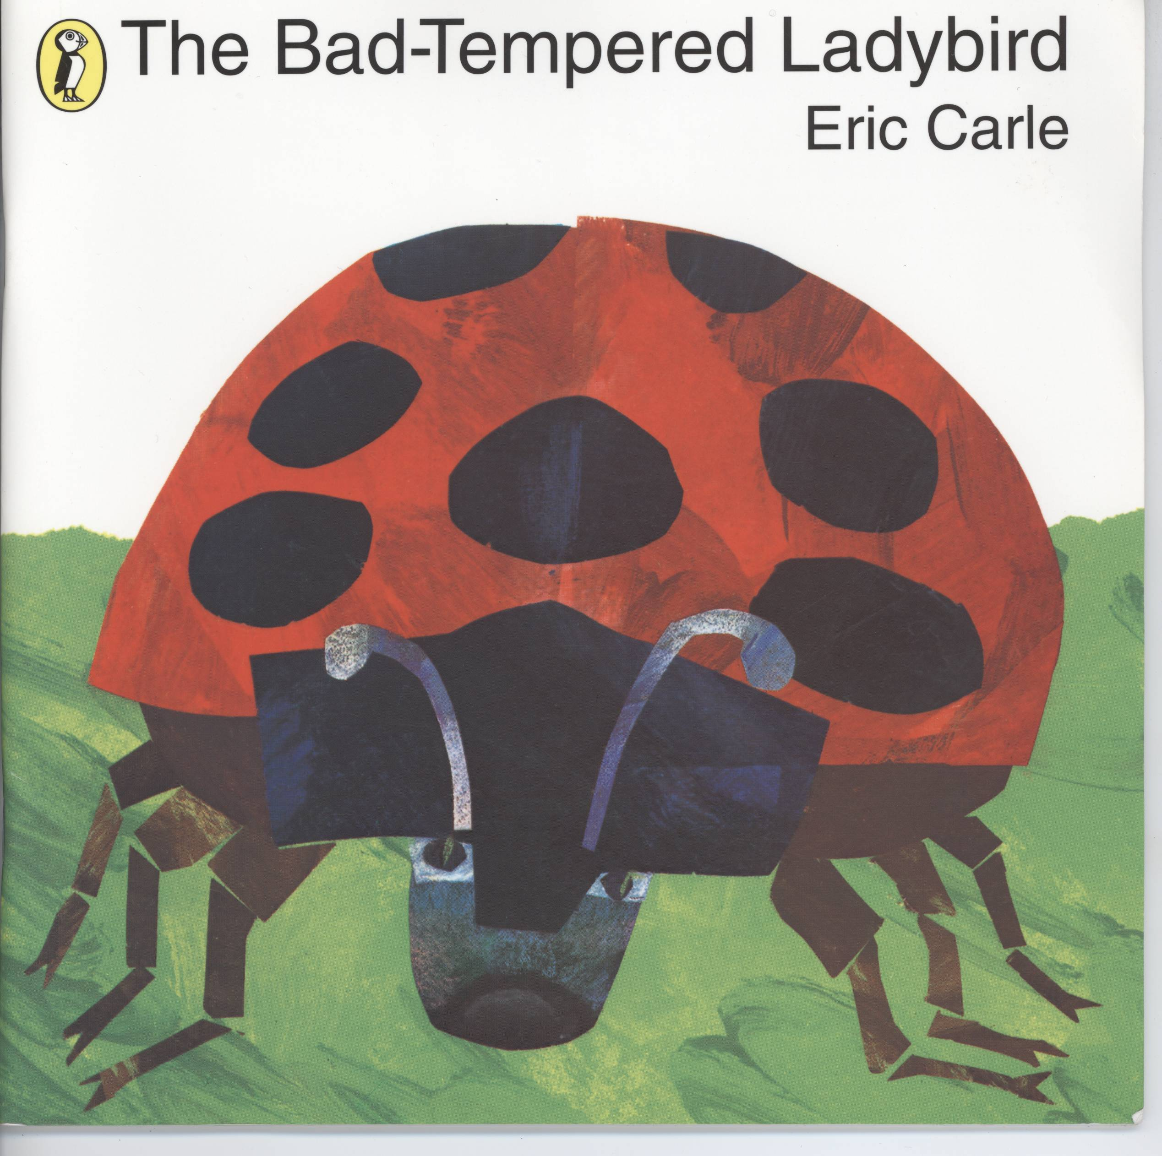

Slide 5
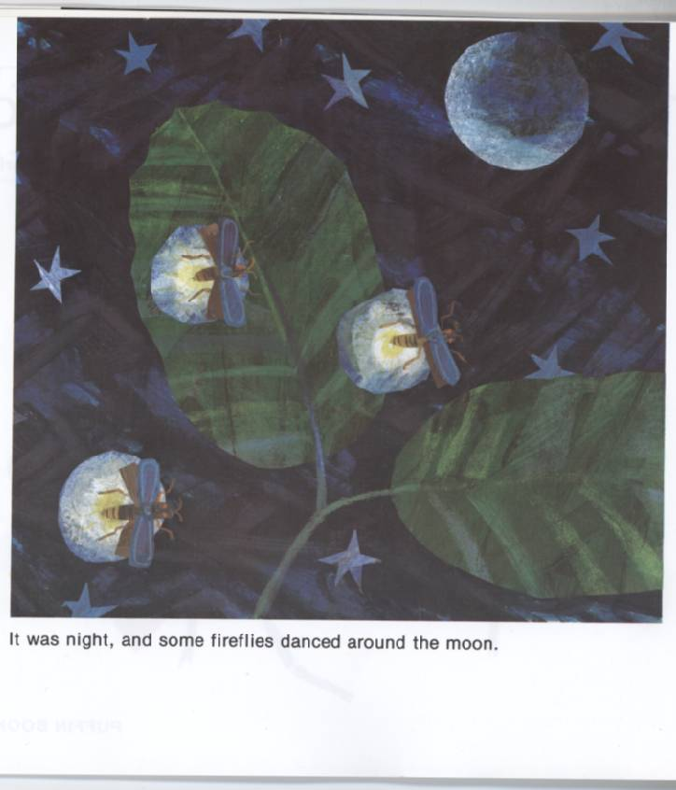


Slide 6
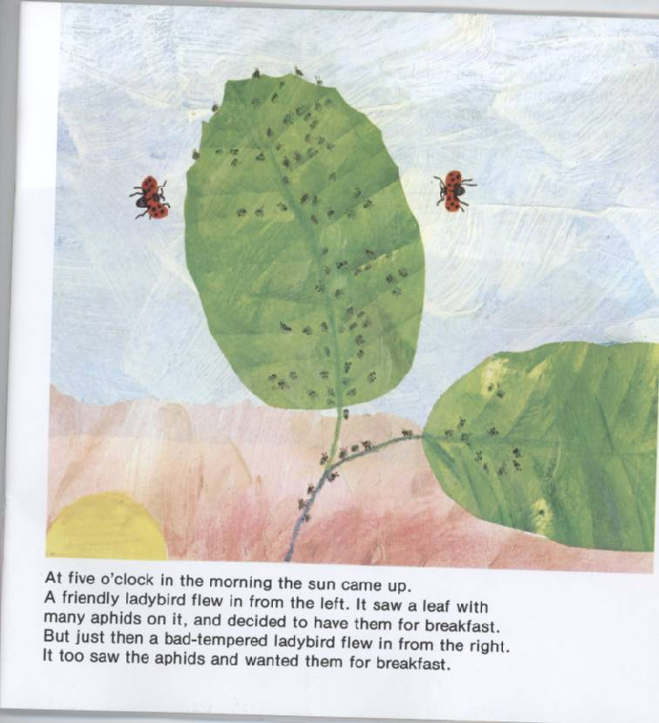

Slide 7
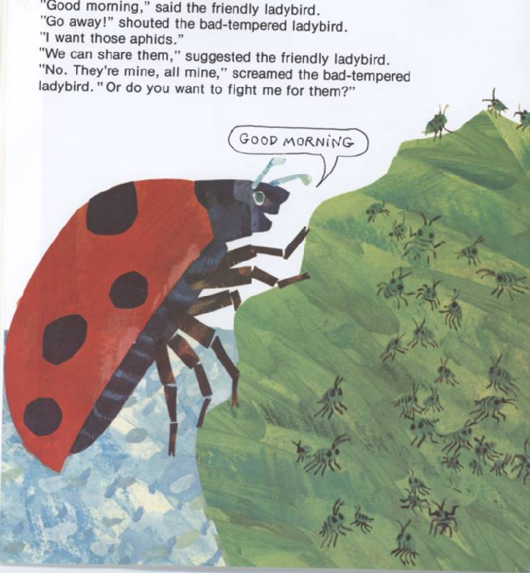

Slide 8
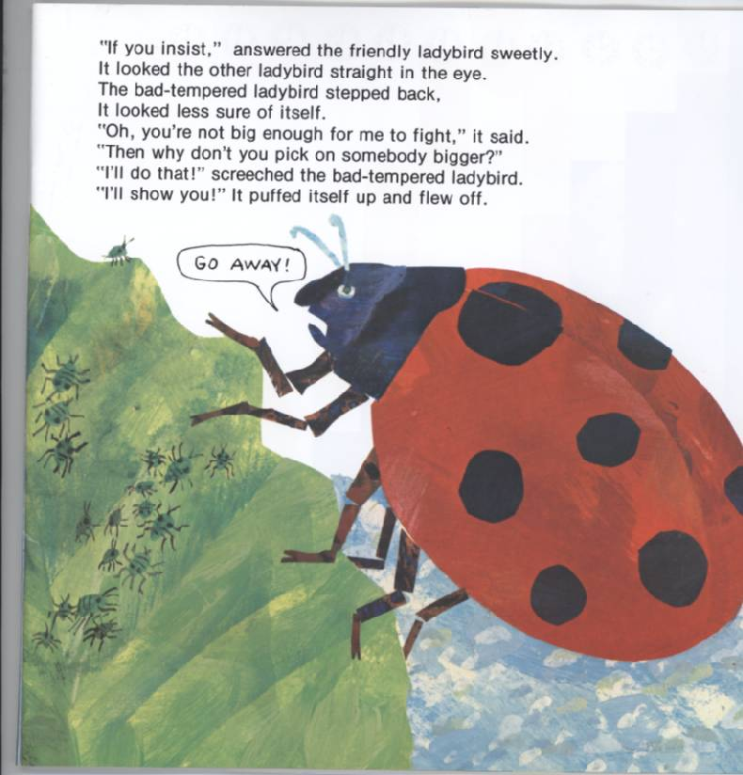

Slide 9
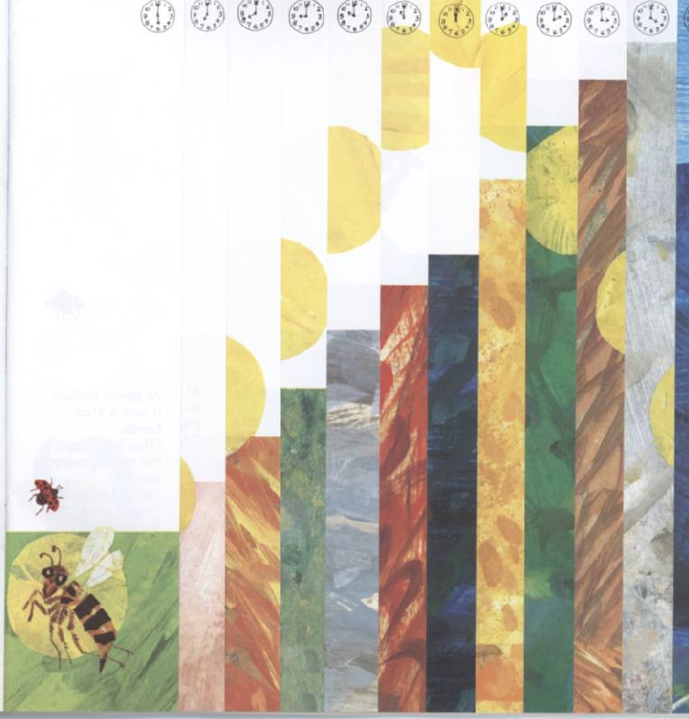
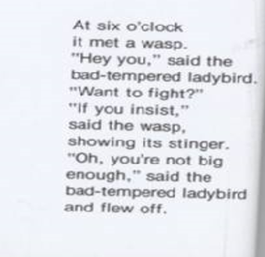

Slide 10
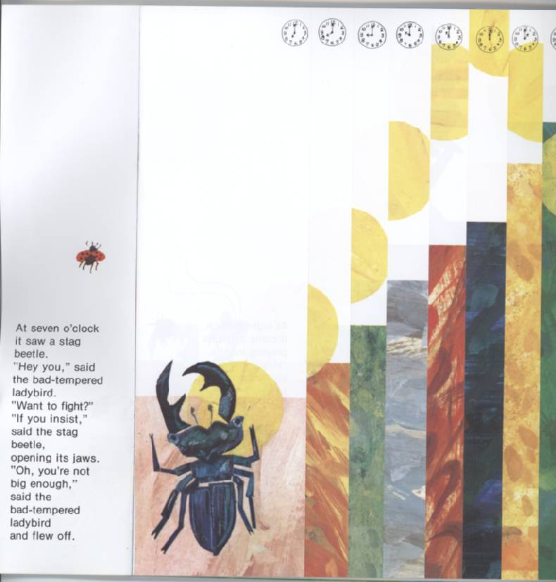

Slide 11
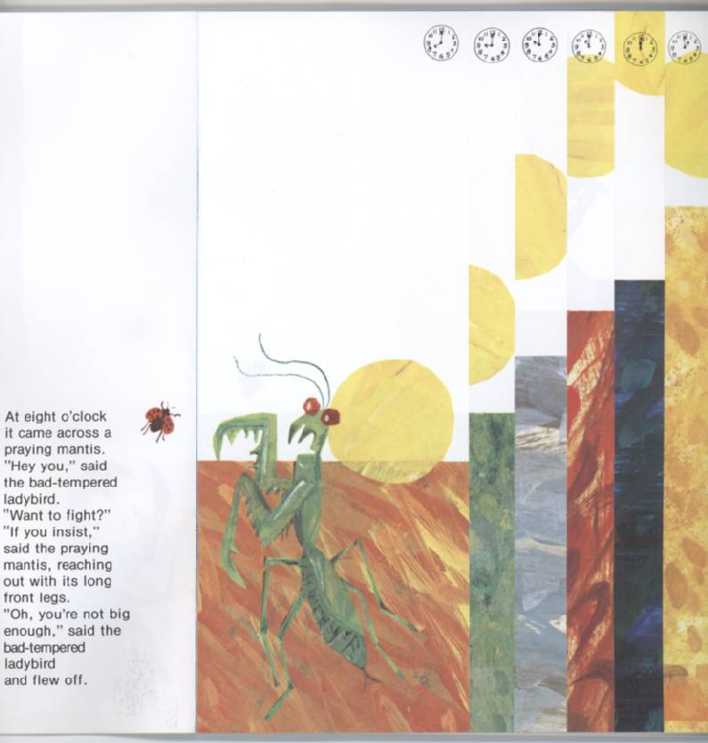

Slide 12
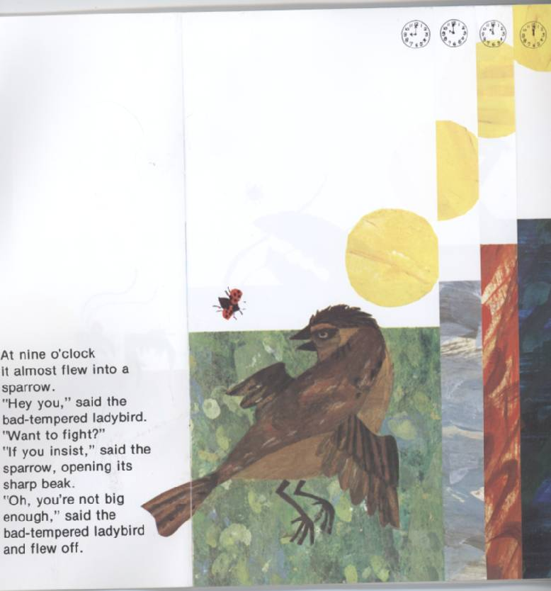

Slide 13
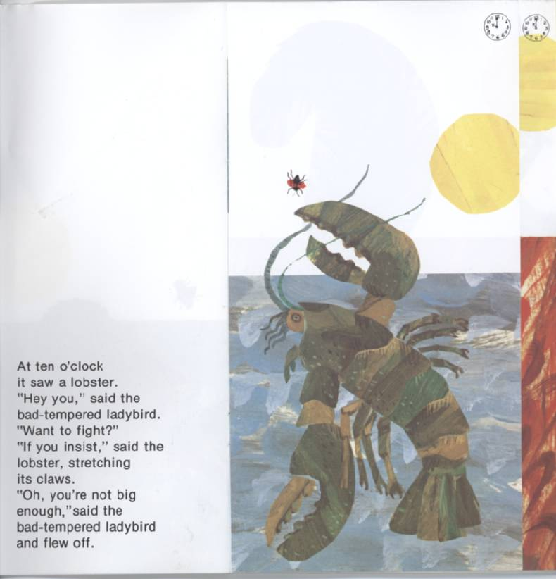

Slide 14
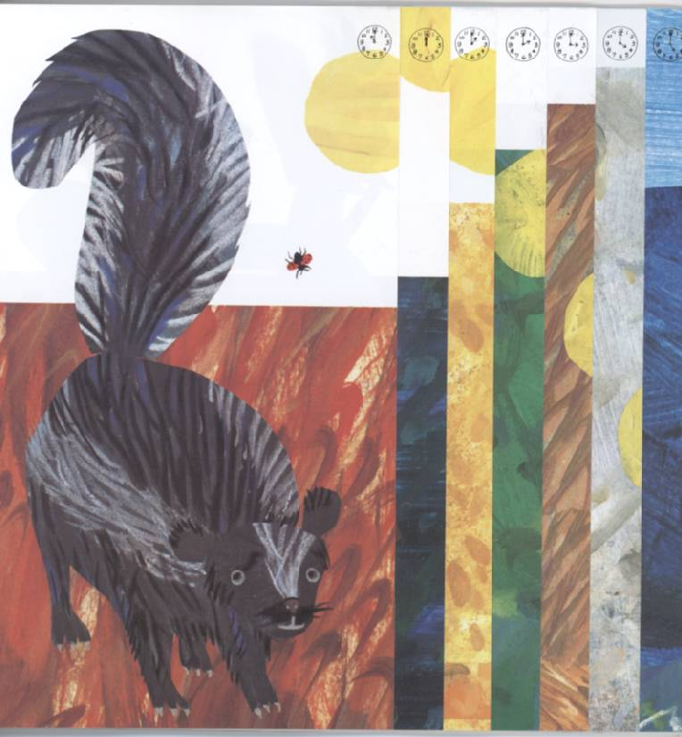
At eleven o’clock it bumped into a skunk.
“Hey you,” said the bad-tempered ladybird
“Want to fight?”.
“If you insist,” said the skunk, starting to lift its tail.
“Oh, you’re not big enough,” said the bad-tempered ladybird and flew off.

Slide 15
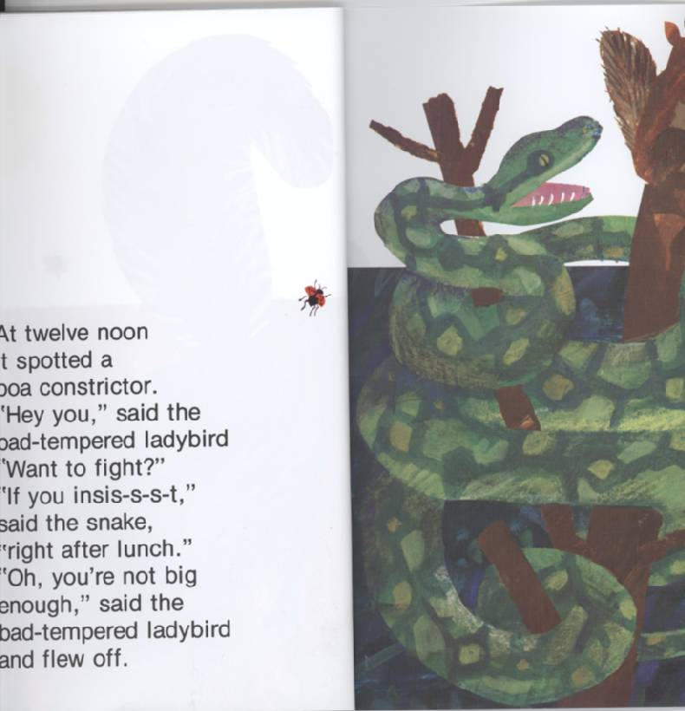
At twelve o’clock it spotted a boa constrictor.
“Hey you,” said the bad-tempered ladybird
“Want to fight?”.
“If you insis-s-s-t,” said the snake, “right after lunch”.
“Oh, you’re not big enough,” said the bad-tempered ladybird and flew off.

Slide 16
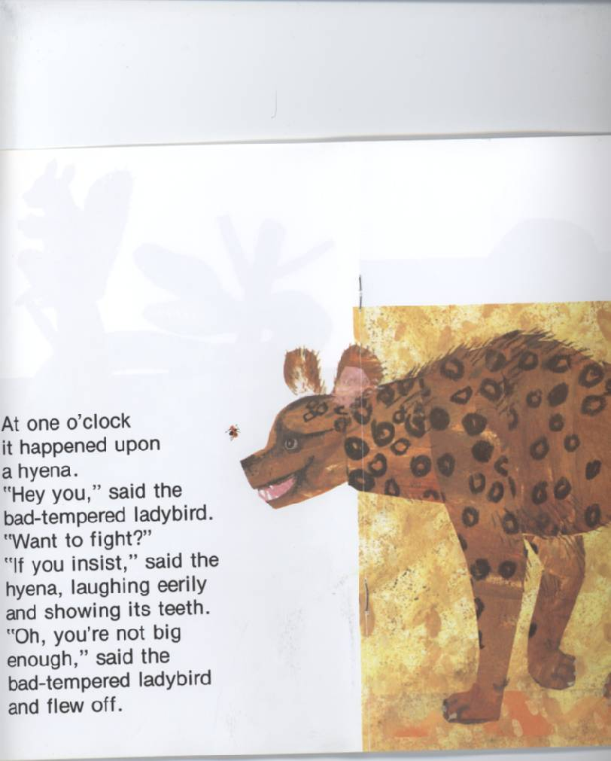

Slide 17
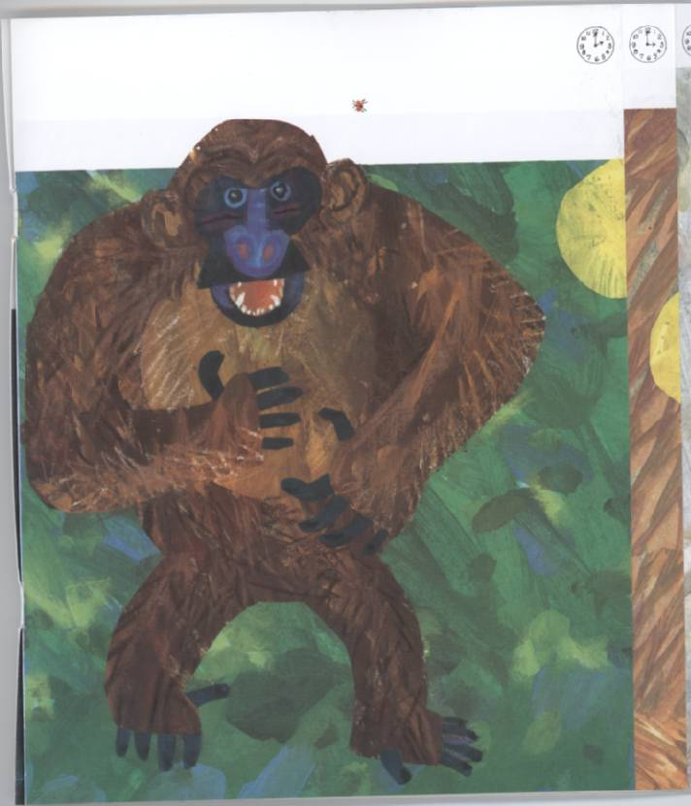
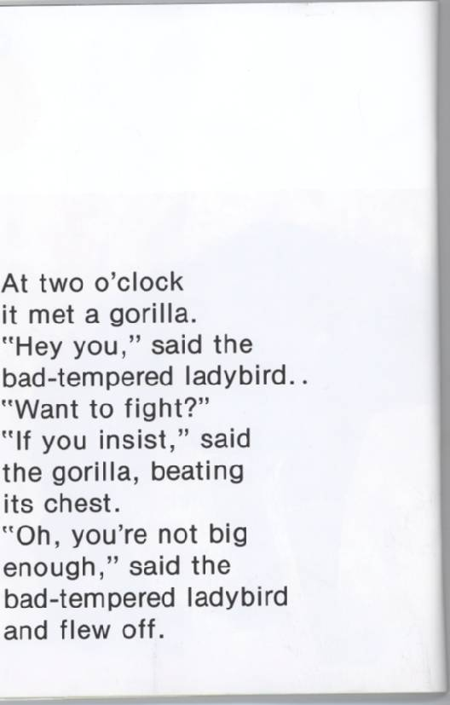

Slide 18
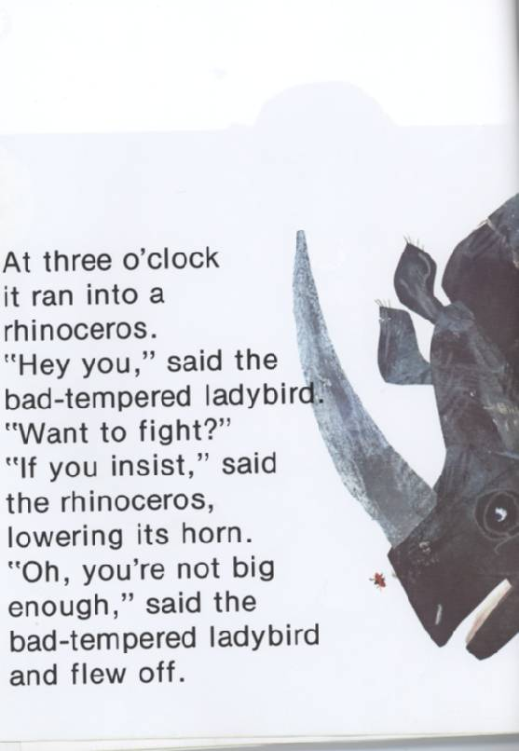

Slide 19
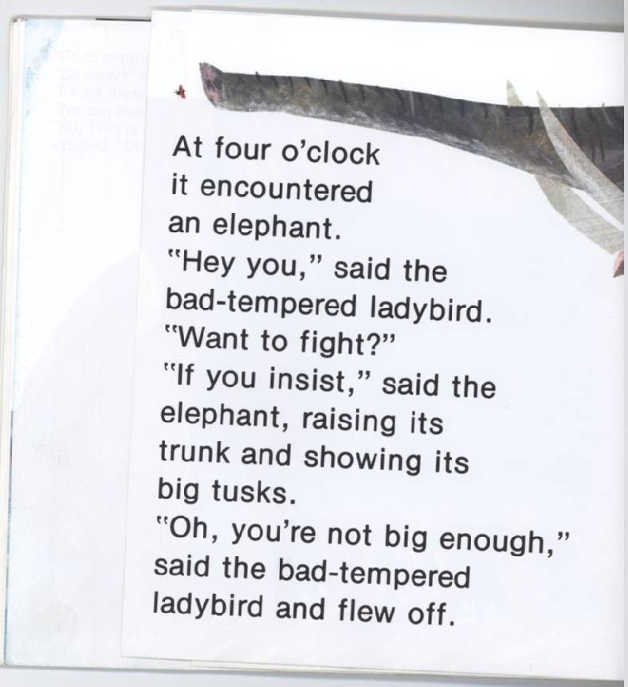
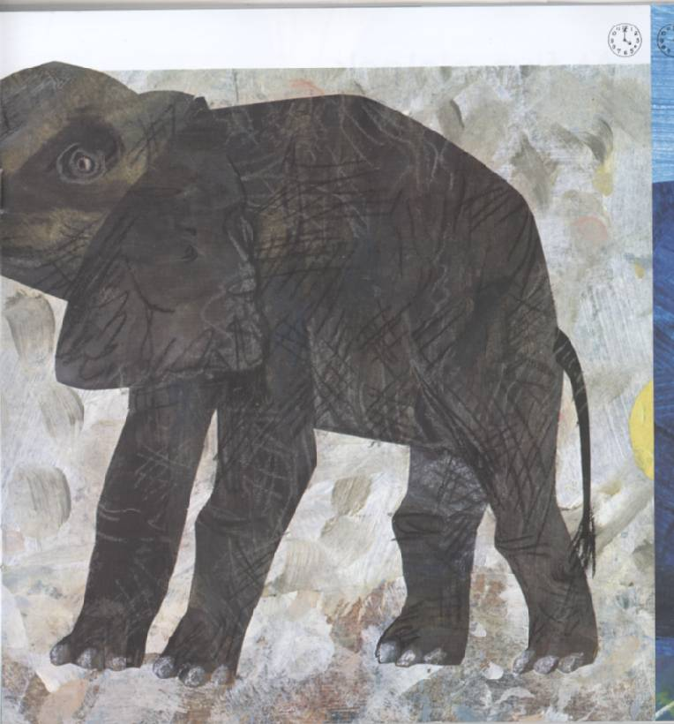

Slide 20
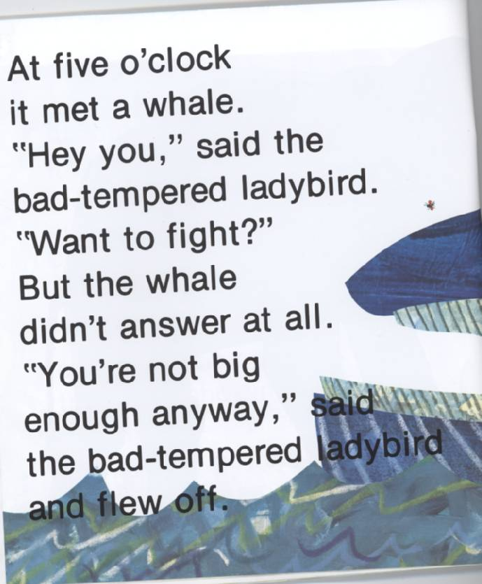
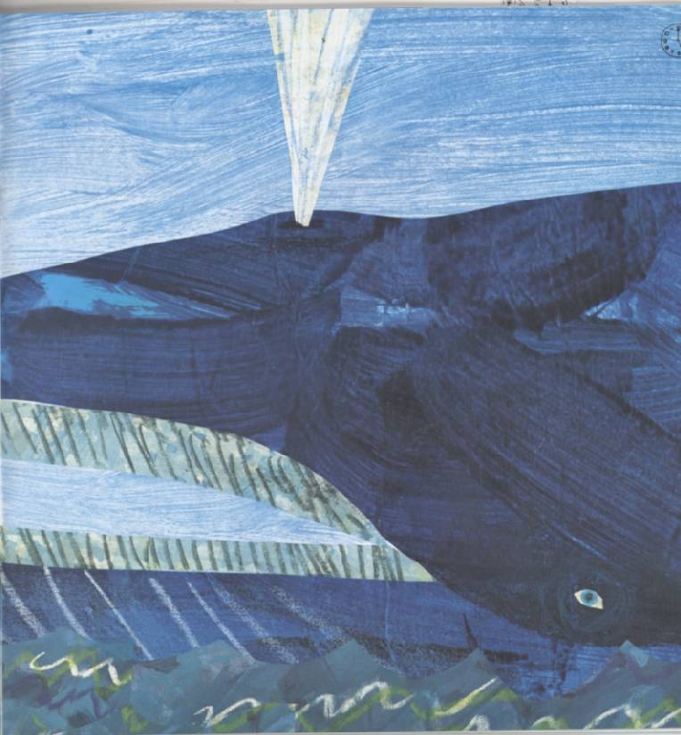

Slide 21
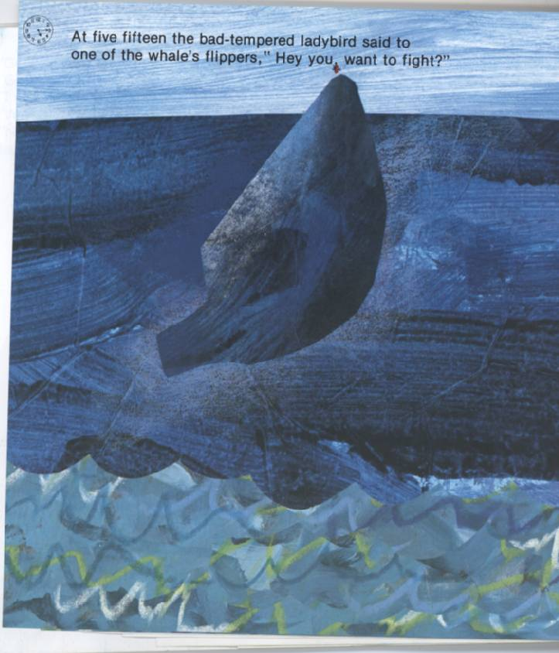

Slide 22


Slide 23
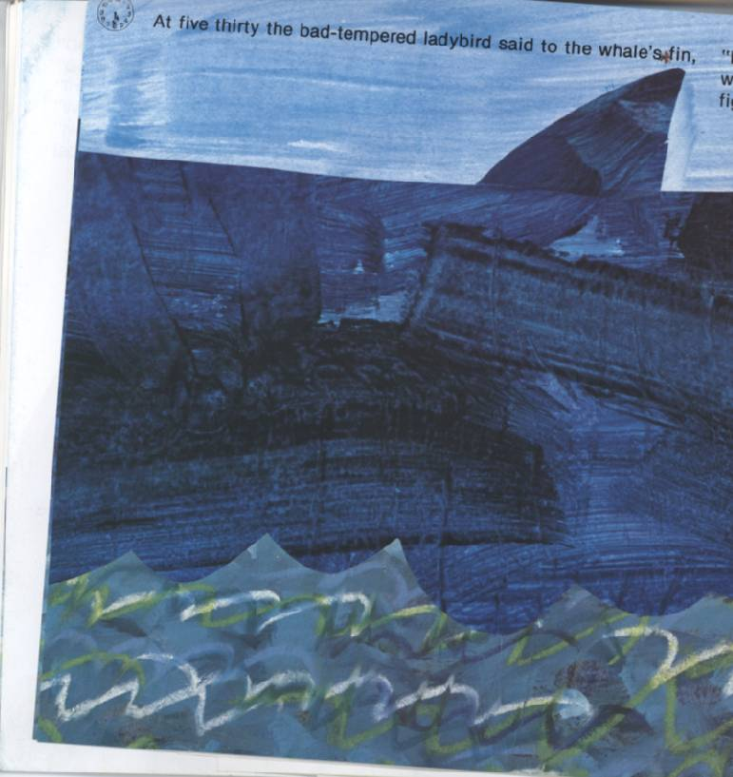

Slide 24
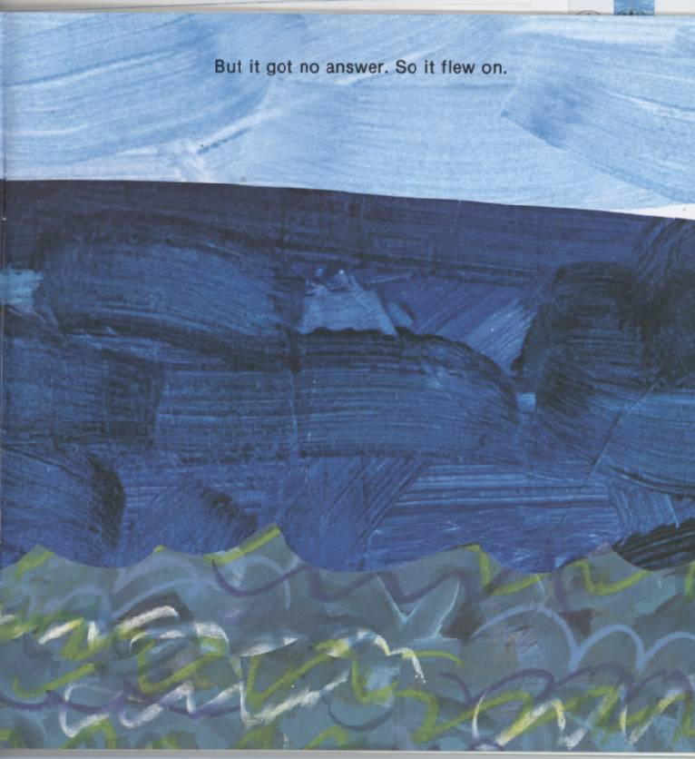

Slide 25
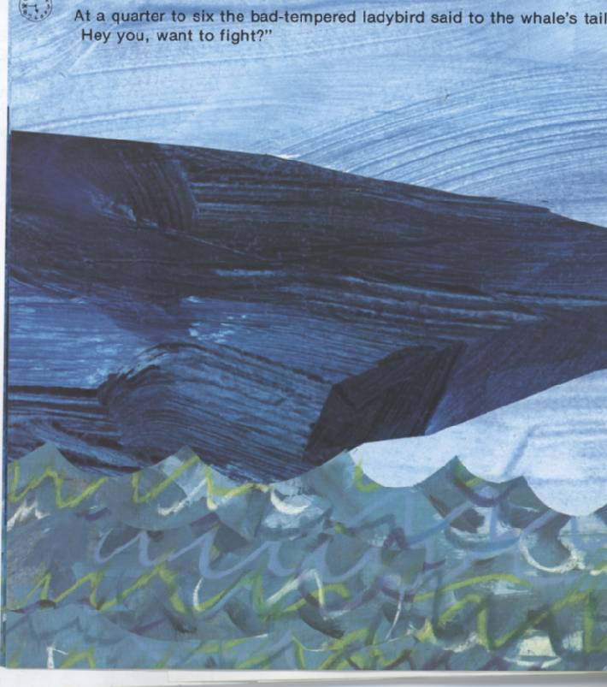

Slide 26
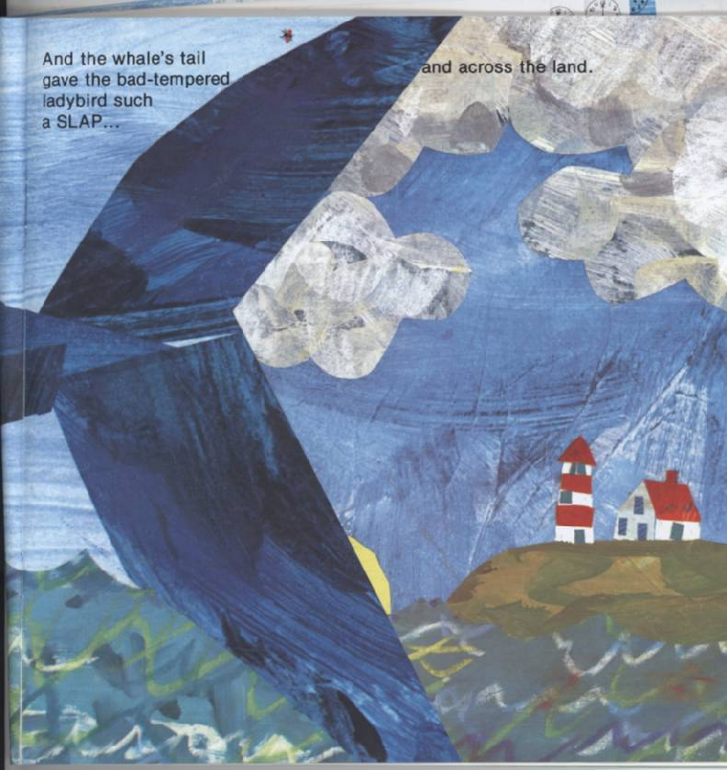
That it flew across the sea and across the land.

Slide 27
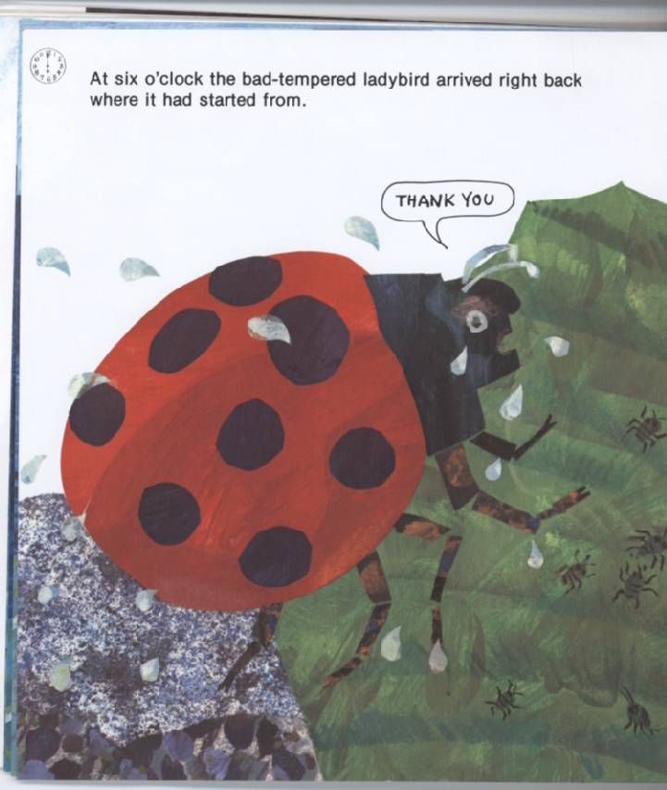

Slide 28
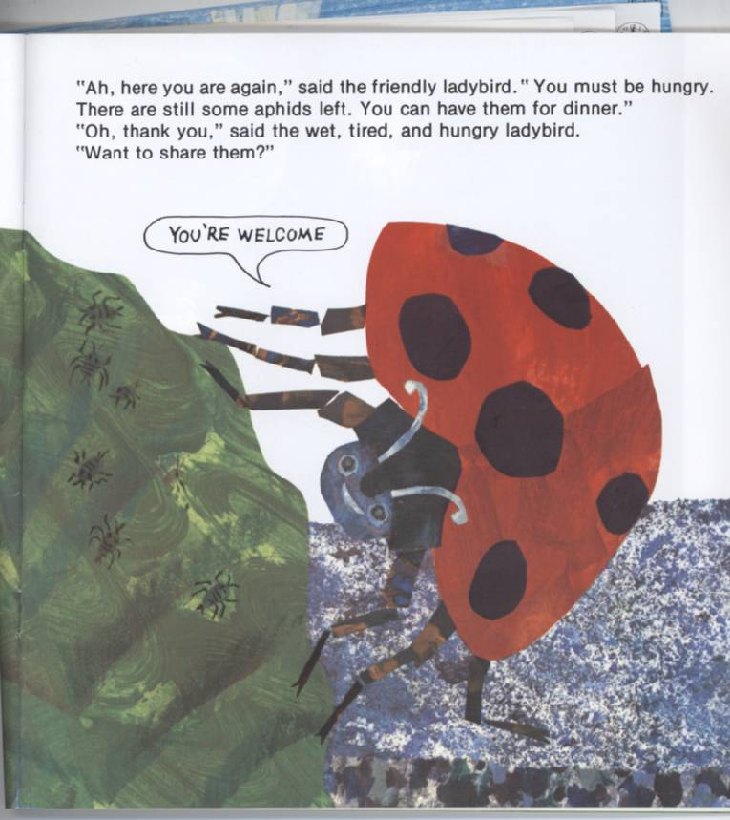

Slide 29
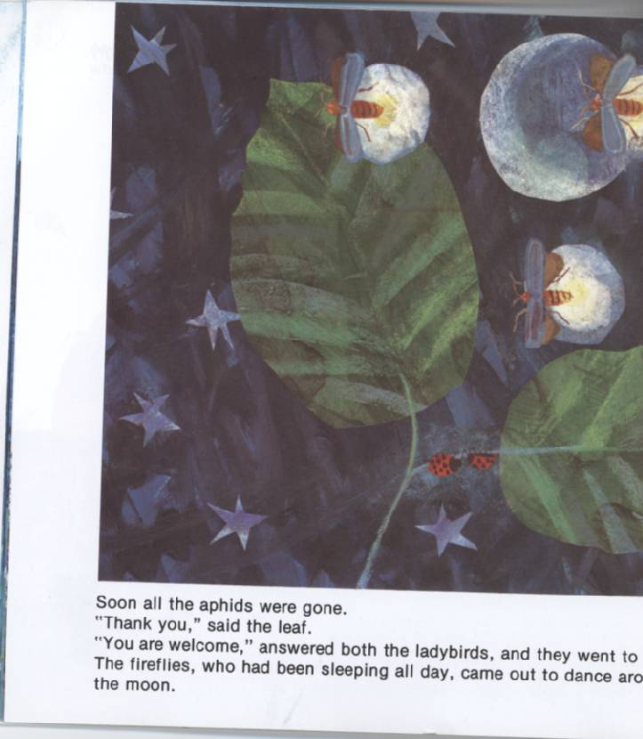
Soon all the aphids were gone.
“Thank you” said the leaf.
“You are welcome,” answered both the ladybirds and they went to sleep.
The fireflies who had been sleeping all day, came out to dance around the moon.

Slide 30
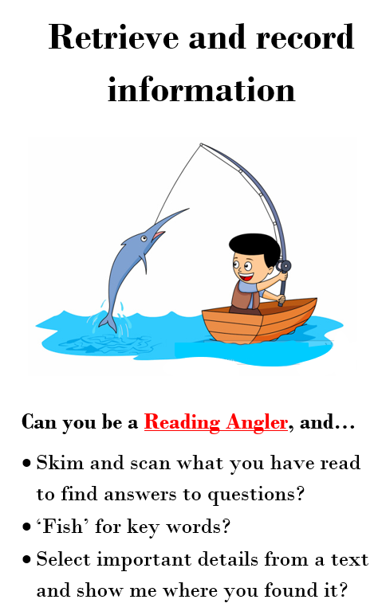
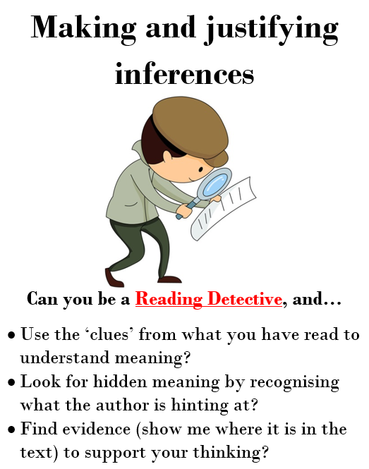
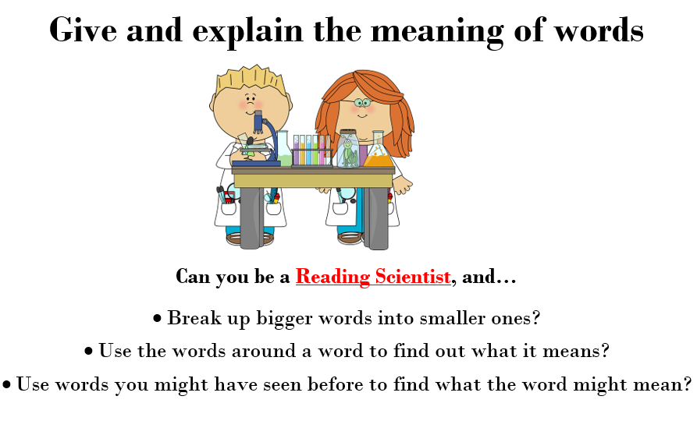
Today we will be using some of the reading characters that we have already learnt about.
Sue and Sally
Derek
Reggie

Slide 31
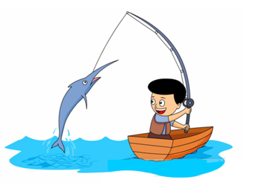
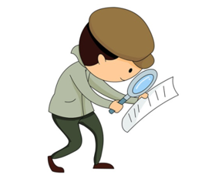
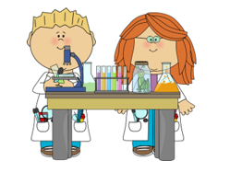
Answer these questions in your green book. Remember to write in full sentences and to explain if it asks you too.
Why does the Bad-tempered ladybird want to fight the Friendly one?
Why do you think the Bad-tempered ladybird doesn’t really want to fight the stag beetle?
Which animal is your favourite that the ladybird comes across? Explain why.
How do we know that Bad-tempered ladybird is confused by the whale?
Why is the word SLAP in capital letters on slide 26?
What has the Bad-tempered ladybird learnt in the story?

