Slide 1
Year 2– Multiplication and division
Session 5 – The 10 times table.

Slide 2
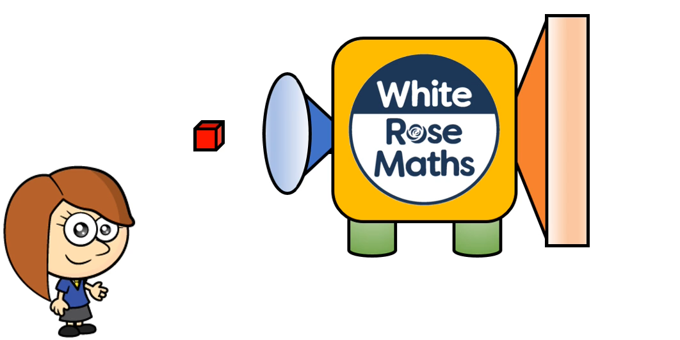
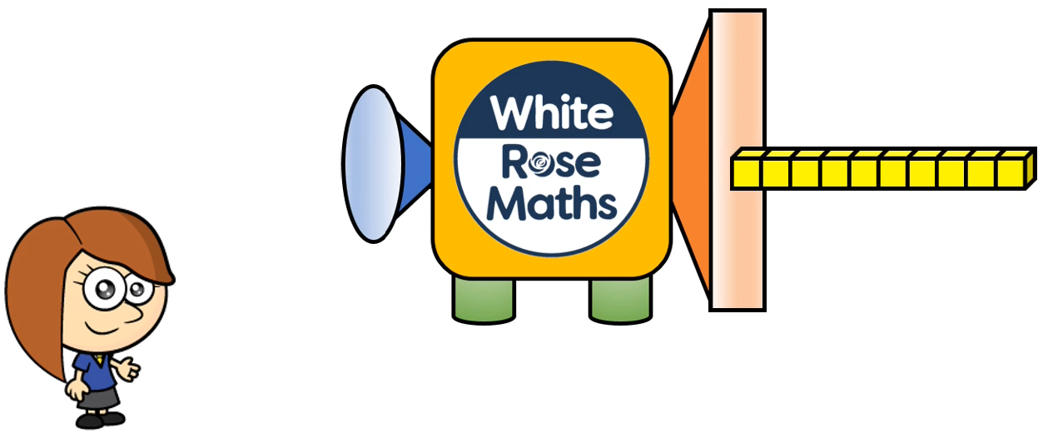
Rosie is playing with a new maths machine.
She puts in one. What comes out the other end? What has happened?

Slide 3
Rosie’s one has turned into a ten.
It has got ten times bigger.

Slide 4
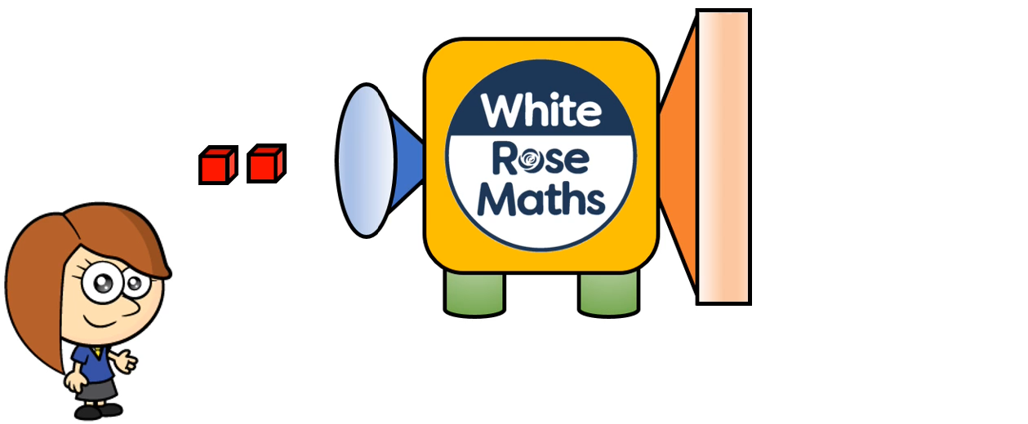
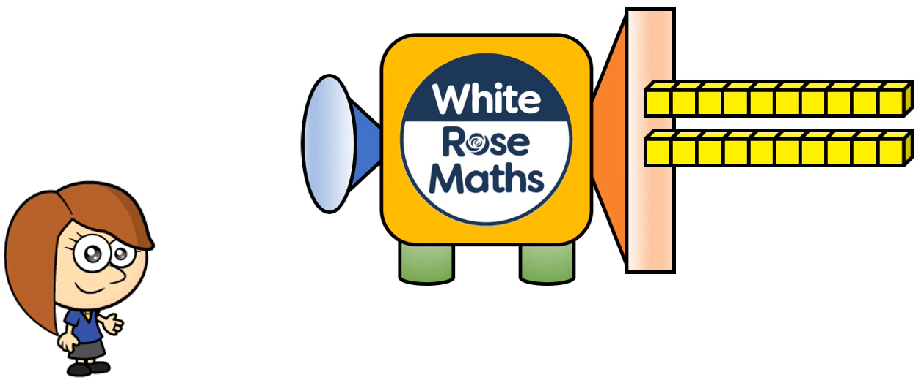
Let’s see what happens this time.
Rosie puts in two ones.
So what is ten times bigger than two ones?
Two tens!
Two tens is 20.

Slide 5
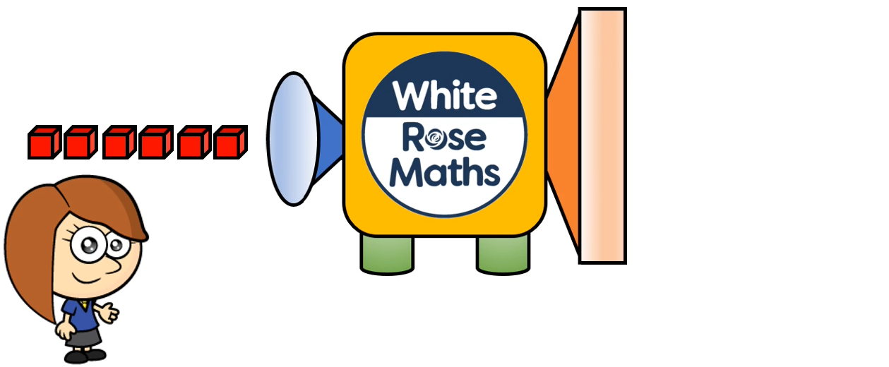
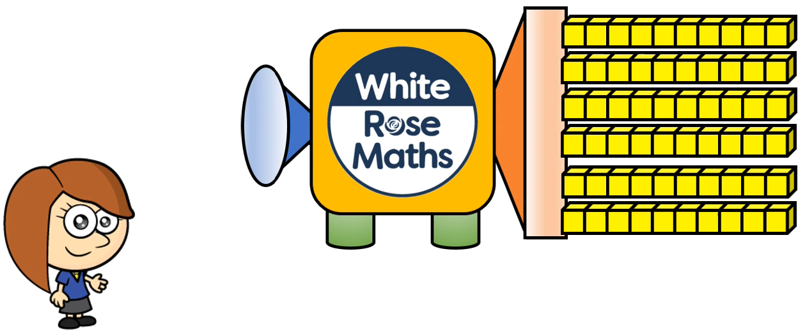
What will happen this time?
Work out how many will come out of the machine before you click.
Did you say 6 tens is ten times bigger than 6 ones?
6 tens is 60.

Slide 6
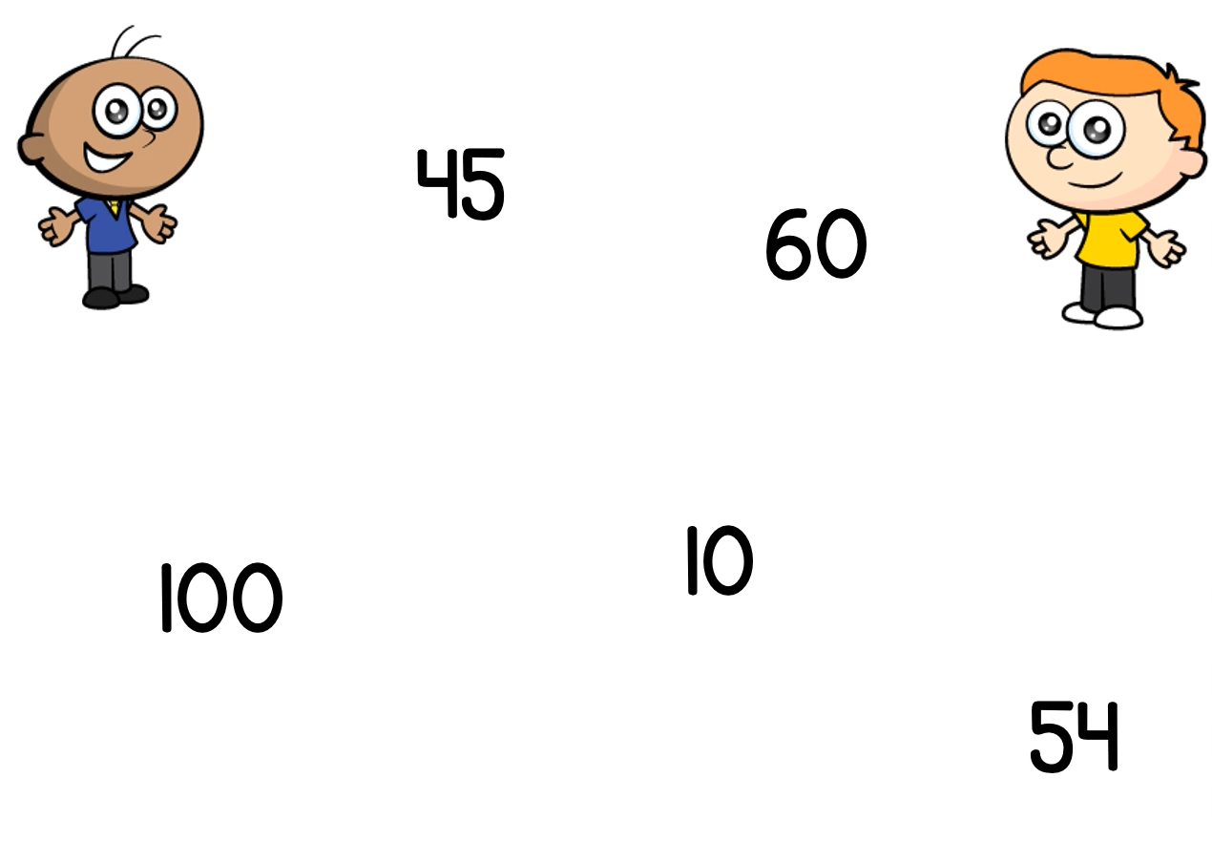
Tommy and Ron are trying to decide which of these numbers are in the ten times table.
Tommy says 45 is in the ten times table because it has 4 tens. Ron is not so sure. What do you think?

Slide 7
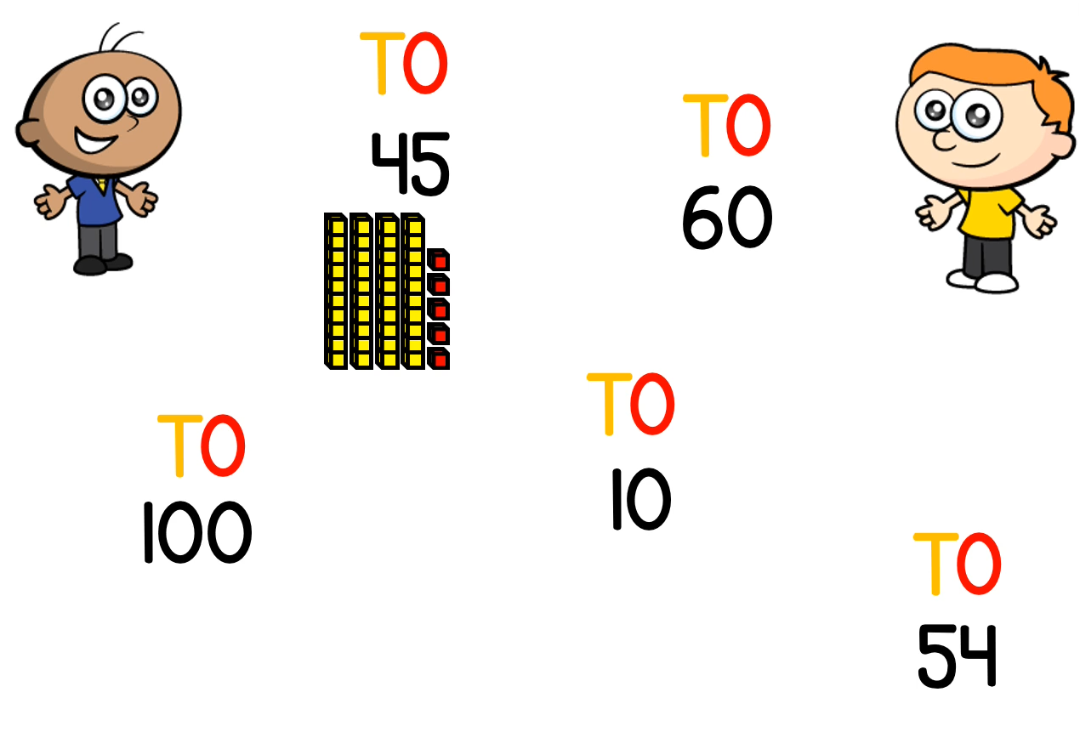
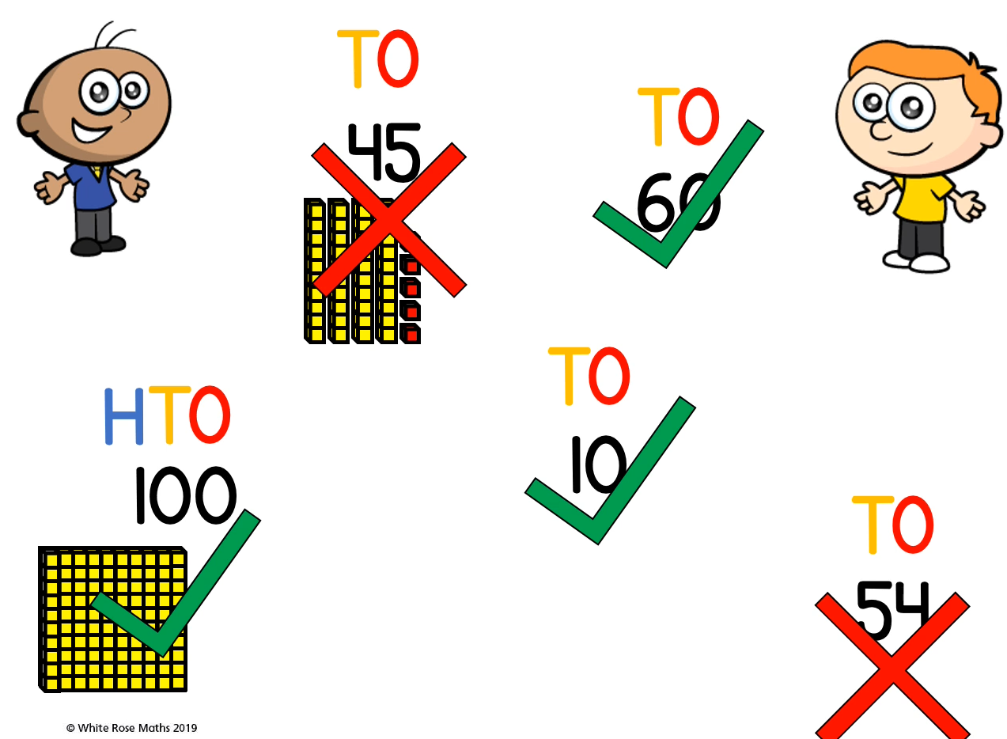
Let’s take a look..
60 however, has got 6 tens and no ones.
We need to think about tens and ones.
Tommy is right 45 does have 4 tens but it also has 5 ones.
So it is in the ten times table.
Numbers in the ten times table don’t have any ones.
Can you work out if the other 3 numbers are in the ten times table?
So 45 isn’t in the ten times table.

Slide 8
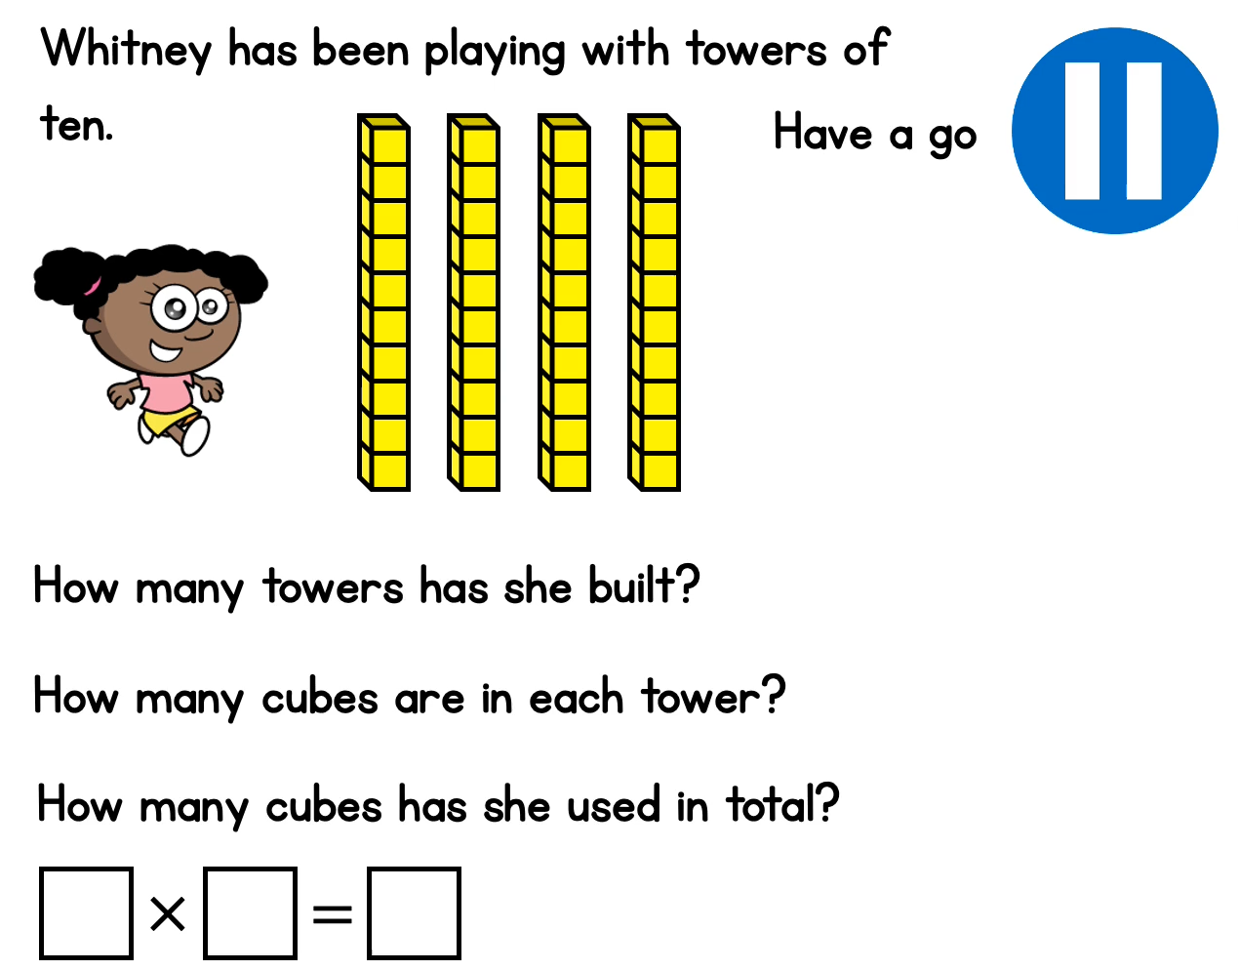
Can you fill in the missing details for Whitney’s towers?

Slide 9
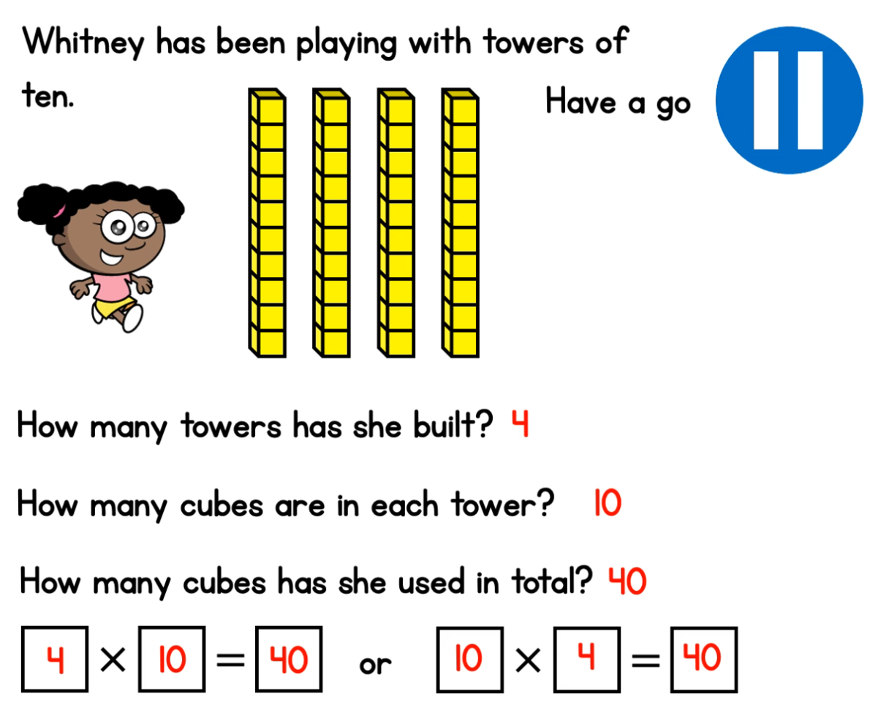

Slide 10
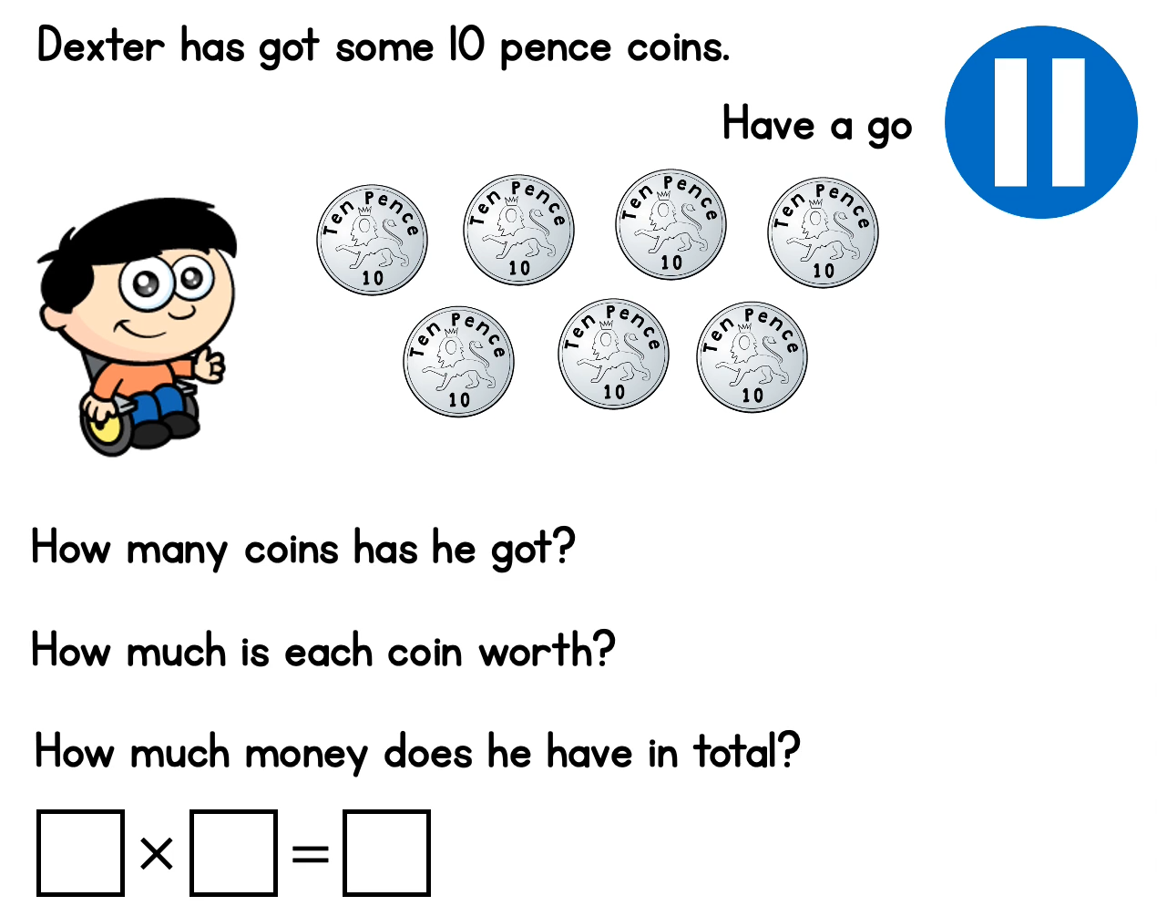
Can you fill in the missing details for Dexter’s money?

Slide 11
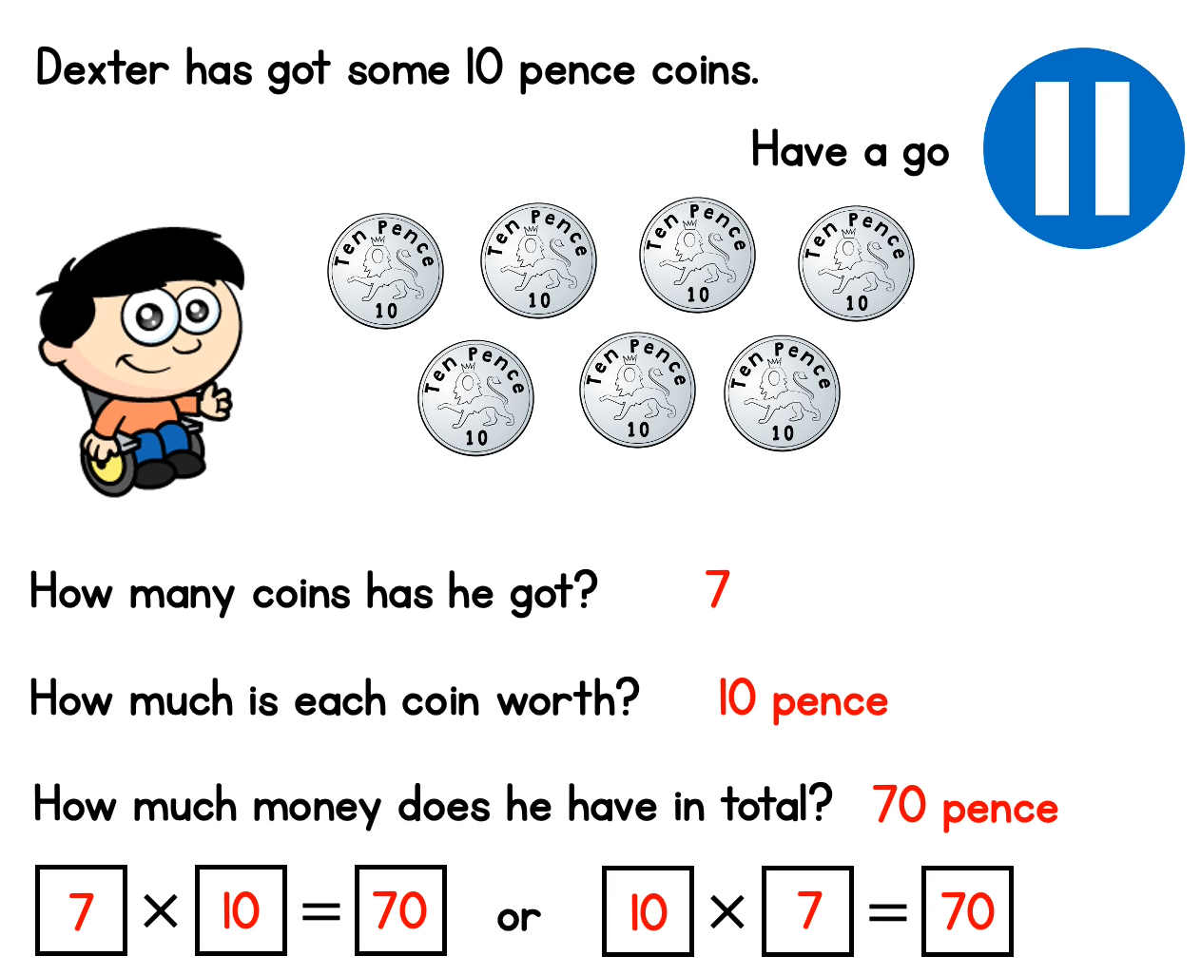

Slide 12
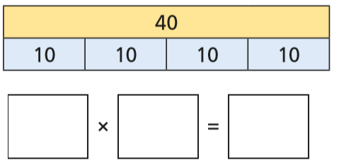
This bar model had been used to represent a times table question.
We can see that the whole number created (the answer) is 40.
We can see that there are 4 equal parts.
4
10
40
We can see that each part is worth 10.
We have 4 lots of 10 which is equal to 40

Slide 13
We’re getting good at our 10 times table now!
Let’s see if we can use counting in twos to answer these questions speedily.
3 x 10=
30

Slide 14
1 x 10 =
10
4 x 10 =
40
7 x 10 =
70
9 x 10 =
90

