Slide 1
Year 2 - Time
Session 4 – Sequencing times

Slide 2
Today we are learning to sequence times of the day

Slide 3
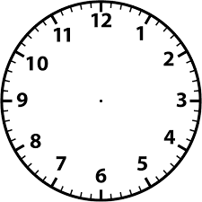
My daily routine
What is the time?

Slide 4
My daily routine
What is the time?

Slide 5
My daily routine
What is the time?

Slide 6
My daily routine
What is the time?

Slide 7
My daily routine
What is the time?

