Slide 1

Non-chronological reports
Yesterday, we planned our
Own Non-chronological reports.

Slide 2
Can you remember some of the features that we explored yesterday?
Non-Chronological reports have..
A clear title
An introduction
Subheadings
Pictures and captions
Fact boxes
They are…
Factual.
Usually written in the present tense (have, are)
Written in the third person (They, it, he, she)
If you are writing about something historical or a famous person who isn’t alive any more. Then you can use the past tense.
The Romans were..
Florence Nightingale was…

Slide 3

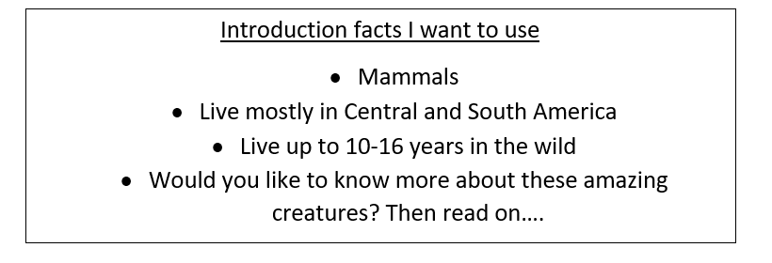
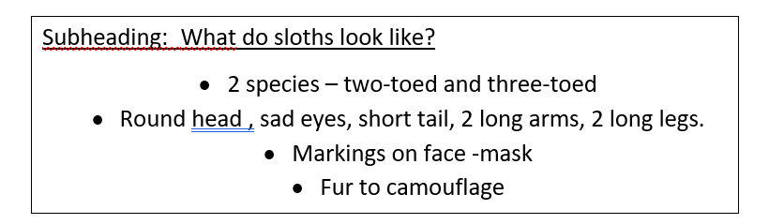
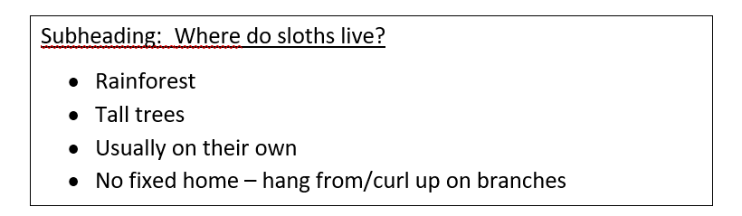
Take some time now to look at your plan from yesterday.
Check your notes.
Can you remember what you meant?
Have you got enough information for each subheading?

Slide 4

Now it is time to write!
A little reminder/help.. I don’t mind if you write your report on paper or if you type it up using a tablet or a laptop. This is up to you.. I want you to enjoy
your writing session as much as possible.
Put your expert hat on! From here on in, you are the expert on your chosen
subject. You are creating an Non-chronological report to teach others.

Slide 5
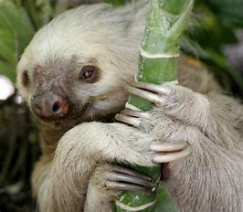
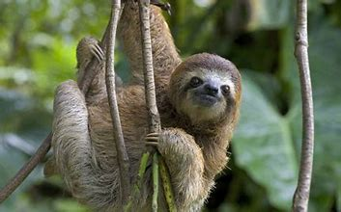
Here is the start of my report. I am going to use my plan and I am going to turn my notes into full sentences.
The wonderful world of sloths
Sloths are small mammals that live mostly in Central and South America. Sloths are amazing creatures that live between 10 and 16 years in the wild. Would you like to know more about these amazing creatures? Then read on…
What do Sloths look like?
There are two types of sloth. There are two-toed sloths and three-toed sloths. You can tell which type a sloth is by counting their toes. Both types of sloths look very similar. They have round heads, sad eyes and a short tail. They also have 2 long arms and 2 long legs which they use to climb and hang. Sloths have markings on their faces that make them look like they are wearing an eye mask. Sloths brown and grey fur helps them to camouflage in their environment.
A two-toed sloth A three-toed sloth
Examples of present tense.
Examples of third person.
Pictures and captions

Slide 6
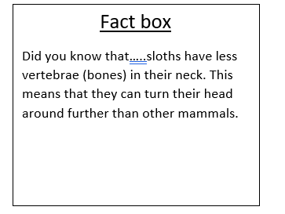
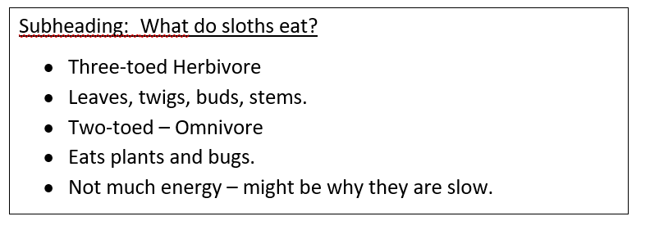
Here is the start of my report. I am going to use my plan and I am going to turn my notes into full sentences.
Where do sloths live?
Sloths live in the rainforest of Central and South America. They spend nearly all of their time in the tall trees as their long limbs and long claws make it difficult to walk. Sloths have to crawl across the ground.
Sloths usually live on their own unless they are looking after a baby sloth. They do not have a fixed home or a nest but hang from or curl up on branches for a rest.
What do sloths eat?
Three-toed sloths are herbivores. This means
they only eat plants. They like to eat leaves,
twigs, buds and plant stems.
The Two-toed sloth is an omnivore. This means
they eat plants and meat. They like to eat leaves and twigs but they also eat small bugs.
Leaves and twigs do not contain much energy. People think this might be why sloths are so slow.
Examples of present tense.
Examples of third person.

Slide 7
Your turn! I know you will do a great job.
Just remember to turn your notes into longer, full sentences with capital letters and full stops. Don’t just copy your notes .
When you’ve finished, check back over your work to spot any spelling errors or missing full stops.
I’d love to see your work!
You could take a picture and email it to me… You could even video yourself reading your report like you are on television!

