Slide 1
Thursday 30th April 2020
English – Longer writing.
Notes:
© Copyright Showeet.com – Free PowerPoint Templates. Photo credits: Pixabay (CC0 Public DomainFree for commercial use No attribution required)

Slide 2
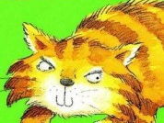
Today, we are going to use the skills that we have been practicing this week in some creative writing.
Diary Of A Killer Cat is written from the Tuffy’s point of view.
This is called Tuffy’s perspective.
We hear his thoughts and we only see events through his eyes.
Notes:
© Copyright Showeet.com – Free PowerPoint Templates

Slide 3
In Today’s extract, the family have taken Tuffy to the vet. Oh Dear!
Choose 1 of the following 3 sections to read and focus on today.

Slide 4
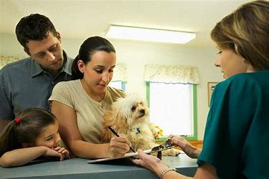
I was still quite suspicious when we reached the vet’s. That is the only reason why I spat at the girl behind the desk. There was no reason on earth to write HANDLE WITH CARE at the top of my case notes. Even the Thompson’s Rottweiler doesn’t have HANDLE WITH CARE written on the top of his case notes. What’s wrong with me?
I wonder what the receptionist might have to say about that? Why did
She write HANDLE WITH CARE on Tuffy’s notes?

Slide 5
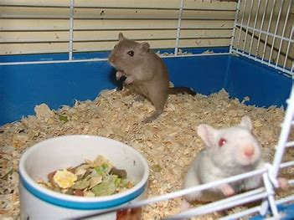
So I was a little rude in the waiting room. So what? I hate waiting. And I especially hate waiting stuffed in a wire cat cage. It’s cramped. It’s hot. And it’s boring. After a few hundred minutes of sitting there quietly, anyone would start teasing their neighbours. I didn’t mean to frighten that little sick baby gerbil half to death. I was only looking at it. It’s a free country, isn’t it? Can’t a cat even look at a sweet little baby gerbil? And if I was licking my lips (which I wasn’t) that’s only because I was thirsty. Honestly. I wasn’t trying to pretend I was going to eat it. The trouble with baby gerbils is they can’t take a joke.
I wonder what gerbils were thinking when Tuffy was watching them and.. was he licking his lips?

Slide 6
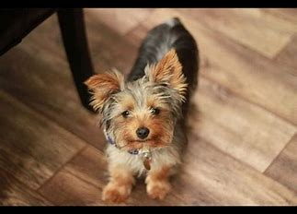
“Turn the cage round the other way, Ellie,” he said. Ellie turned my cage round the other way. Now I was looking at the Fisher’s terrier. (And if there’s any animal in the world who ought to have HANDLE WITH CARE written at the top, it’s the Fisher’s terrier).
Okay, so I hissed at him. You practically had to have bionic ears to hear it. And I did growl a bit. But you’d think he’d have a head start on growling. He’s a dog, after all. I’m only a cat. And yes, okay, I spat a bit. But only a bit. Nothing you’d even notice unless you were waiting to pick on someone. Well how was I to know he wasn’t feeling very well?
Even if I was ill, something furry locked in a cage could make an eensy-weensy noise at me without my ending up whimpering and cowering, and scrabbling to get under the seat, to hide behind the knees of my owner. More a chicken than a Scotch terrier, if you want my opinion.
I wonder what the terrier was thinking when Tuffy was hissing and growling at him!

Slide 7
Now that you have chosen your section, you are going to write about the event in the vets from the other character’s point of view. 1) The receptionist 2) The baby gerbil 3) The terrier Think about what that person or animal would sound like. What would they say happened? Try to use a range of sentence types to keep the reader interested.

Slide 8
The original My Example..
“Turn the cage round the other way, Ellie,” he said. Ellie turned my cage round the other way. Now I was looking at the Fisher’s terrier. (And if there’s any animal in the world who ought to have HANDLE WITH CARE written at the top, it’s the Fisher’s terrier).
Okay, so I hissed at him. You practically had to have bionic ears to hear it. And I did growl a bit. But you’d think he’d have a head start on growling. He’s a dog, after all. I’m only a cat. And yes, okay, I spat a bit. But only a bit. Nothing you’d even notice unless you were waiting to pick on someone. Well how was I to know he wasn’t feeling very well?
Even if I was ill, something furry locked in a cage could make an eensy-weensy noise at me without my ending up whimpering and cowering, and scrabbling to get under the seat, to hide behind the knees of my owner. More a chicken than a Scotch terrier, if you want my opinion.
I hadn’t been feeling well and had an enormous headache so my human took me to the vet. I was sitting quietly, minding my own business in the waiting room when the little girl turned the box around.
In it, was the biggest, hairiest, most disgusting cat
I’ve ever seen! It eye balled me from the other
side of the wire door and began to hiss! What a horrible sound it made!
Then it growled at me! A cat! Growled at me! If I
wasn’t feeling so bad I would have barked my head off!
Why was it being so mean? I hadn’t done anything! I ran to my owner, Mrs Fisher. She glared at that cat and said “Stop that now! Vile kitty!” What a good owner Mrs Fisher is!

Slide 9
Your turn…
I would like you to pretend to be Tuffy telling the reader about another of your ‘naughty’ moments (that you think is perfectly natural – You’re a cat!).
Perhaps you catch another bird, or a mouse?
Maybe you get dirt all over Mum’s clean washing?
In your short section of writing I would like you make sure that you use:
At least 1 statement.
At least 1 question.
At least 1 command.
At least 1 exclamation.

Slide 10
When you’ve finished..
Practise reading your writing out loud in your best Tuffy voice. Do you sound like Tuffy? A cat with attitude?
Can you find where you used each sentence type?

