Slide 1
Year 2 - Time
Finding end times

Slide 2
Today we are learning to find end times

Slide 3
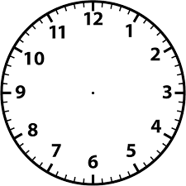
Lets find the end time
I left my house at 9 o’clock. It takes me 1 hour minutes to get to work.
What time did I get to work?
9 o’clock + 1 hour =10 o’clock
I get to work at 10 o’clock

Slide 4
Lets find the end time
A film starts at 11 o’clock. It is in for 2 hours.
What time does the film finish?
11 o’clock + 2 hours =1 o’clock
The film finishes at 1 o’clock

Slide 5
Lets find the end time
I go on a walk at 5 o’clock. The walk lasts 1 hour.
What time do I get back?
5 o’clock + 1 hour =6 o’clock
My walk finishes at 6 o’clock.

Slide 6
Lets find the end time
I leave the house at 3 o’clock. I get to the gym half an hour later.
What time do I get to the shop?
3 o’clock + half an hour =half past 3.
I get to the gym at half past 3.

Slide 7
Lets find the end time
I leave the house at 9 o’clock. I get to work half an hour later.
What time do I get to work?
9 o’clock + half an hour =half past 9.
I get to work at half past 9.

Slide 8
Lets find the end time
I leave the house at 6 o’clock. I get to work 15 minutes later.
What time do I get to work?
9 o’clock + 15 minutes = 9.15.
I get to work at quarter past 9.

Slide 9
Lets find the end time
My favourite TV programme starts at 9 o’clock.
It lasts quarter of an hour.
What time does it finish?
2 o’clock + 15 minutes = 2.15.
It finishes at quarter past 2

