Slide 1
^{Tuesday 2nd June 2020}
English - Spelling
Notes:
© Copyright Showeet.com – Free PowerPoint Templates. Photo credits: Pixabay (CC0 Public DomainFree for commercial use No attribution required)

Slide 2
This week we are going to be studying Non-Chronological reports.
Today, we are going to read a Non-Chronological report and answer questions about it.

Slide 3
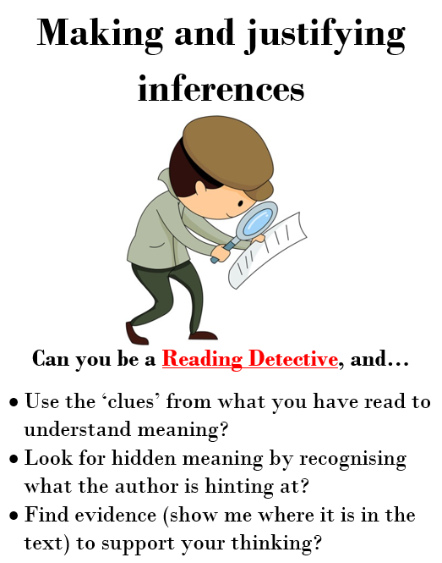
Today we will be using some of the reading characters that we have already learnt about.
Sue and Sally
Derek
Reggie

Slide 4
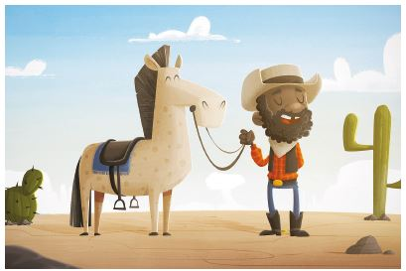
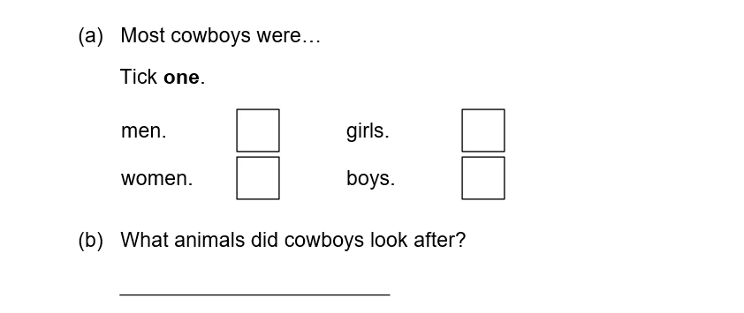
Let’s try one together….
What is A Cowboy?
A long time ago, there were lots of cowboys in North American.
Some were young and some were old; most were men and very few women. They rode horses and looked after cows.
Read the text.
Read the question carefully.
Go back and hunt for key words and clues in the text.
I’m going to look for a sentence about cowboys with were in it.
✓
I’m going to look for the words looked after.
They looked after cows.

Slide 5
Now use these skills to find the answers to the questions in the report about cowboys.

