Slide 1
Year 2– Measures
Session 7 – Reading scales to tell the temperature

Slide 2
Temperature
Temperature tell us how hot or cold something is.
We use a thermometer to measure temperature.
Temperature is measured in degrees. In the U.K, we mainly use Degrees Celsius C

Slide 3
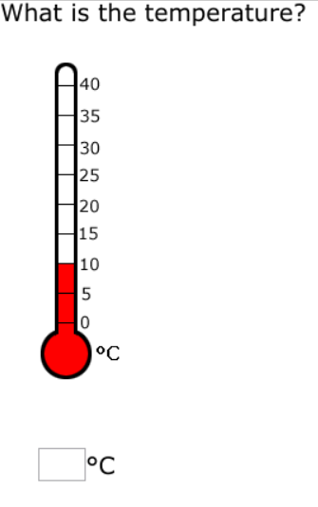
We can apply our scale reading skills to read
temperature.
Let’s look carefully at the level of the liquid in the thermometer.
The liquid is level with 10
The temperature is 10

Slide 4
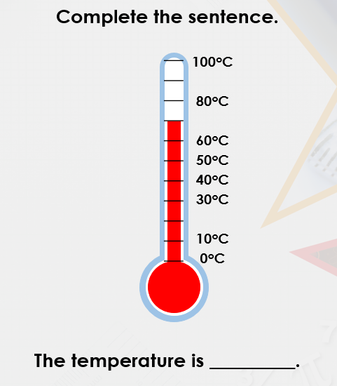
Look carefully at the scale. This scale counts in 10s.
We can see that the liquid is above 60
We need to add 10 as the liquid is 1 scale line above 60.
60 + 10 = 70
The temperature is 70

Slide 5
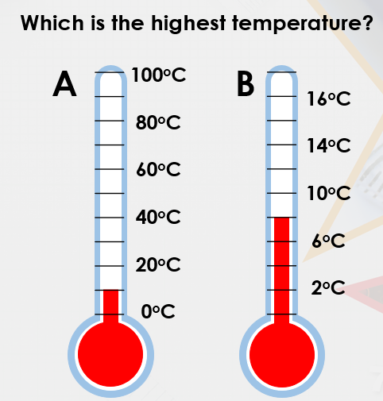
When we read scales the first things we need to do is to check what the scale is jumping in.
This scale jumps in 10
This scale jumps in 2
This thermometer shows 10
This thermometer shows 8
Thermometer A has the highest temperature even though the liquid looks higher in B.

Slide 6
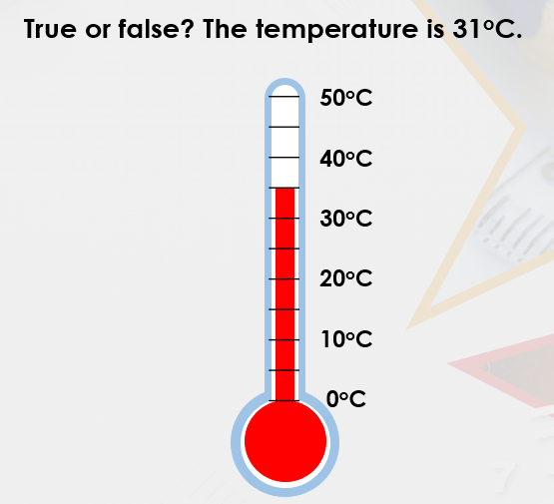
Remember – check what the scale is jumping in.
The scale is jumping in 5s
30 + 5 = 35
False, the temperature is 35

