Slide 1

Non-chronological reports
Can you remember what
a non-chronological
report is?

Slide 2

Non-Chronological reports
Aim to give us information on a topic.
Written to give other people information.
Useful for studying things we don’t know a lot about.
Non-chronological reports can be read in any order.
Written in paragraphs.
Contain an introduction and many small sections of information.
Reports contain specific features.

Slide 3

Over the next two days, we are going to plan and write our own Non-Chronological reports.
You have the freedom to plan a report about anything you want to teach others about.
You might choose:
Your favourite animal
Your favourite computer game
Space and the planets
A famous historical event
A famous person
The list is endless.. But remember, you have to know facts about the topic or be able to do some research. You are the author and the author must be an expert!

Slide 4

So what do we need in our report?
A clear title
Your title needs to tell the reader exactly what your report is about. They can be plain and simple or you can add adjectives to draw the reader in.
Here are some examples:
The wonderful world of Sloths
Dolphins
Fantastic Florence Nightingale
Revolting Romans
Magical Minecraft
The Great Fire of London
Space
Decide what your report is going to be about and plan your title now. Write it down at the top of your planning page
I wonder……Can you guess my title Year Two?

Slide 5
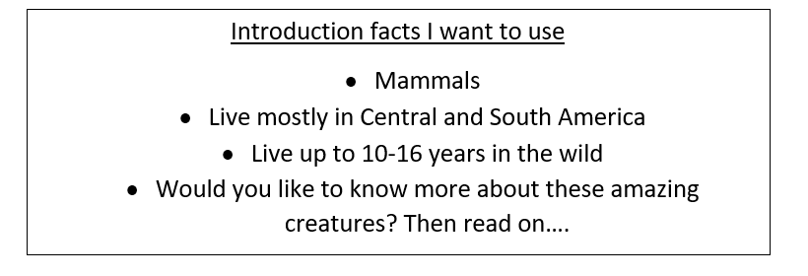
So what do we need in our report?
An introduction paragraph
This tells the reader what your report is about. This is general information. You are going to give them more detail in your sections. It’s a good idea to include a question to engage the reader too!
Think of a couple of things you want to tell your reader in the introduction and make notes on your plan. Today we are planning. You don’t need to write full sentences, just notes to remind you.
Here is mine to give you an idea…

Slide 6
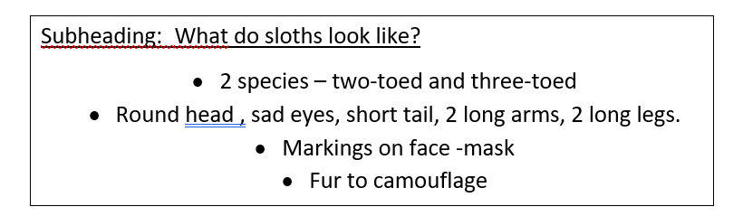
So what do we need in our report?
Subheadings
These are mini titles that tell you what a small section of writing is going to be about. They can be questions or simple statements.
What do sloths look like? or Appearance
Plan your first section… What is your subheading?
What are you going to tell people in this section? Make notes like you did for your introduction. If you need to do some research to get extra facts, now is a good time to build this in.
You could research using books you have at home, using the internet or even watching video clips like animal documentaries. Check with an adult before you watch any videos online please.

Slide 7
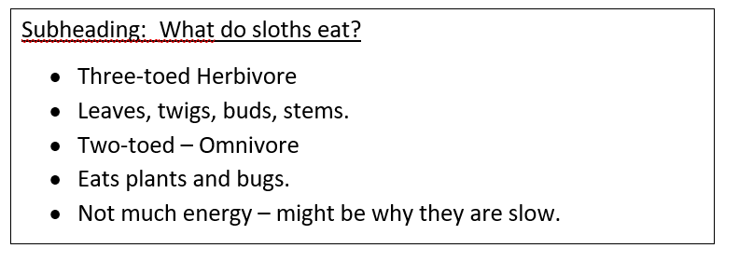
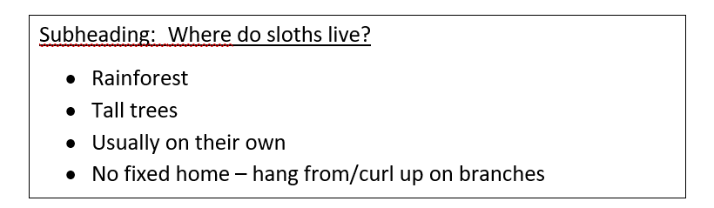
So what do we need in our report?
Subheadings
Now plan another 2 sections for your report in the same way.
Remember: What is your subheading?
What do you want to tell the reader in that section.
Research if you need to.
You could research using books you have at home, using the internet or even watching video clips like animal documentaries. Check with an adult before you watch any videos online please.

Slide 8
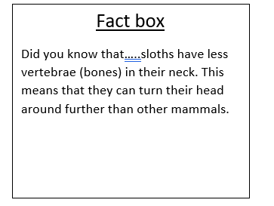
So what do we need in our report?
Fact boxes
These are a great way to draw your reader in by giving them extra, really interesting facts that might not always fit into your subheadings.
Plan yourself at least 1 fact box to surprise your reader.

Slide 9
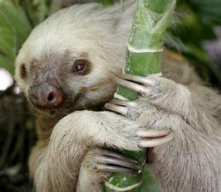
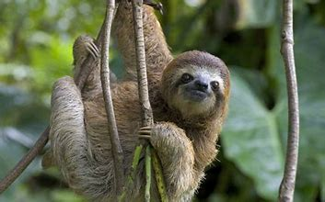
So what do we need in our report?
Pictures and captions
Pictures help the reader see what you are talking about.
Captions are a short sentence to say what is happening in the picture.
What pictures and captions will you include? Plan at least 1.
You could use pictures from the internet in your report or you could draw your own!
A two-toed sloth A three-toed sloth

Slide 10
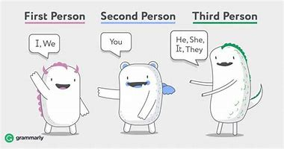
Other things to know…
If you are writing about something historical or a famous person who isn’t alive any more. Then you can use the past tense.
The Romans were..
Florence Nightingale was…
Non- Chronological reports are usually written in the present tense. We write as if things are happening now.
Sloths are… Sloths have…. They are….. You can…..
Non-Chronological reports are usually written in the third person.
We use words like…. He She They It

Slide 11
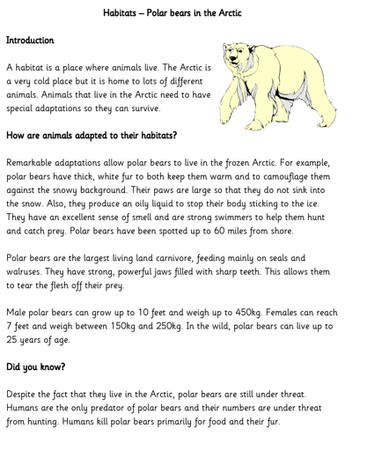
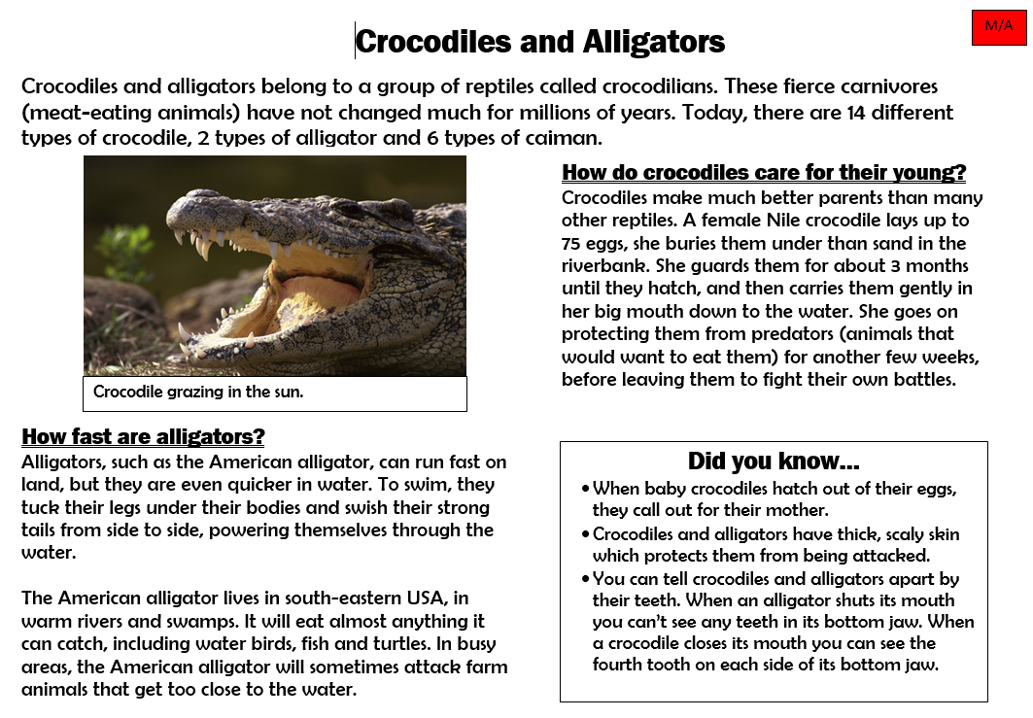
Great Job! You have planned a report all about a topic of your choice.
Tomorrow, we are going to put all of this together to create a report that uses all the features that we have learnt about today. It might look something like these! Can you spot the features we have talked about today?

