Slide 1
Thursday 11th June 2020
Notes:
© Copyright Showeet.com – Free PowerPoint Templates. Photo credits: Pixabay (CC0 Public DomainFree for commercial use No attribution required)

Slide 2
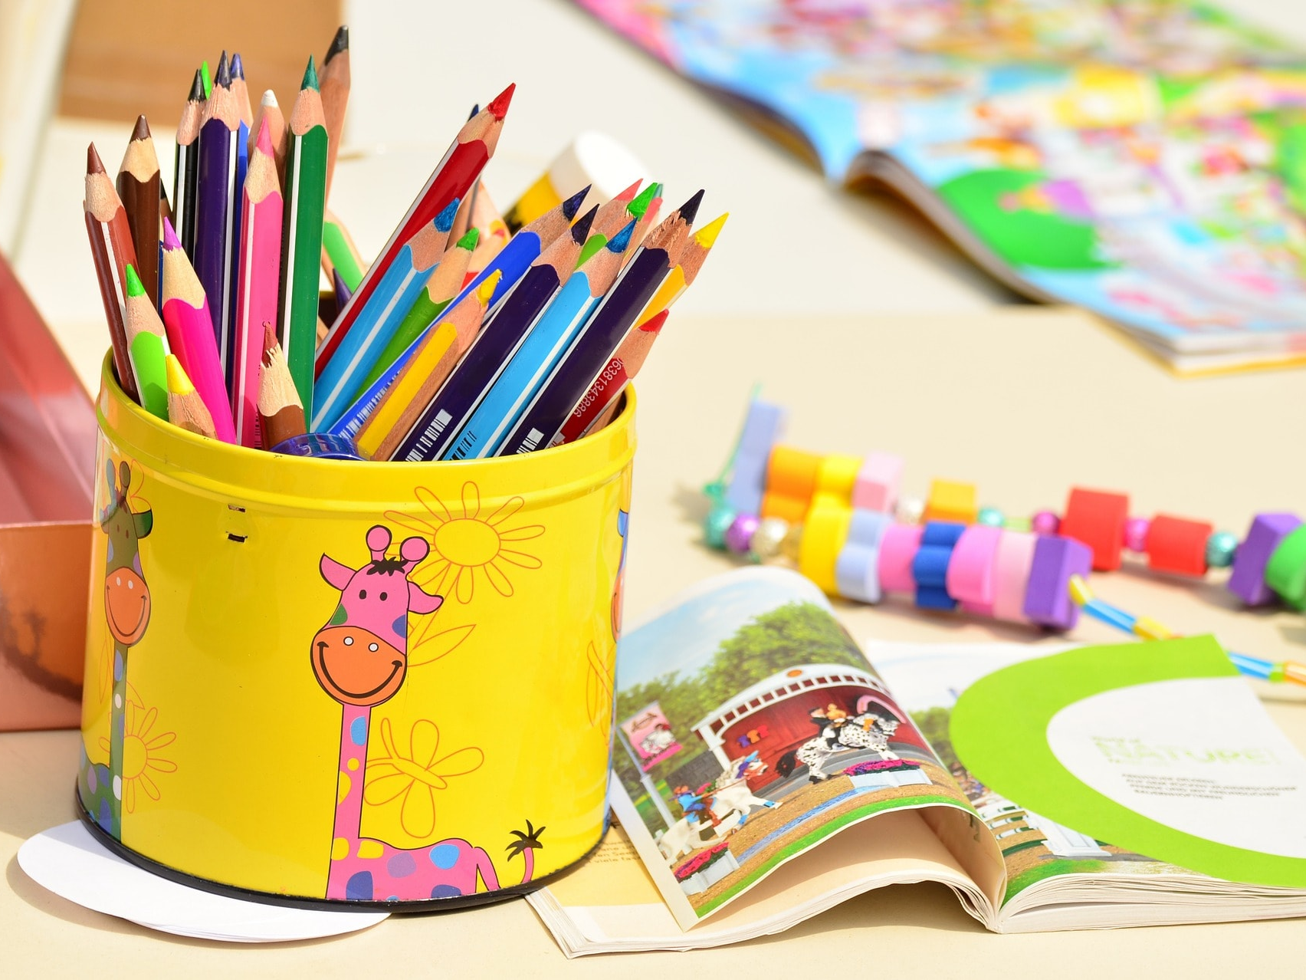
Today, we are going to practice spelling some of our Year 2 common exception words.
Notes:
© Copyright Showeet.com – Free PowerPoint Templates. Photo credits: Pixabay (CC0 Public DomainFree for commercial use No attribution required)

Slide 3
Can you read these Year 2 words?
improve
even
prove
great
break
steak
sugar
sure
move

Slide 4
Today we are going to practise using spelling pyramids. This is how they work.
We write the word inside the pyramid, building an extra letter on each time like this..
break
b
br
bre
brea
break

Slide 5
Use your spelling pyramid template to practise our nine spellings for today.

Slide 6
Mini spelling test… Which of our 9 words am I describing? Write it down…
When something snaps of cracks.
“Be careful! You will __________ it!”

Slide 7
Mini spelling test… Which of our 9 words am I describing? Write it down…
A piece of meat that some people like
to eat with chips.
“ ___________ and chips please”.

Slide 8
Mini spelling test… Which of our 9 words am I describing? Write it down…
Making something better or getting
better at a skill
“I want to _____________ my handwriting”.

Slide 9
Mini spelling test… Which of our 9 words am I describing? Write it down…
When you are certain about something.
“Are you _________about that?”

Slide 10
Mini spelling test… Which of our 9 words am I describing? Write it down…
Travel from one place to another.
“I like to ________ it , ________it”

Slide 11
Mini spelling test… Which of our 9 words am I describing? Write it down…
Test if something is correct.
“____________ your answer.”

Slide 12
Answers
1) break
2) steak
3) improve
4) sure
5) move
6) prove

Slide 13
We are going to finish our lesson today with story time. We are going to listen to and read along with Chapters 5 and 6 using this online video.
https://www.youtube.com/watch?time_continue=5&v=Lx7eMBR_cOs&feature=emb_logo
Chapter 5 starts 9 minutes into the video.

Slide 14
See you next week for more of George’s Marvellous Medicine!
Notes:
© Copyright Showeet.com – Free PowerPoint Templates. Photo credits: Pixabay (CC0 Public DomainFree for commercial use No attribution required)

