Slide 1
Year 2– Multiplication and division
Session 2 – Using arrays.

Slide 2
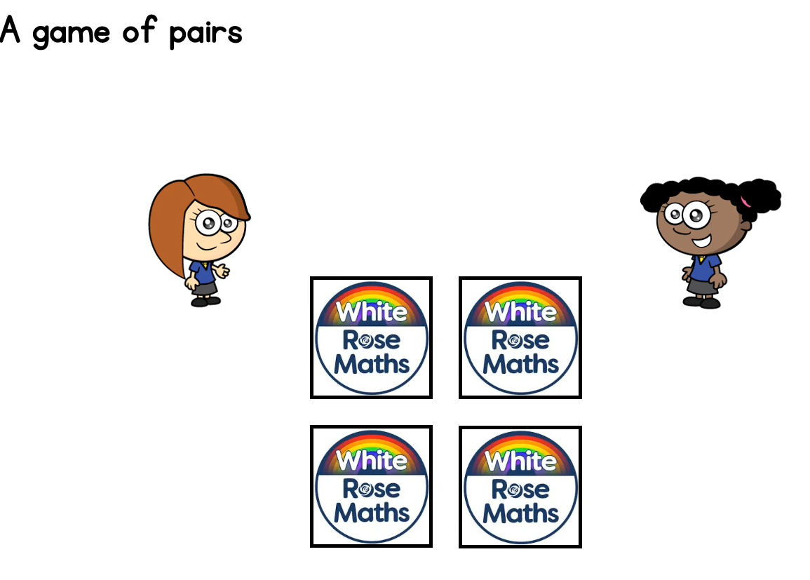
Rosie and Whitney are playing a game of pairs.
They have arranged
Their cards into an
array.
An array has rows and columns,
This array has 2 rows.
And 2 columns

Slide 3
This a 2 x 2 array.
It has 2 rows and 2 columns.
We could also say that they have 2 in each row and they have 2 rows.
2 x 2

Slide 4
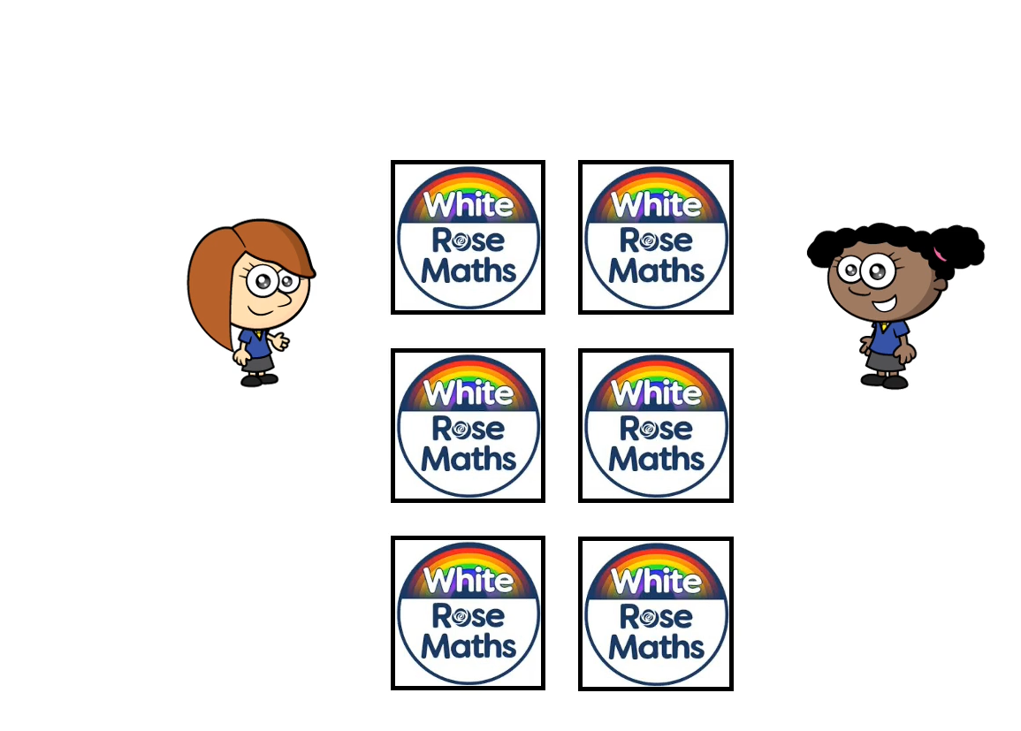
Rosie and Whitney make their game trickier by adding 2 more cards.
2 x 3
Now, they have 3 rows and 2 columns.
They have 2 in each row and they have 3 rows.
They have a
2 x 3 array.

Slide 5
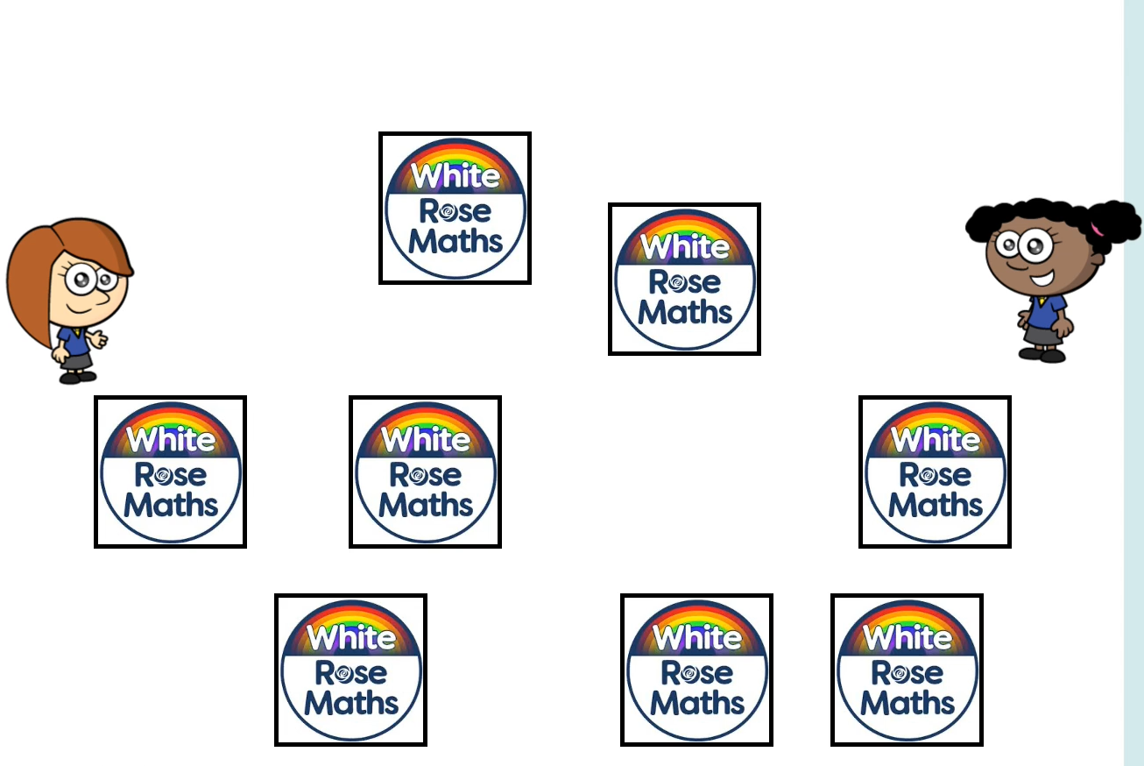
Rosie and Whitney make their game trickier by adding 2 more cards. Now they have 8.
Can you use any 8 items around the house to help Rosie and Whitney to arrange their cards into an array?

Slide 6
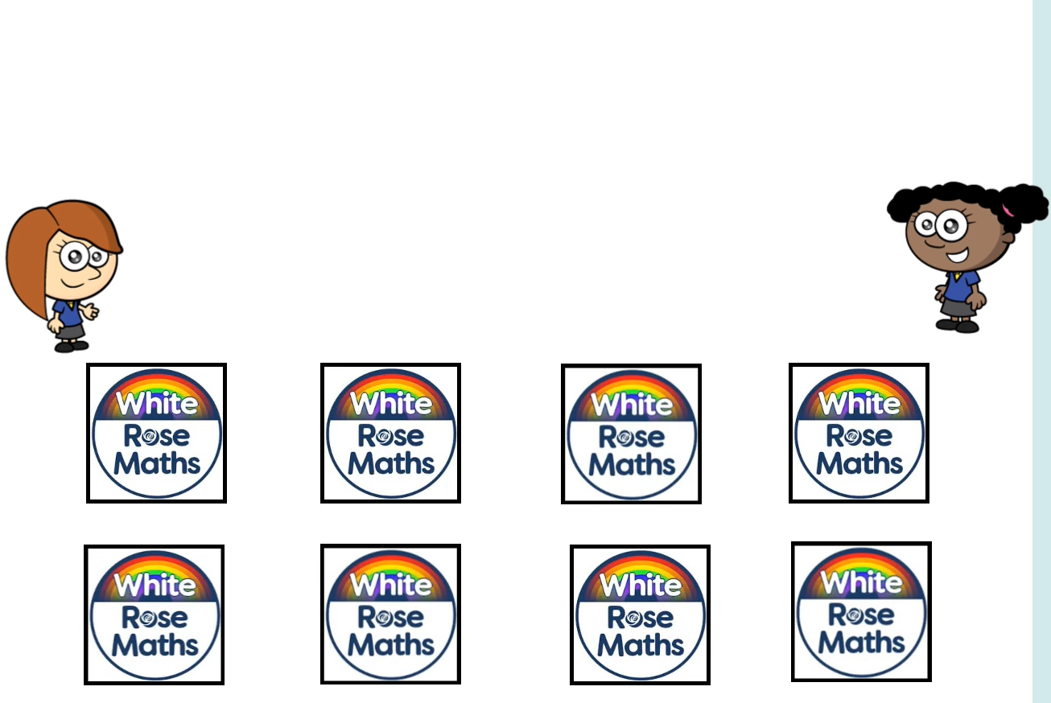
Id
Did you make a 4 x 2 array like me?
4 in each row. 2 rows.

Slide 7

Or… did you make a 2 x 4 array
2 in each row, 4 rows.

Slide 8
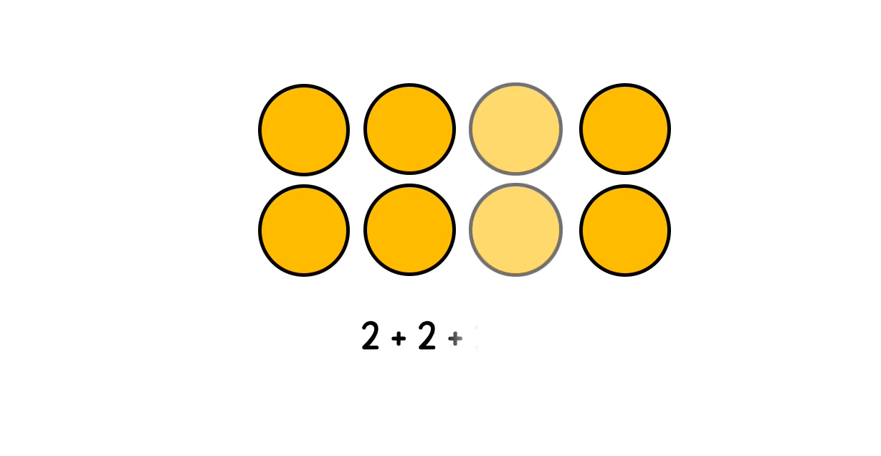
This is a 4 x 2 array.
It has 4 in each row. It has 2 rows.

Slide 9
I want to work out how many circles there are in my array.
Count in 4s 4 + 4 = 8
Count in 2s 2 + 2 + 2 + 2= 8
Instead of counting them one by one. I’m going to use my counting in steps skills to make it quicker. I could….

Slide 10
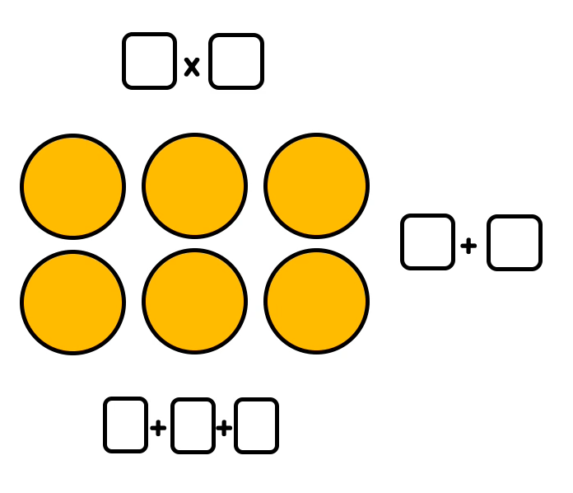
Can you use my example to work out the two addition sentences and the multiplication sentence for this array?

Slide 11
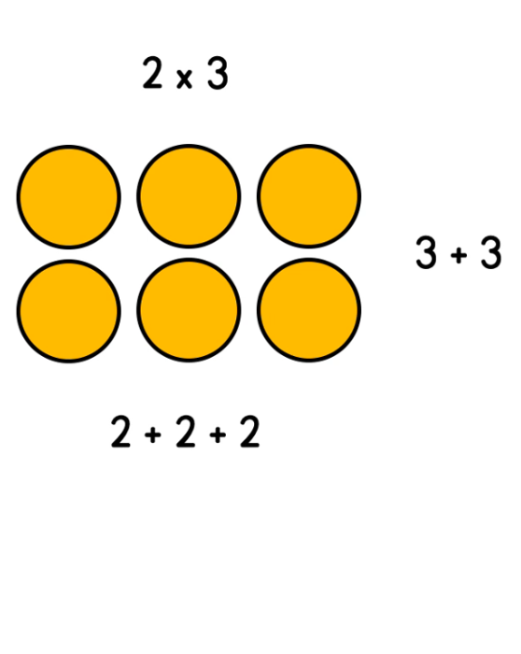
3 x 2
3 in each row. 2 rows.

Slide 12
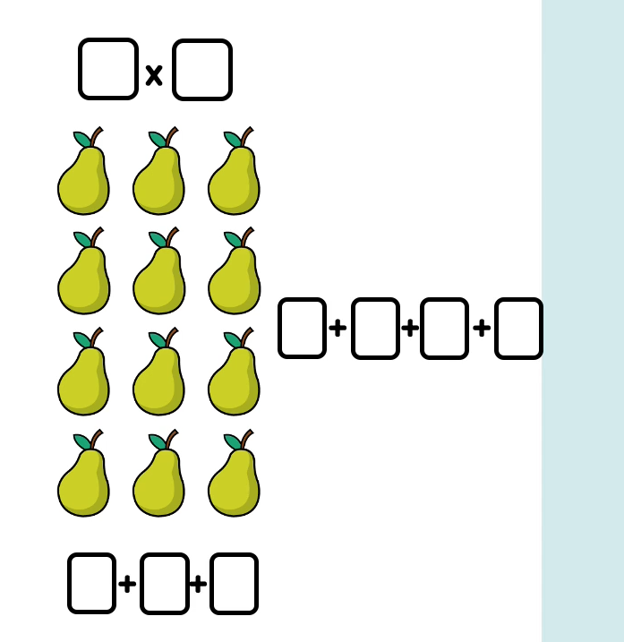
Try this one….

Slide 13
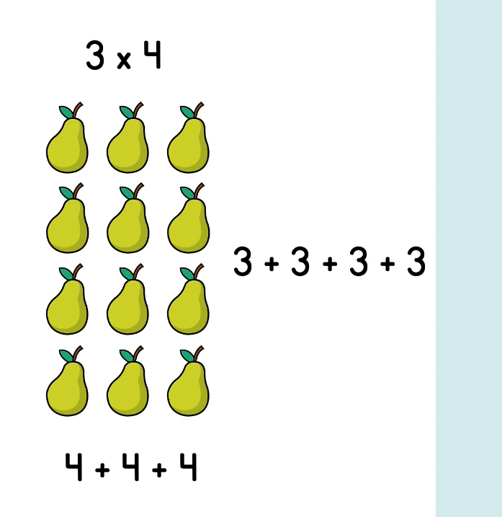
3 in each row. 4 rows.

Slide 14

Is Eva correct?
Using a whiteboard or a piece of paper… use what we have learnt today, can you draw a 7 x 4 array?

Slide 15
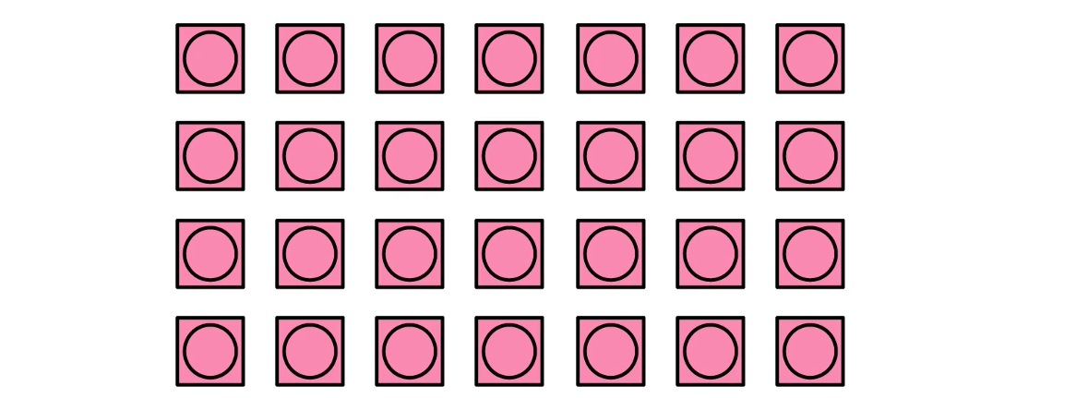
We can draw a 7 x 4 array! Eva is wrong.
7 in each row.
4 rows.

Slide 16
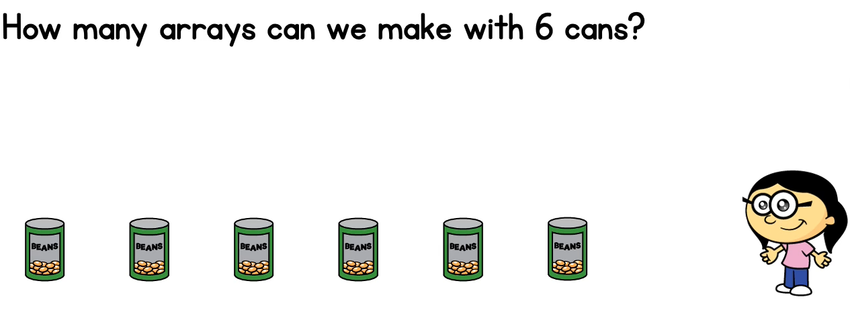
Find 6 objects. How many different ways of laying them out to make an array can you find?
Annie has done the first one for you!
6 x 1 6 in each row. 1 row.

Slide 17

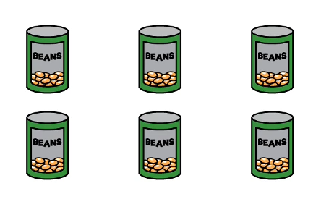
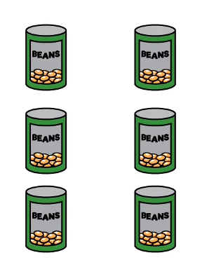
Did you find any of these arrays?
1 x 6
6 x 1
3 x 2
2 x 3

