Slide 1
Monday 20th April 2020
English - Spelling
Notes:
© Copyright Showeet.com – Free PowerPoint Templates. Photo credits: Pixabay (CC0 Public DomainFree for commercial use No attribution required)

Slide 2

Today, we are focusing on a Year 2 spelling pattern.
tch
Three letters, one sound, special friends
They make the same sound as ch
Notes:
© Copyright Showeet.com – Free PowerPoint Templates

Slide 3
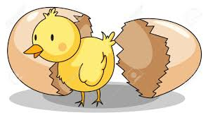

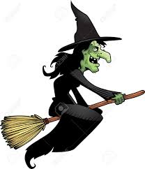
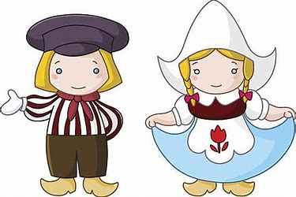
We use this way to spell the sound ‘ch’ when it comes after a short vowel sound.
The short vowel sounds are …
Like in these words..
hatch
fetch
witch Dutch
Notes:
© Copyright Showeet.com – Free PowerPoint Templates

Slide 4
How many tch words can you spot? Make a list.
My mum got me a new watch for my birthday. The colour matched my new shirt. I loved it so much. I was very sad when I lost it on the pitch of my football match. Luckily my friend Mitchell found it for me!
When I got home I had a snack in the kitchen. I was very cross when my baby brother tried to snatch my watch. My mum was so clever that she quickly switched it for his baby rattle
Notes:
© Copyright Showeet.com – Free PowerPoint Templates

Slide 5
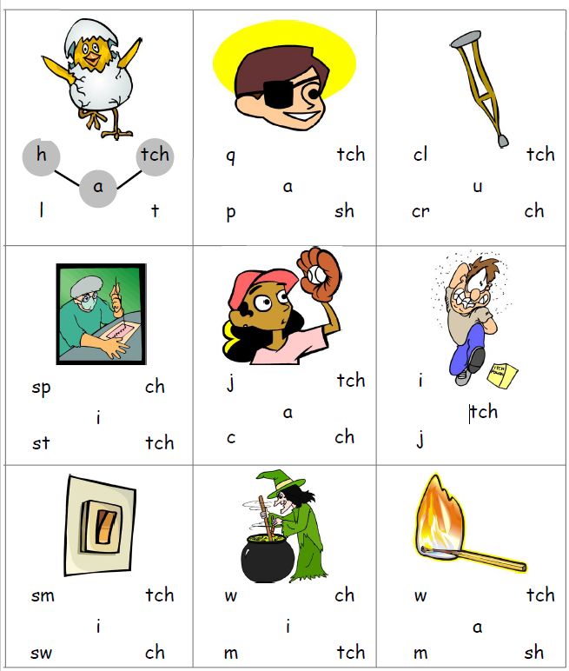
Use the sheet for today to complete this activity. Your sheet should look like this
Use the sounds provided to create the
Spelling path that matches the picture.
The first one has been done for you.
If you can’t print off the sheet, don’t worry. Just use your finger to track the path on the screen.
Notes:
© Copyright Showeet.com – Free PowerPoint Templates

Slide 6

To finish our spelling session today…
We are going to use our tch sound to play…
Fred Fingers!
The children will be experts at this!
This is how we play…
Adult says the word.
Child counts the sounds (not the letters) on their fingers.
Child writes the word.
Adult and child check together
Adults – Use words with tch that we have looked at today
Or choose some of your own to test our tch sound knowledge!

