Slide 1
Year 2– Measures
Session1 – Comparing mass

Slide 2
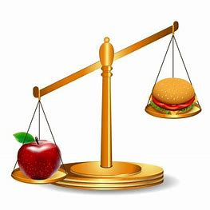
Look carefully at this set of balance scales.
Which side is lower? What does this tell us about the objects?

Slide 3
Look carefully at this set of scales.
Which side is lower? What does this tell us about the objects?
We use scales to measure how heavy something is. We sometimes call this measuring its mass.
The burger is higher than the apple.
This means the burger weighs less. It is lighter.
The apple is lower than the burger.
This means the apple weighs more. It is heavier.

Slide 4
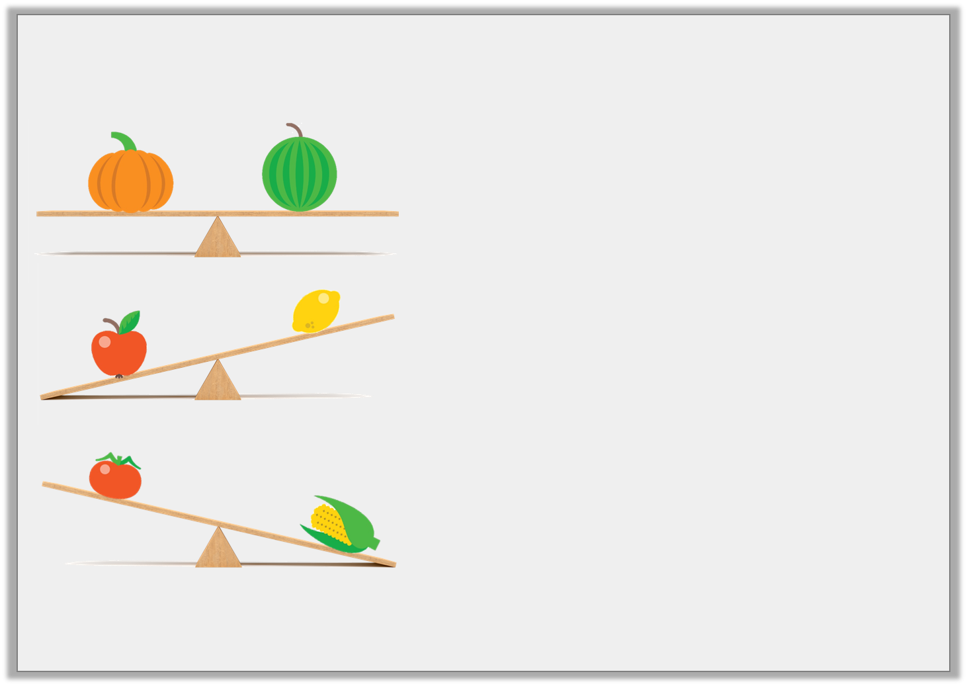
Complete the sentences below:
The pumpkin weighs the
as the melon.
The lemon weighs
than the apple.
The sweetcorn weighs
than the tomato.
Word bank: more less same

Slide 5
Complete the sentences below:
The scales are level. They are equal. The pumpkin and the melon weigh the same.
The pumpkin weighs the
as the melon.
same
less
The lemon weighs
than the apple.
The lemon is higher than the apple is weighs less.
more
The sweetcorn weighs
than the tomato.
The sweetcorn is lower than the tomato. It weighs more.
Word bank: more less same

Slide 6






When comparing mass, we can use our less than, more than, the same as symbols to help.
< > =
Which symbol would you use to complete these picture sentences?
=
= They are both the same.
>
V
> The apple weighs more than the lemon.
<
< The tomato weighs less than the sweetcorn.

Slide 7
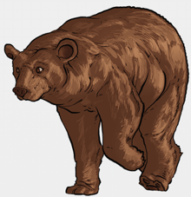
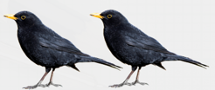
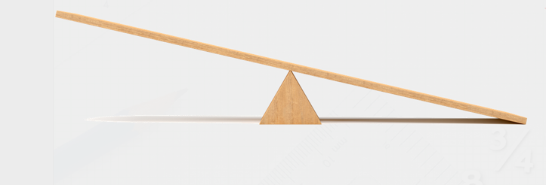
Look at the balance scales below.
Where would you put the bear? Where would you put the two birds? Why?
A bear would be much heavier than two birds. The bear needs to be at the lowest end of the scale because he weighs more.

Slide 8
What sentences could we write about this?
Use these words to help you:
Two birds
One bear
more than
less than
heavier
lighter
Now, can you write your sentences using the < and > signs?
One bear Two birds
Two birds One bear

Slide 9
What sentences could we write about this?
Possible answers:
Two birds weigh less than one bear.
Two birds are lighter than one bear.
One bear weighs more than two birds.
One bear is heavier than two birds.
Now, can you write your sentences using the < and > signs?
One bear Two birds
Two birds One bear
1 bear > two birds
Two birds < 1 bear

Slide 10
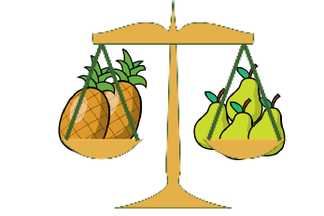
One pear weighs 10 cubes.
How many cubes will balance 1 pineapple?
4 pears = 2 pineapples.
4 pears is the same as 2 pineapples.
One pear weighs 10 cubes. There are 4 pears.
4 x 10 cubes = 40 cubes.
I’m going to multiply by counting in steps.
10
20
30
40
4 Pears = 2 pineapples
this means
40 cubes = 2 pineapples.
I’m going to divide by sharing.
0 0 0 0 0 0 0 0 0 0
0 0 0 0 0
0 0 0 0 0
20
0 0 0 0 0 0 0 0 0 0
0 0 0 0 0
0 0 0 0 0
20
I only want 1 pineapple….I’ll need to divide the cubes into two.
1 pineapple = 20 cubes.
I will need 2 cubes to balance 1 pineapple.

