Slide 1
Wednesday 8th July 2020
Letter Writing

Slide 2
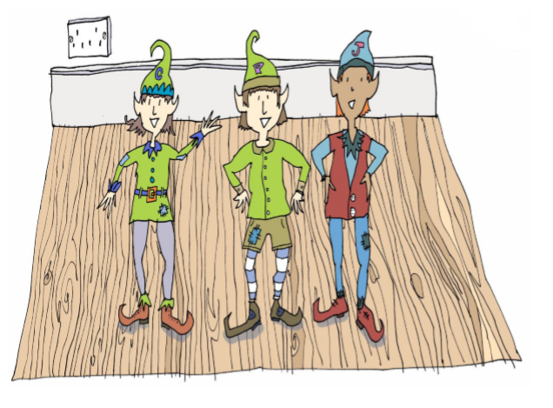
Yesterday, you wrote a new magical
helping story inspired by ‘The Elves and
The Shoemaker’. In your story, you created
your own magical characters who were friends
with Clary, Jaz and Pepper.

Slide 3
Today we are going to be writing letters in role.

Slide 4
We are going to pretend to be our new magical creatures writing to Clary, Jaz and Pepper to tell them all about what they have been doing.
We are going to be writing to our friends so we are writing an
informal letter.
This means our letter can sound chatty and doesn’t
have to use formal (posh) language.

Slide 5
Example of a Thank-you Letter
1 Holly Lane
Erdington
Birmingham
West Midlands
B23 7RE
Wednesday 8th July 2020
Dear Santa,
I am writing to thank you for the lovely presents you left at my house on Christmas Eve. I couldn’t believe my eyes when I saw them all and so beautifully wrapped. Your elves must have been very busy this year.
I especially loved the bike and have been learning how to ride it, as I haven’t had one without stabilisers before. The pink helmet is a perfect fit and I wear it to protect my head when I’m on my bike in case I fall off.
My brother James loved his train set and has been playing with it everyday since you delivered it. He loves the noises it makes and connecting all of the carriages together.
I hope you and Mrs Claus have a lovely holiday and the elves and reindeers have a well deserved rest.
Love from
Daisy xx

Slide 6
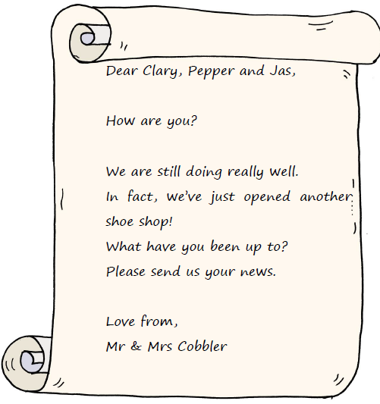
Let’s build our letter together. Remember, you are your magical creatures writing to Clary, Pepper and Jaz to tell them about how you have been helping people.

Slide 7
How to Write an Informal Letter
Step 1 – Write your magical characters address in the top right hand corner of your letter.
Daisy Happy
Flat 1 Flowers Towers Tulipville Rose Town FL12 4ON

Slide 8
How to Write an Informal Letter
Step 2 – Write the date underneath your address.
Daisy Happy
Flat 1 Flowers Towers Tulipville Rose Town FL12 4ON
Wednesday 8th July 2020

Slide 9
How to Write an Informal Letter
Step 3 – Write the name of the person who the letter is for below the date on the left hand side. You can use ‘Dear’ or a more informal greeting, such as ‘Hello’, or ‘Hi’. Add a comma after the person’s name.
Daisy Happy
Flat 1 Flowers Towers Tulipville Rose Town FL12 4ON
Wednesday 8th July 2020
Dear Clary, Pepper and Jaz

Slide 10
How to Write an Informal Letter
Step 4 – Tell the person why you are writing to them.
Daisy Happy
Flat 1 Flowers Towers Tulipville Rose Town FL12 4ON
Wednesday 8th July 2020
Dear Clary, Pepper and Jaz,
I am writing to tell you all about how we have been helping Mr and Mrs Bloom in the flower shop. You will be so proud of us! We really have been busy and Mr and Mrs Bloom are so thankful!

Slide 11
How to Write an Informal Letter
Step 5 –Now tell them all about how you helped and what happened.
Daisy Happy
Flat 1 Flowers Towers Tulipville Rose Town FL12 4ON
Wednesday 8th July 2020
Dear Clary, Pepper and Jaz,
I am writing to tell you all about how we have been helping Mr and Mrs Bloom in the flower shop. You will be so proud of us! We really have been busy and Mr and Mrs Bloom are so thankful!
Mr and Mrs Bloom were down to their very last flowers in their florist shop and didn’t know how they were going to make anymore bouquets. They were very sad and we felt very sorry for them. While they were asleep, we planted some of our magical quick growing seeds and grew enough sunflowers for one bunch over night. How quickly they grew! We tied them together in a big bow and left them as a surprise. You should have seen Mr and Mrs Bloom’s faces in the morning! They stood with their mouths wide open! A rich man came to and brought the flowers for his daughter.
The next night, we planted hundreds of different types of fast growing seeds for them. Mr and Mrs Bloom must have seen us because they made us some new clothes from some petals and some leaves to say thank you. We look super cool now! You will be jealous when you seem my rose slippers!

Slide 12
How to Write an Informal Letter
Step 6 – Finish off your letter using an appropriate ending e.g. ‘Love from’ or ‘See you soon’, followed by your name.
Daisy Happy
Flat 1 Flowers Towers Tulipville Rose Town FL12 4ON
Wednesday 8th July 2020
Dear Clary, Pepper and Jaz,
I am writing to tell you all about how we have been helping Mr and Mrs Bloom in the flower shop. You will be so proud of us! We really have been busy and Mr and Mrs Bloom are so thankful!
Mr and Mrs Bloom were down to their very last flowers in their florist shop and didn’t know how they were going to make anymore bouquets. They were very sad and we felt very sorry for them. While they were asleep, we planted some of our magical quick growing seeds and grew enough sunflowers for one bunch over night. How quickly they grew! We tied them together in a big bow and left them as a surprise. You should have seen Mr and Mrs Bloom’s faces in the morning! They stood with their mouths wide open! A rich man came to and brought the flowers for his daughter.
The next night, we planted hundreds of different types of fast growing seeds for them. Mr and Mrs Bloom must have seen us because they made us some new clothes from some petals and some leaves to say thank you. We look super cool now! You will be jealous when you seem my rose slippers!
Love from
Daisy, Petal and Poppy xxxxx

