Slide 1
Year 2 - Time
Session 1 – o’clock

Slide 2
Today we are learning to telling the time to o’clock

Slide 3
Important Facts
There are 2 hands on a clock
The long hand is the ‘minute’ hand
The short-hand is the ‘hour’ hand

Slide 4
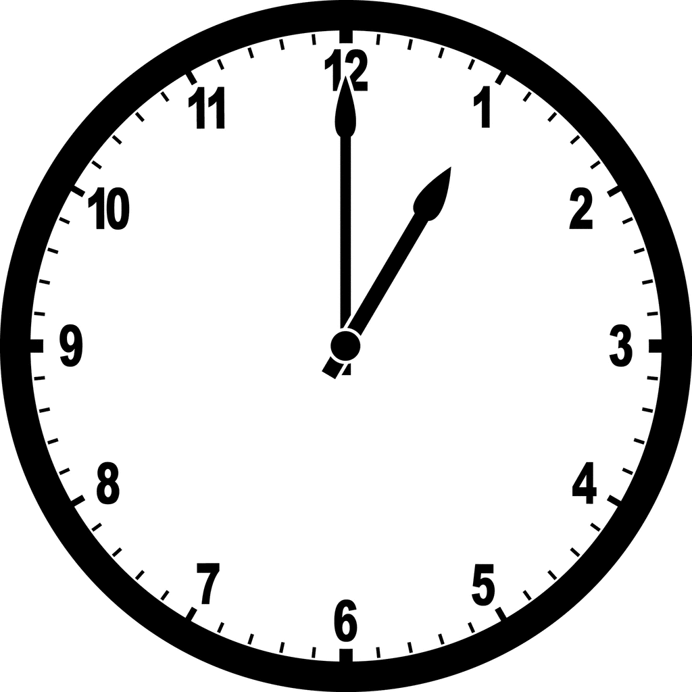
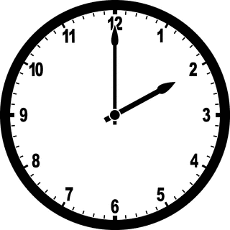
It takes the ‘minute hand’ 60 minutes to go around the clock once.
1 o’clock
2 o’clock
It is o’clock when the ‘minute hand’ (long hand) is on the 12

Slide 5
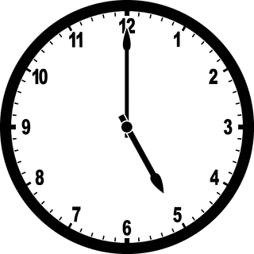
The minute hand is on the 12
The hour hand is on the 5
So this clock reads 5 o’clock

Slide 6
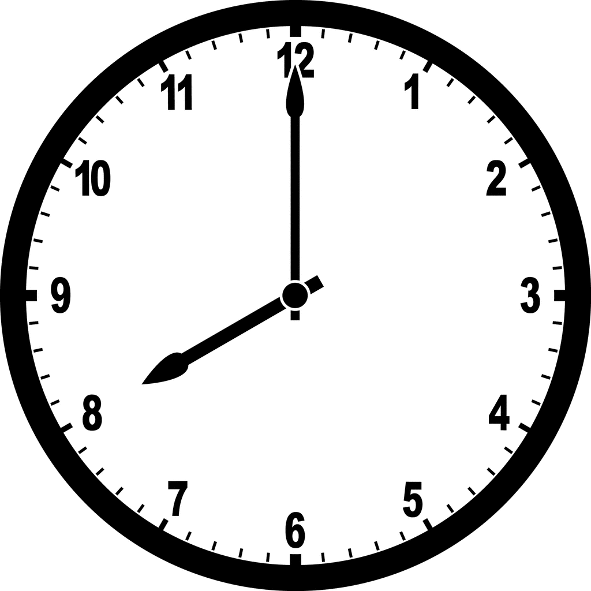
The minute hand is on the 12
The hour hand is on the 8
So this clock reads 8 o’clock

