Slide 1
Thursday 18th June 2020
Notes:
© Copyright Showeet.com – Free PowerPoint Templates. Photo credits: Pixabay (CC0 Public DomainFree for commercial use No attribution required)

Slide 2
We are going to read some more of ‘George’s Marvellous Medicine’ later in the session.
First, we are going to begin writing our own
Explanation text.
Notes:
© Copyright Showeet.com – Free PowerPoint Templates. Photo credits: Pixabay (CC0 Public DomainFree for commercial use No attribution required)

Slide 3
Our explanation text is going to tell people all about how the medicine we designed on Monday works.
Find your work from Monday and remind yourself :
Who is your medicine for?
Why do they need it?
What you put into your medicine and why?
If you haven’t done it yet, take a peek at lesson 1 for this week to help you.
My plan from Monday is on the next page.

Slide 4
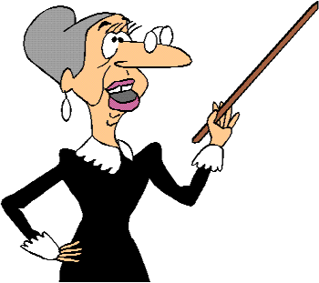
What would I put in a medicine for Miss Strict?
Mouthwash – To wash the mean words out of her mouth.
Conditioner – To make her voice smooth and friendly.
Toothpaste – To clean her horrid, brown teeth.
Washing powder – To make her have clean, happy thoughts.
5 cans of pop – To give her fizz and energy (or to make her explode!)
Perfume – To stop her from smelling badly.

Slide 5





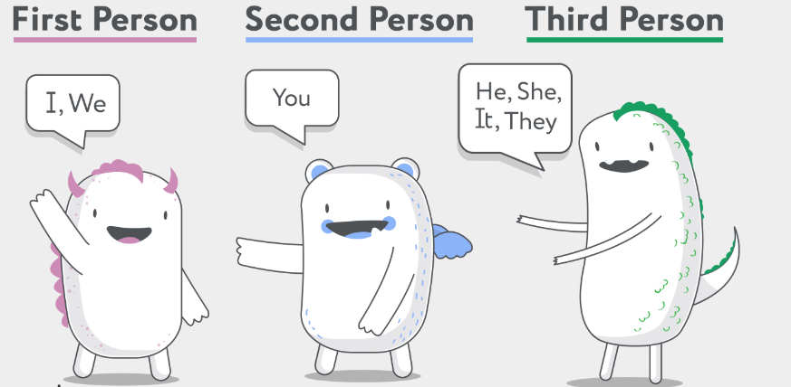

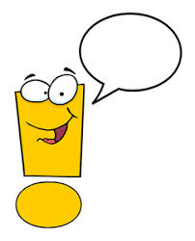

We are going to plan each section of our explanation text together. Can you remember what an explanation text needs?

Slide 6
First we need to plan a title.
What are you going to call your marvellous medicine!
The title!
We want our title to make people want to know more. Mine is:
Write your title at the top of your page.

Slide 7
A good way to start an explanation is with a question for the reader. The start should also tell them how the text will help them.
This is a question opener.
Our question should be about the problem we are trying to solve.
For example: Do you have the world’s grumpiest teacher? Do they have a black cloud over their head?
Then, we need to tell the reader how our text will help them.
If so, worry no more! Use Miss Lacey’s magical medicine and your teacher will be a ray of sunshine!
So, how does it work?

Slide 8
So far, my explanation text looks like this.
Miss Lacey’s magical medicine
Do you have the world’s grumpiest teacher? Do they have a black cloud over their head?
If so, worry no more! Use Miss Lacey’s magical medicine and your teacher will be a ray of sunshine! So, how does it work?
Write your question opener underneath your title now. ☺

Slide 9
The middle of an explanation text usually tells us about events in order. The events are split into paragraphs.
To help us order events, we use time conjunctions.
This is where we need to think about our tricky causal conjunctions from yesterday too.

Slide 10
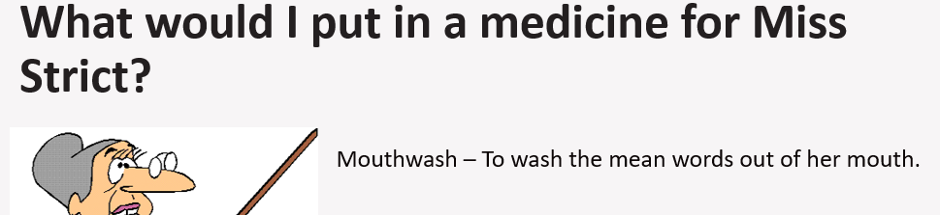
We are going to tell the reader what each ingredient in our magical mixtures does in order.
My first ingredient from Monday
I’m going to turn this into a full sentence with a time word and a causal conjunction.
First, the mouthwash will trickle down their neck as a result all the mean words will be washed straight out of their mouth.

Slide 11
So far, my explanation text looks like this.
Miss Lacey’s magical medicine
Do you have the world’s grumpiest teacher? Do they have a black cloud over their head?
If so, worry no more! Use Miss Lacey’s magical medicine and your teacher will be a ray of sunshine! So, how does it work?
First, the mouthwash will trickle down their neck as a result all the mean words will be washed straight out of their mouth.

Slide 12
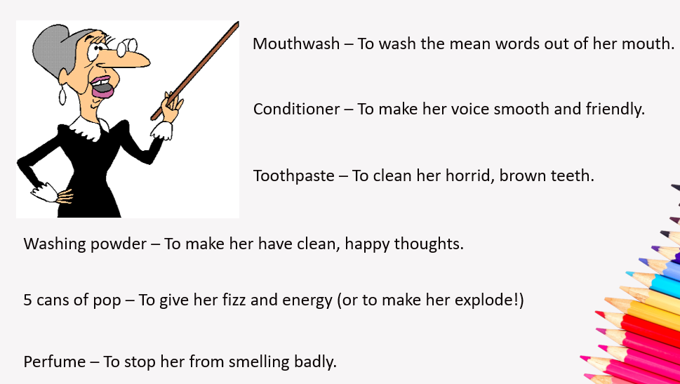
We are going to write a new causal conjunction sentence for each ingredient in our medicine to tell the reader what it does.
My first ingredient from Monday
Start a new line for each new sentence. For today, write sentences for 2 more ingredients. We will write the rest on Monday.

Slide 13
So far, my explanation text looks like this.
Miss Lacey’s magical medicine
Do you have the world’s grumpiest teacher? Do they have a black cloud over their head?
If so, worry no more! Use Miss Lacey’s magical medicine and your teacher will be a ray of sunshine! So, how does it work?
First, the mouthwash will trickle down their neck as a result all the mean words will be washed straight out of their mouth.
Next, the slimy conditioner starts to bubble consequently your teacher’s voice will be
silky and smooth.
After that, the toothpaste blasts away all the brown dirt from their teeth so that they
have a beautiful, clean smile.

Slide 14
Quick check!
Have a look back over your writing so far..
Have you got a catchy title?
Do you have a question opener?
Can you spot time conjunctions in your work?
Can you spot causal conjunctions?

Slide 15
Time to relax
Chapter 10
A Crane for Grandma
https://www.youtube.com/watch?v=Xls7XtU8hq0
Notes:
© Copyright Showeet.com – Free PowerPoint Templates. Photo credits: Pixabay (CC0 Public DomainFree for commercial use No attribution required)

Slide 16
See you on Monday for more of George’s Marvellous Medicine!
Notes:
© Copyright Showeet.com – Free PowerPoint Templates. Photo credits: Pixabay (CC0 Public DomainFree for commercial use No attribution required)

