Slide 1
Thursday 9th July 2020
Kenning poems

Slide 2
Today we are going to be writing a special type of poem.

Slide 3
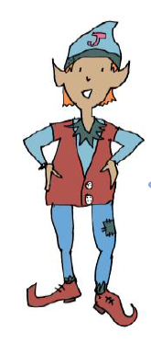
Jaz loves riddles!
We learnt about riddles at school.
A riddle is a short poem
where we have to use
the clues in the poem to find
an answer.

Slide 4
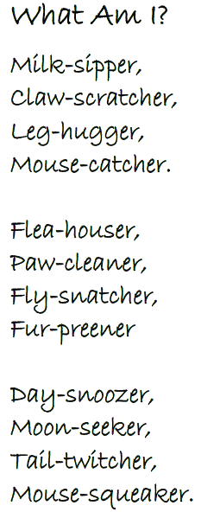
Read this riddle, what is Jaz describing?

Slide 5
Read this riddle, what is Jaz describing?
A cat

Slide 6
We are going to make up our own riddles about an animal?
Here’s what to do:
★ Choose your animal
★ Write a list of things you know about the animal
Turn the list into a riddle like Jaz has done in
the example.
The next few slides will guide you
through an example.

Slide 7
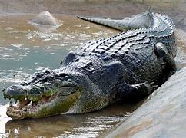
What do I know about a crocodile?
What do they do? What do they look like?
Long snout
Can swim quickly
Can bite!
Sharp teeth
Eats meat
Scaly skin
Lives in lakes and rives.
Sleeps on muddy banks

Slide 8
This riddle is a special type of riddle. It is called a kenning.
All lines in a kenning poem have 2 words that are linked together.They usually describe animals/objects in a different way.
I am going to use my ideas about a crocodile. I’m going to try and make sure that all my ideas end in –er to make a pattern.
What am I?
Fast Swimmer,
Lake Liver,
Long snouter,
Bite giver,
Mud sleeper,
Jaw snapper.

Slide 9
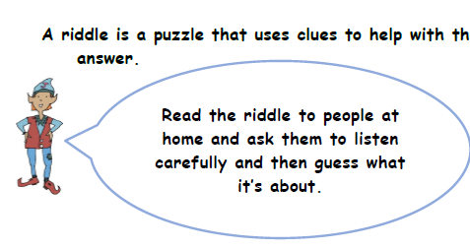
Your turn..
Choose an animal.
Write a list of things that your character does.
Put them together to make a kenning.

