Slide 1
Wednesday 15th July2020

Slide 2
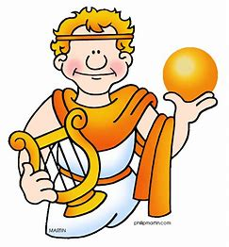
As well as knowledge, Apollo was also the God of poetry.
Today, we are going to be focusing on a poem about a magic box.

Slide 3
You can read the poem yourself or you can here Kit Wright the author reading it here :
https://www.bbc.co.uk/bitesize/clips/zd9bwmn

Slide 4
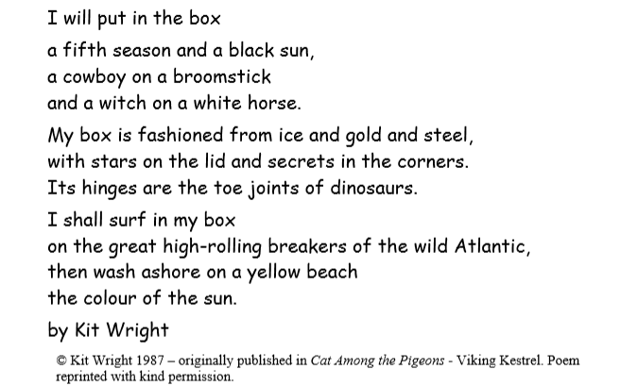

Slide 5
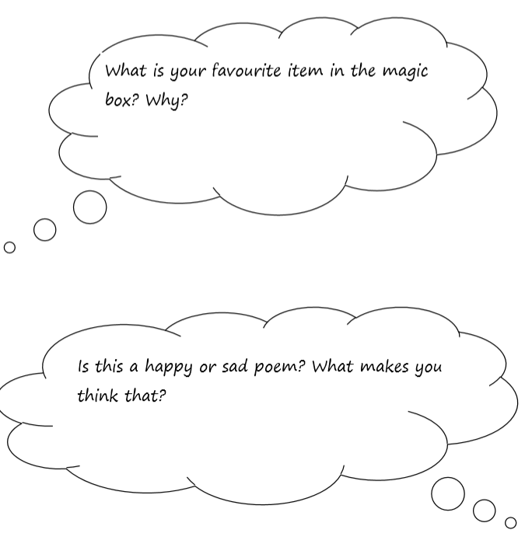
Talk about the poem..

Slide 6
Activity
Today, we are going to make out own magic
box like the one in Kit’s poem.

