Slide 1
Tuesday 16th June 2020
Notes:
© Copyright Showeet.com – Free PowerPoint Templates. Photo credits: Pixabay (CC0 Public DomainFree for commercial use No attribution required)

Slide 2
We are going to read some more of ‘George’s Marvellous Medicine’ later in the session.
First, we are going to learn about a new type of writing called
Explanation texts.
Notes:
© Copyright Showeet.com – Free PowerPoint Templates. Photo credits: Pixabay (CC0 Public DomainFree for commercial use No attribution required)

Slide 3
We are going to read some examples and then together we are going to spot the features of the text.

Slide 4
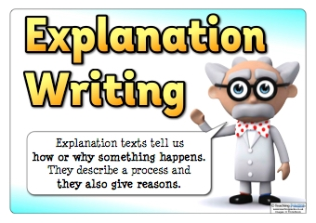
Explanations are a type of non-fiction writing. They explain how something works or why something happens.

Slide 5
Choose an explanation text from the examples to use today.
Read your explanation text.
What is your explanation about?
All our texts today tells us how something works.

Slide 6
What was the first clue you got that told you what your explanation was going to be about?
The title!
Find and label this on your example.

Slide 7
A good way to start an explanation is with a question for the reader. The start should also tell them how the text will help them.
We are going to call this a question opener.
For example: Do you struggle to get up in the morning? This alarm clock could make your mornings a dream!
Find and read the question opener in your example.
What is the question? How is the text trying to help the reader?

Slide 8
The middle of an explanation text usually tells us about events in order. The events are split into paragraphs.
To help us order events, we use time conjunctions.
Write a list of time conjunctions you can spot. Can you see the paragraphs clearly?
A clue… First, Next,

Slide 9
Explanations use a new kind of conjunction that we have not really spoken about before. They are called causal conjunctions.
They join 2 sentences together where 1 action has caused another.
now that
so that
therefore
consequently
as a result
Can you spot causal conjunctions in your piece?

Slide 10
Explanations are written in the present tense.
What present verb words can you spot?
Examples: press push wait

Slide 11
Explanations tell someone else what to do. They are usually written in the second or third person.
They use the word you or it/they
What examples can you spot?

Slide 12
At the end of an exclamation, there a closing statement. It sometimes gives a small warning and nearly always finishes with a positive, encouraging feel.
Warnings that if you don't use it correctly....
Positive sentences.
Exclamations.
Your life will be..
Your problem will be gone.
Label your conclusion. What positive
sentences can you see?

Slide 13
So...what can you remember about explanations?
What is an explanation?

Slide 14
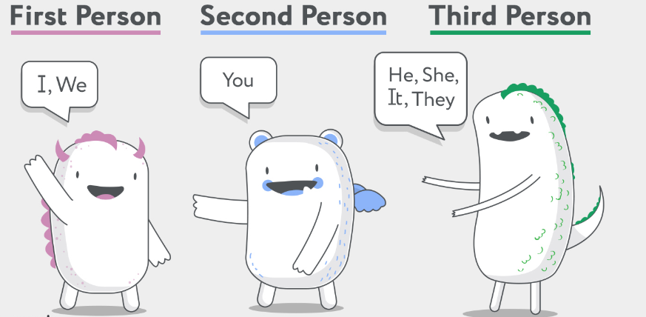
What do explanations need?

Slide 15
We are going to be learning to write explanation texts over the next few days. Let’s finish today by listening to Chapter 8.

Slide 16
Chapter 8
The Brown Hen
https://www.youtube.com/watch?v=6-YgPWf7ppw
Notes:
© Copyright Showeet.com – Free PowerPoint Templates. Photo credits: Pixabay (CC0 Public DomainFree for commercial use No attribution required)

Slide 17
See you tomorrow for more of George’s Marvellous Medicine!
Notes:
© Copyright Showeet.com – Free PowerPoint Templates. Photo credits: Pixabay (CC0 Public DomainFree for commercial use No attribution required)

