Slide 1
Tuesday 5th May 2020
English –Reading
Notes:
© Copyright Showeet.com – Free PowerPoint Templates. Photo credits: Pixabay (CC0 Public DomainFree for commercial use No attribution required)

Slide 2
Today, we are focusing on our prosody skills as well as our comprehension skills.
Prosody is reading fluently with lots of expression.
We are reading poetry today so this is really important.
Notes:
© Copyright Showeet.com – Free PowerPoint Templates

Slide 3
Step 1: Read the poem slowly to check you know all the words without having to sound stop to sound them out.
Sea Poem The glimmering blue sea was calm, As the waves floated upon the sand, The seagulls cry was loud and sharp, As they flew across the warm land. The sun was shining brightly, As the rays lit up the sky, The water danced and tumbled, As the day went flying by.
Notes:
© Copyright Showeet.com – Free PowerPoint Templates

Slide 4
Today, we are going to focus on questions about vocabulary and word choice.
This is Sue and Sally. They are word scientists.
They think about how words are made and what
they mean.

Slide 5
Today, we are going to focus on questions about vocabulary and word choice.
Sea Poem
The glittering blue sea was calm,
As the waves floated upon the sand,
The seagulls cry was loud and sharp,
As they flew across the warm land.
The sun was shining brightly,
As the rays lit up the sky,
The water danced and tumbled,
As the day went flying by.
Find and copy a word in the first verse that mean the same as shining.
glittering

Slide 6
Today, we are going to focus on questions about vocabulary and word choice.
Sea Poem
The glittering blue sea was calm,
As the waves floated upon the sand,
The seagulls cry was loud and sharp,
As they flew across the warm land.
The sun was shining brightly,
As the rays lit up the sky,
The water danced and tumbled,
As the day went flying by.
In this poem, does the word cry mean....
The seagulls were sad and upset. 
The seagulls were making a noise. 
The seagulls were flying. 

Slide 7
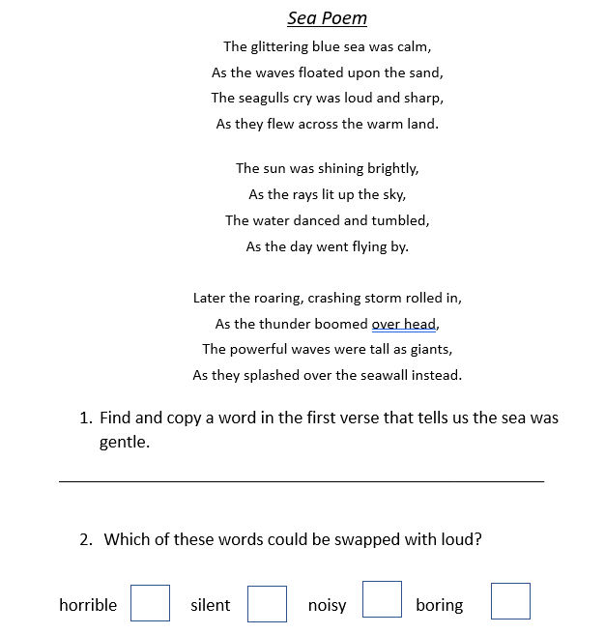
Now, tackle the reading comprehension task.
It should look like this. If you need an adult to help you read, that’s totally okay! ☺ We are practising finding the answers.
If you can’t print, don’t worry, read on the screen and write your answers in your book.
Notes:
© Copyright Showeet.com – Free PowerPoint Templates

