Slide 1
Year 2– Measures
Session 2 – Weighing using grams

Slide 2
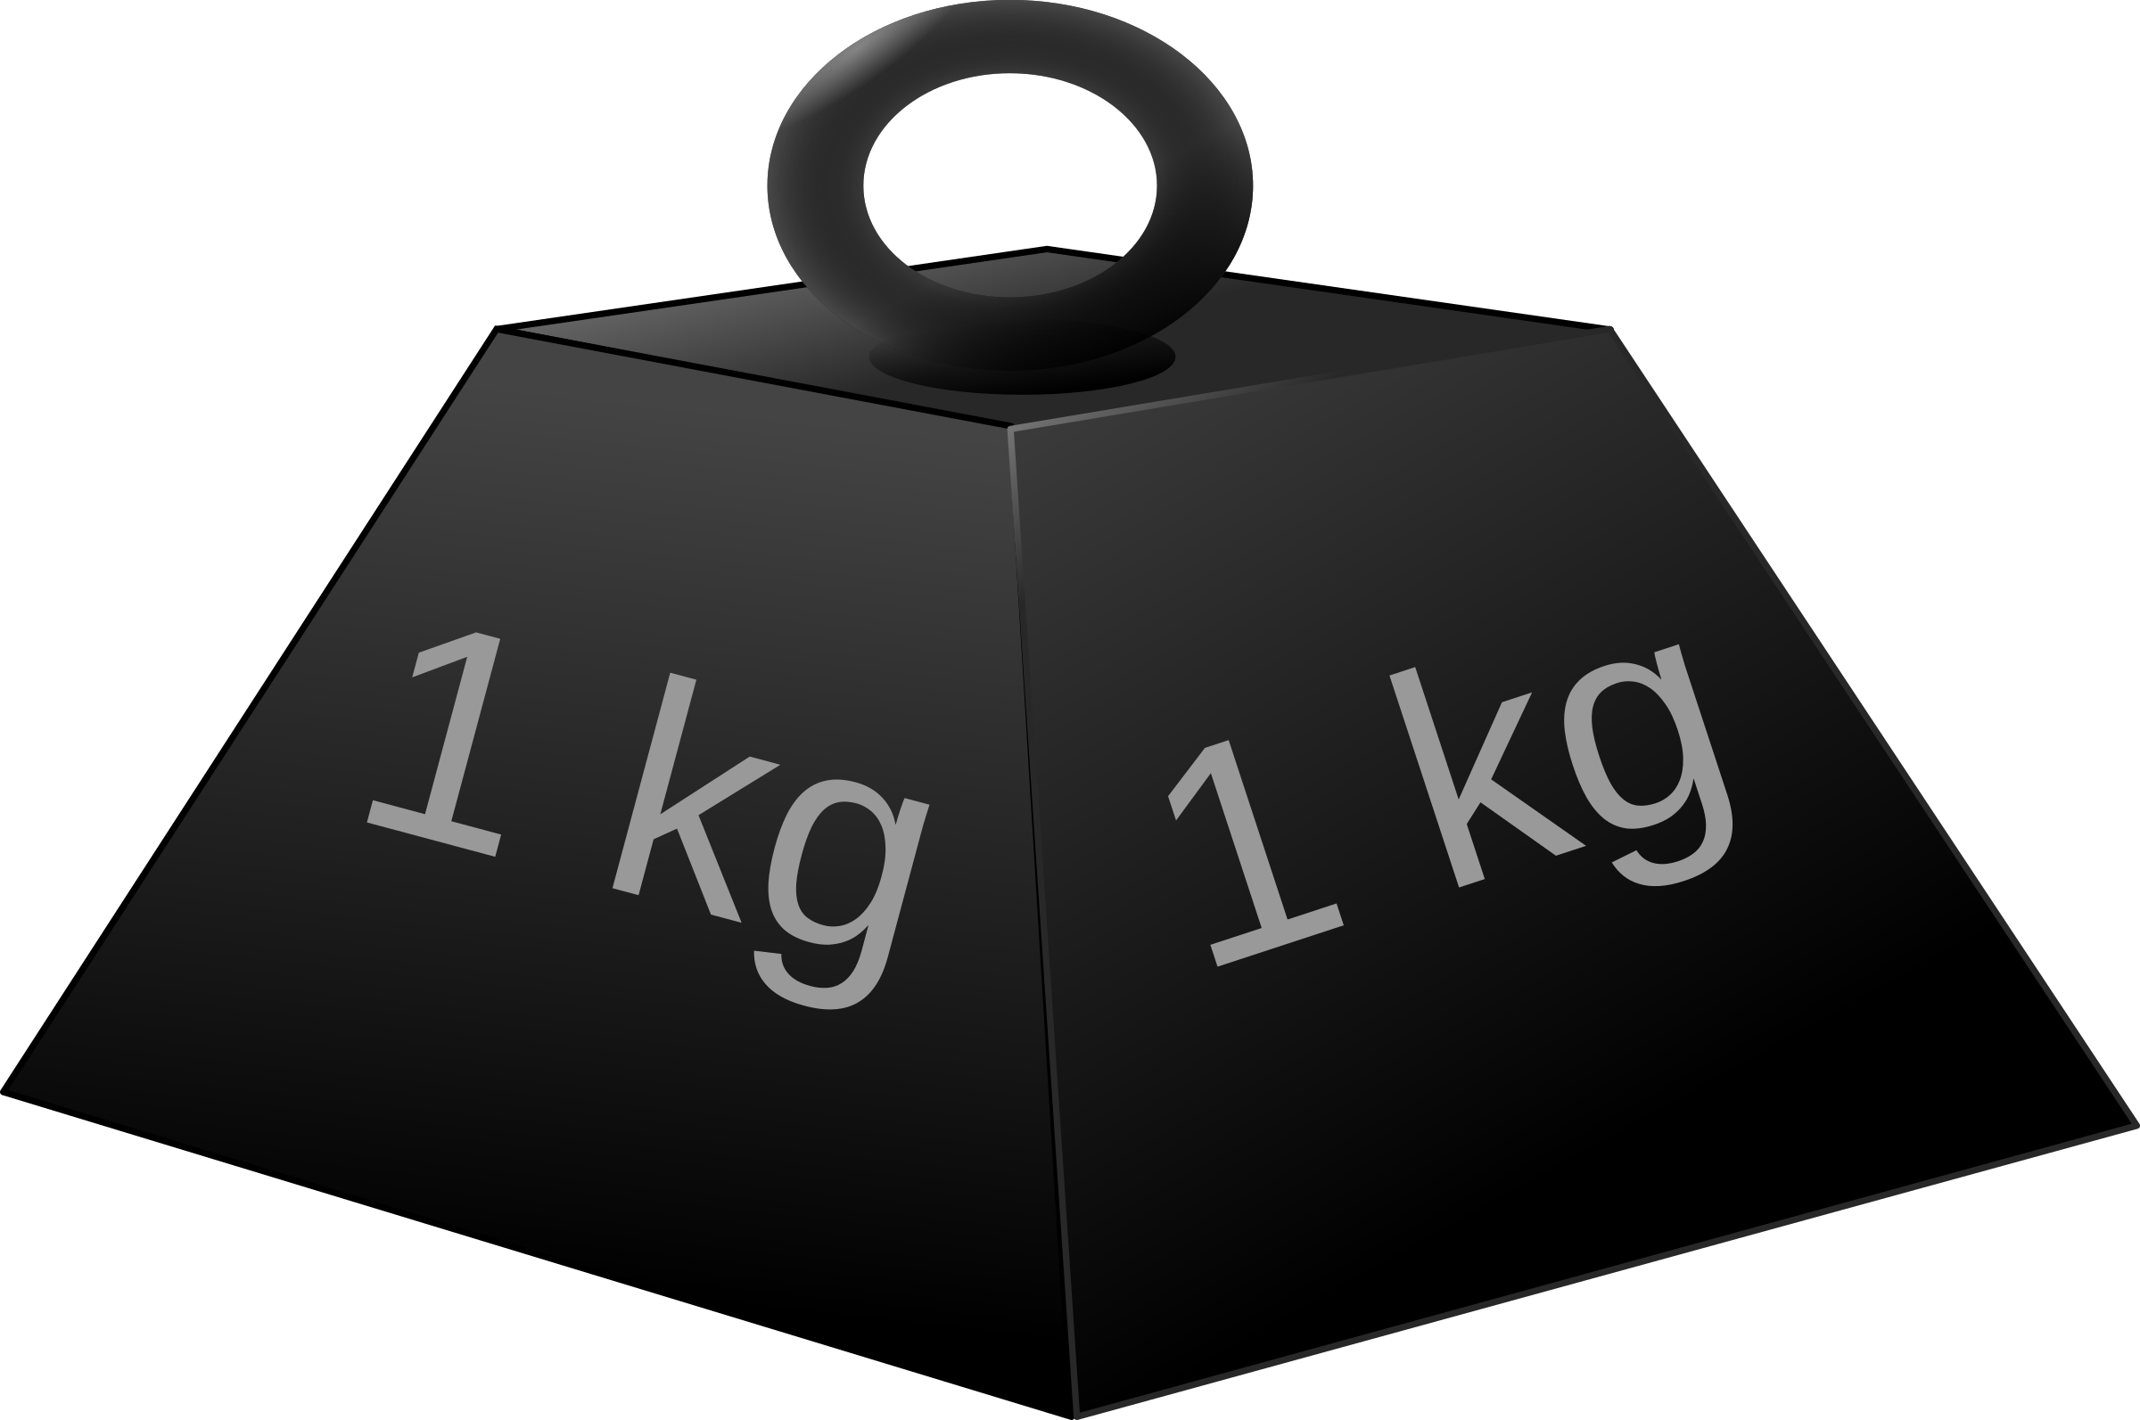
Yesterday, we began looking at standard units for measuring mass.
A standard measure is the same where ever you go in the world. Our unit of measure today is grams.
1 gram (1g) is much much smaller that 1 kilogram 1 kg.
In fact there are 1000 grams inside 1 kilogram!

Slide 3
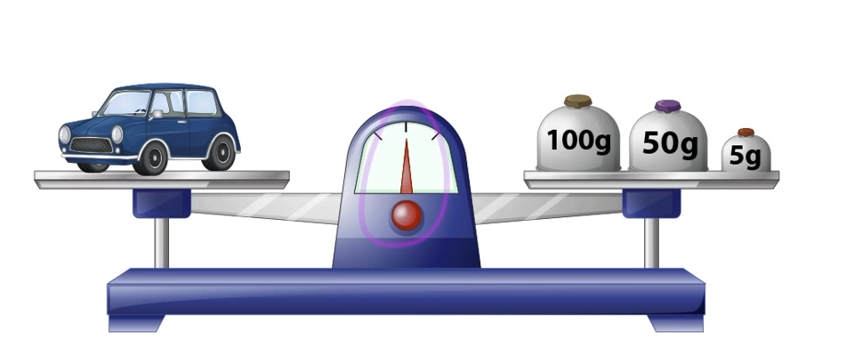
Measuring in grams using a balance scale.
On one side of the scale is a toy car.
On the other are some gram
weights.
The balance is level.
We need to add our gram weights together to find the total.
100 + 50 = 150
150 + 5 = 155
The toy car weighs 155 grams.

Slide 4
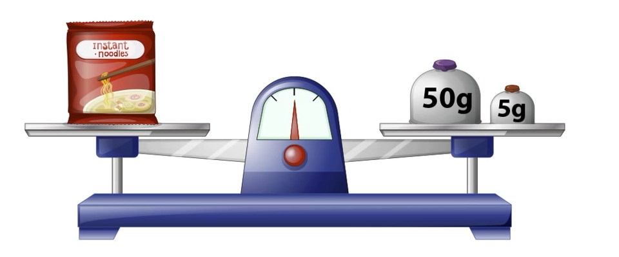
Measuring in grams using a balance scale.
Try this one before clicking through for the answers.
On one side of the scale there
are some noodles.
On the other are some gram
weights.
The balance is level.
We need to add our gram weights together to find the total.
50 + 5 = 55
The noodles weigh 55 grams.

Slide 5
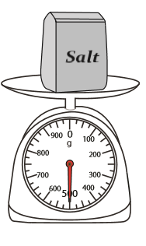
Measuring in grams with mechanical scales is exactly the same process as measuring for kilograms.
We look carefully to see where the needle is pointing to.
The needle is pointing to 500.
This scale has a small g at the top. This means it is used for measuring grams.
The salt weighs 500g
Which is 500 grams

Slide 6
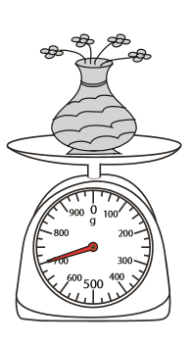
Can you read this scale very carefully?
The needle is pointing to 700.
This scale has a small g at the top. This means it is used for measuring grams.
The flowers weigh 700g
Which is 700 grams

Slide 7
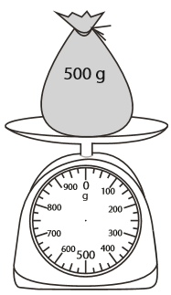
The needle has fallen off this set of mechanical scales.
I’m going to fix it by drawing the needle back on.
The bag weighs 500 g.
The needle needs to point to 500 g.

Slide 8
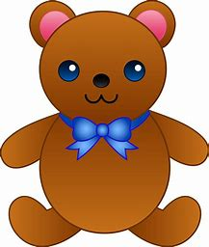
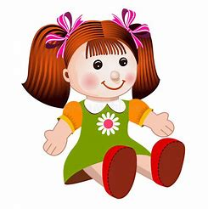
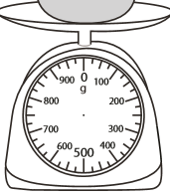
Let’s try a puzzle?
200
= g
= g
Finding how heavy the bear is is easy!
We can read the needle.
It says 200g.

Slide 9
Let’s try a puzzle?
200
= g
200
= g
The bear and the doll together weighs 500g.
We know the bear is 200g on his own.
The doll must be the difference between
500g and 200g.
I’m going to count on to find the difference

Slide 10
100 + 100 + 100 = 300g
+100
+100
+100
200g
300g
400g
500g
I am not going to jump in ones or tens, that would take to long as the numbers are too far apart
I can see these are both hundred numbers as the both end with two zeros. I am going to count in
100s.

Slide 11
Let’s try a puzzle?
200
= g
300
= g
The doll weighs 300 g

Slide 12
A reminder about number lines…..
If your numbers are closer together than mine were think about using jumps of ten and jumps of 1.
Like this:
+10
+10
+1
+1
+1
24
34
44
45
46
47
10 + 10 = 20
20 + 3 = 23
The difference between 24 and 47 is 23.

