Slide 1
Tuesday 14th July2020

Slide 2
Today we are going to be thinking about vocabulary and alphabetical order.
We are going to be thinking about what words mean and how to use the alphabet to help us to order words.

Slide 3
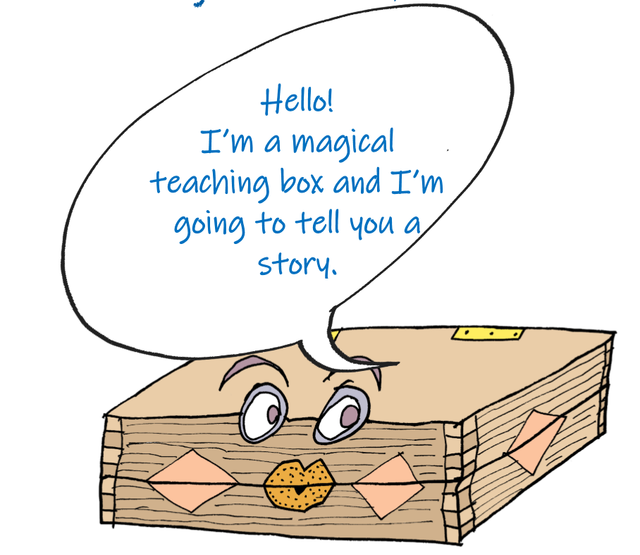
Let’s start by recapping our story
from yesterday.

Slide 4
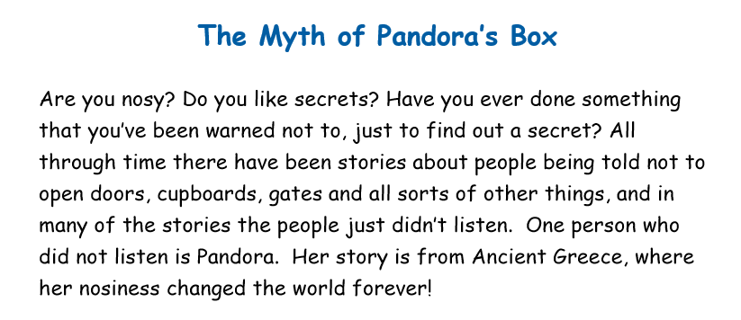

Slide 5
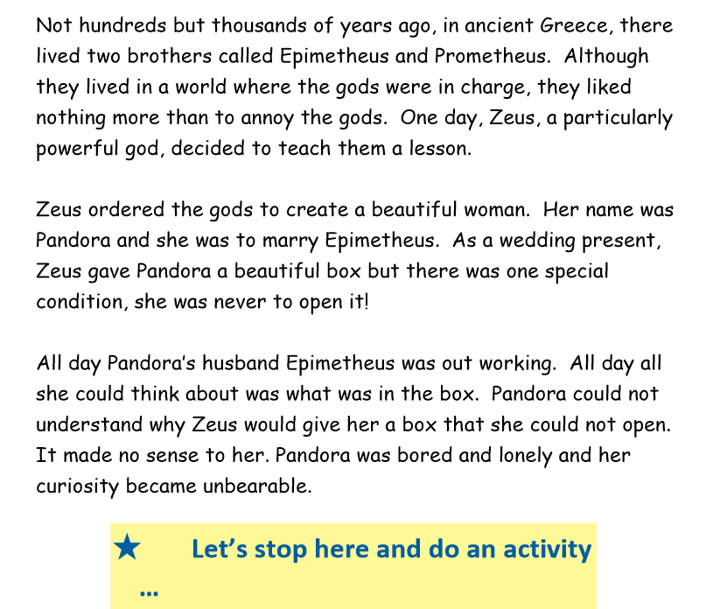

Slide 6
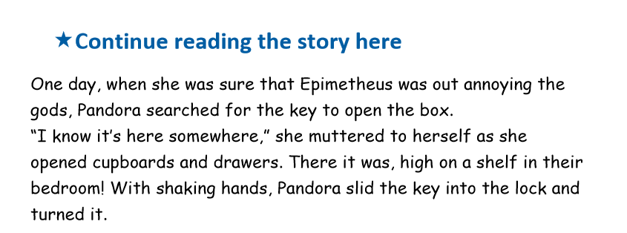
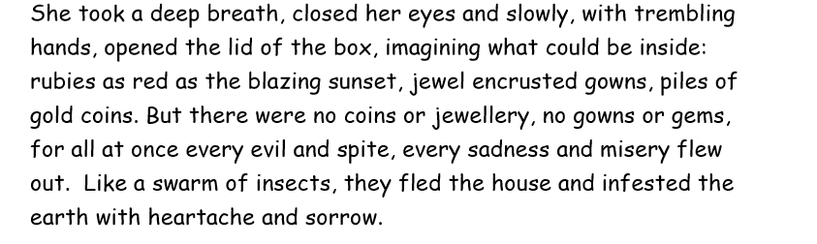

Slide 7
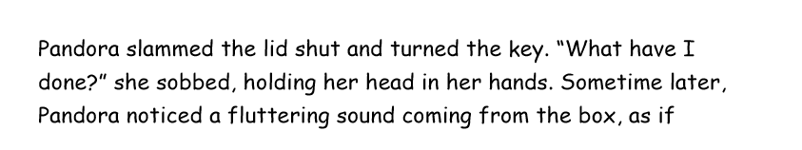
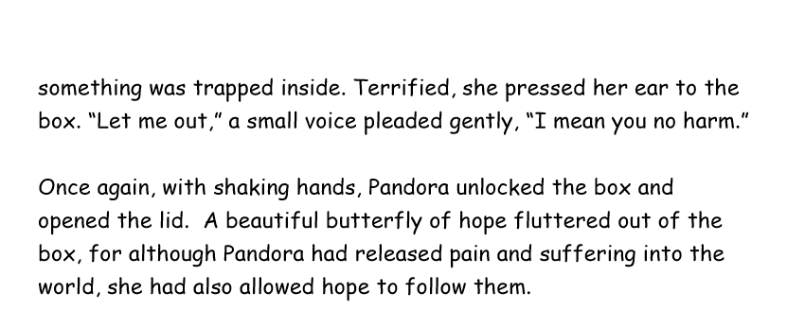

Slide 8
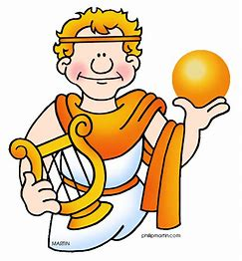
Meet Apollo.
Apollo was the Greek God of knowledge (as well as being the god of lots of other things!)

Slide 9
Apollo is going to be asking us to put words into alphabetical order.
Let’s start by saying the alphabet outloud..
A, B, C….

Slide 10
Alphabetical order
When we put words into alphabetical
order. We are putting them into the
order that they would come in the
alphabet according to the order
of their letters.
These words are in alphabetical order:
Apple carrot strawberry
A is first in the alphabet so apple is first.
then C so carrot is next and finally S for strawberry.

Slide 11
Alphabetical order
If two words start with the same letter,
to decide which one goes first we
must look at the second letter in each
word. Like this:
Digger dog
Both words start with D. If we look at their
Second letter, I comes before O in the
alphabet so digger goes first.

Slide 12
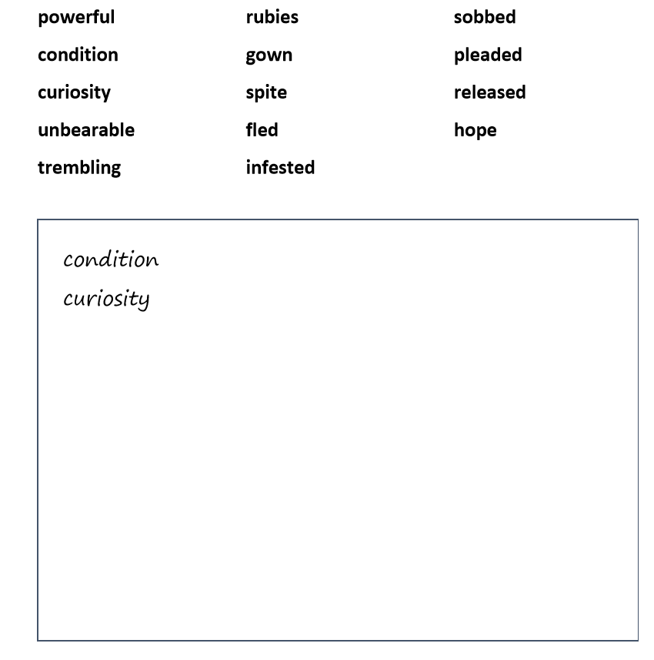
Activity 1
Apollo has been through the story and
he has picked out some of his favourite
words. He would like you to put the
words into alphabetical order.

Slide 13
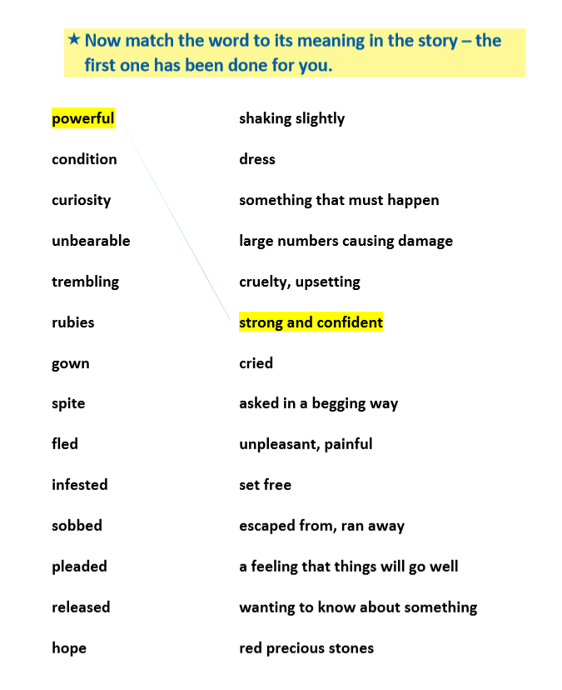
Activity 2
Next, we are going to think about what
words mean.
To do this, we could find the
word in the text by skimming and scanning
with our eyes.
Then we need to read the sentence to help
us work out the meaning.
We could also use a dictionary to help us. (Dictionaries also use a
alphabetical order).
Finally, we will make a matching pair on our
work sheet, like this:

