Slide 1
Week 5 English 3
Reading Activity 2

Slide 2
You need to read the following two slides about the Rainforest animals. Use your green home learning book to write down any notes to help you.

Slide 5
Today you are going to use your tick box table and the information from yesterday to answer some questions.

Slide 6
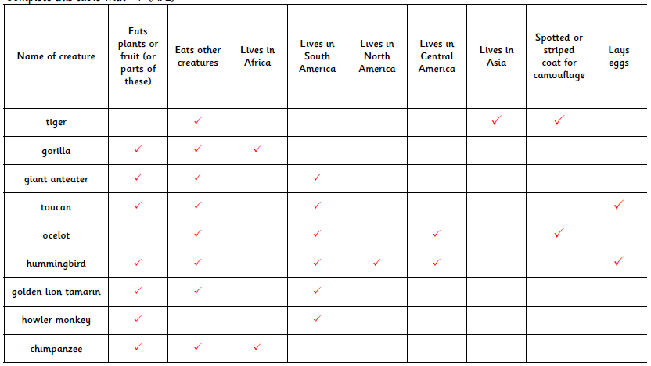

Slide 7
Questions
Why has the writer put the information in boxes?
What does the anteater use to help it eat?
Do you think all birds pick and peel fruit in the same way that a toucan does?
Why do you think that the ocelot has a spotted coat?
Why is a table like that above a good way to present information?
How do you think that the howler monkey got its name?
Why do you think that the ocelot hunts at night?

Slide 8
Answers

Slide 9
Questions
Why has the writer put the information in boxes? To make it easier to read.
What does the anteater use to help it eat? It uses it’s long tongue.
Do you think all birds pick and peel fruit in the same way that a toucan does? No some birds eat fish, seeds, insects etc.
Why do you think that the ocelot has a spotted coat? It acts as a camouflage, in the same way as a tiger’s coat.
Why is a table like that above a good way to present information? Easy to find information.
How do you think that the howler monkey got its name?
From its really loud call that can be heard for mile.
Why do you think that the ocelot hunts at night?
Darkness enables it to creep up and surprise its prey.

