Slide 1
Year 3 – Money
Session 2 – converting between pounds and pence.

Slide 2
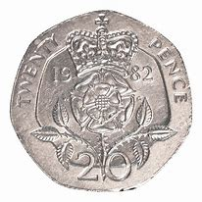
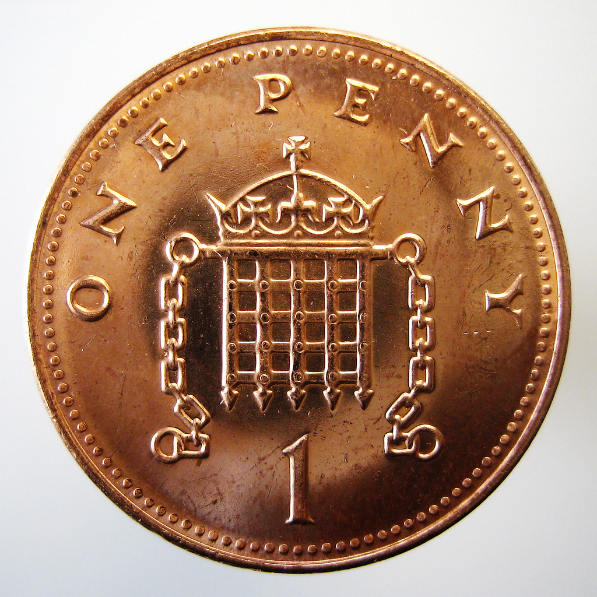
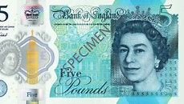
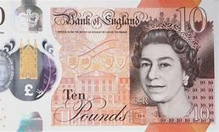
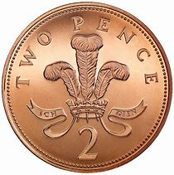
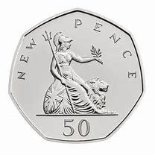
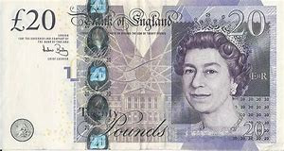
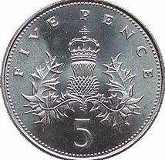
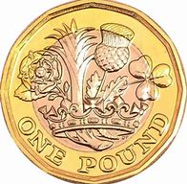
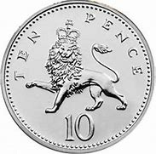
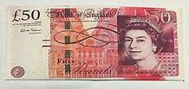
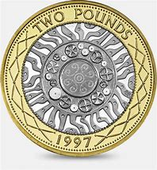
Recap – what are each of these coins and notes?
20p
£5
1p
2p
50p
£10
£20
5p
£1
10p
£2
£50

Slide 3
How many pence are in a pound?
This is 100p
There are 100p in £1
Every time we make 100p we make £1

Slide 4
How many pence are in….
£1 and 23 p
Remember there are 100p in £1
23p
£1 = 100p
Altogether = 100p + 23p = 123p

Slide 5
How many pence are in….
£2 and 42 p
Remember there are 100p in £1
42p
£2 = 2 lots of £1
= 2 lots of 100p
100p + 100p = 200p
Altogether = 200p + 42p = 242p

Slide 6
How many pence are in….
£4 and 68 p
Remember there are 100p in £1
68p
£4 = 4 lots of £1
= 4 lots of 100p
100p + 100p +100p + 100p = 400p
Altogether = 400p + 68p = 468p

Slide 7
Convert into pounds and pence.
HTO
156p
Remember there are 100p in £1
How many pence are left over?
The number of hundreds are the amount of pounds we have
56p
We have 100 = £1
Altogether = £1 and 56p

Slide 8
Convert into pounds and pence.
HTO
238p
Remember there are 100p in £1
How many pence are left over?
The number of hundreds are the amount of pounds we have
38p
We have 200 = £2
Altogether = £2 and 83p

Slide 9
Convert into pounds and pence.
HTO
605p
Remember there are 100p in £1
How many pence are left over?
The number of hundreds are the amount of pounds we have
5p
We have 600 = £6
Altogether = £6 and 5p

Slide 10
Convert into pounds and pence.
ThHTO
1020p
Remember there are 100p in £1
How many pence are left over?
The number of hundreds are the amount of pounds we have
20p
We have 10 hundreds = 1000
1000 = £10
Altogether = £10 and 20p

