Slide 1
Week 5 English 2
Reading Activity 1

Slide 2
You need to read the following two slides about the Rainforest animals.
Use your green home learning book to write down any notes to help you.

Slide 3
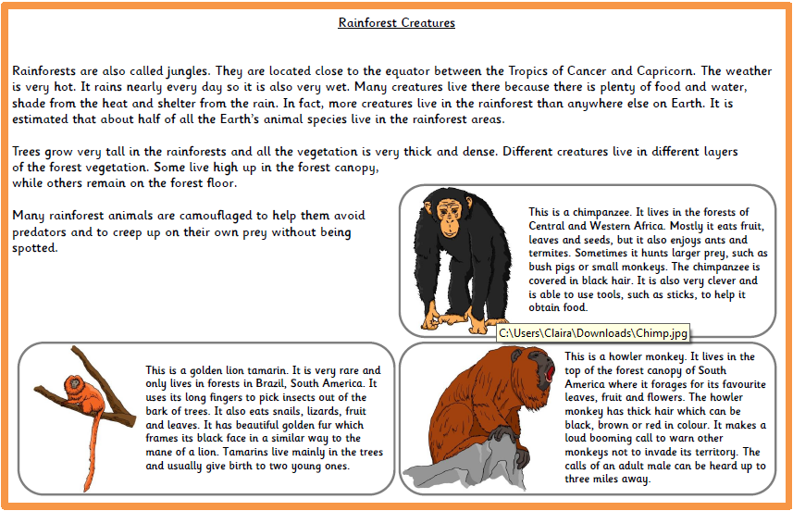

Slide 4
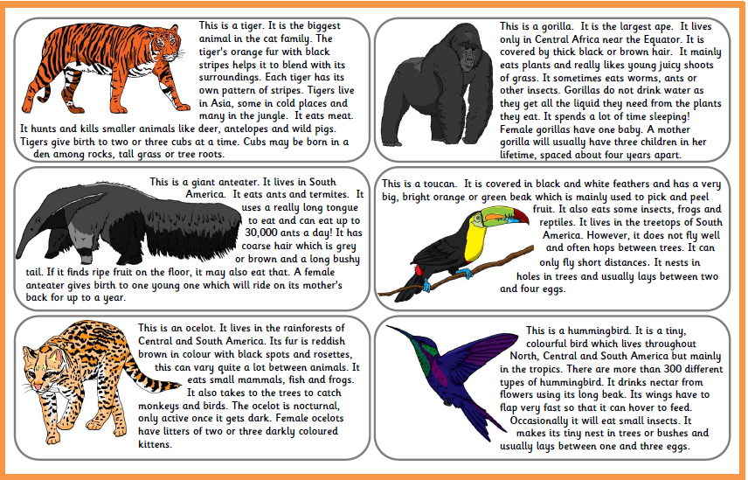

Slide 5
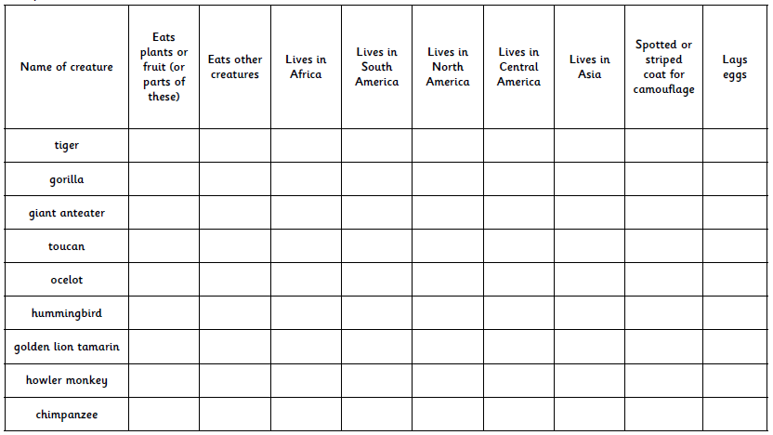
Today you are going to fill out the table by ticking in the correct box.

Slide 6
Answers

Slide 7
