Slide 1
Week 11 English 3
The Girl and the Robot

Slide 2
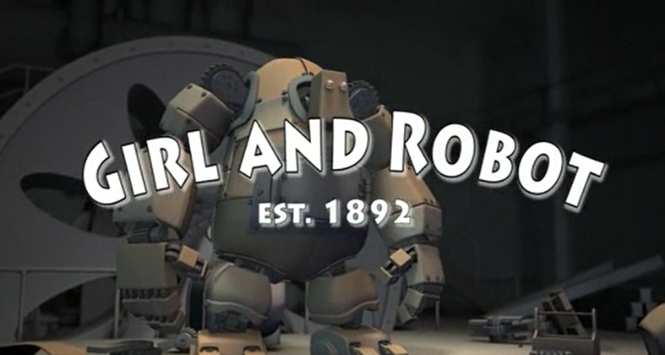
Your story….

Slide 3
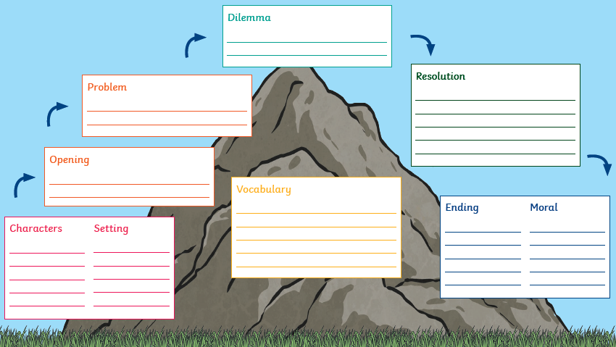
Use your story mountain from yesterday to start writing your story….

Slide 4
Your task…
You are going to write the first part of your story.
Paragraph 1:
Opening - Setting
Paragraph 2:
Introduce characters
Paragraph 3:
Problem

