Slide 1
Week 8 Lesson 3
Equivalent fractions 1

Slide 2
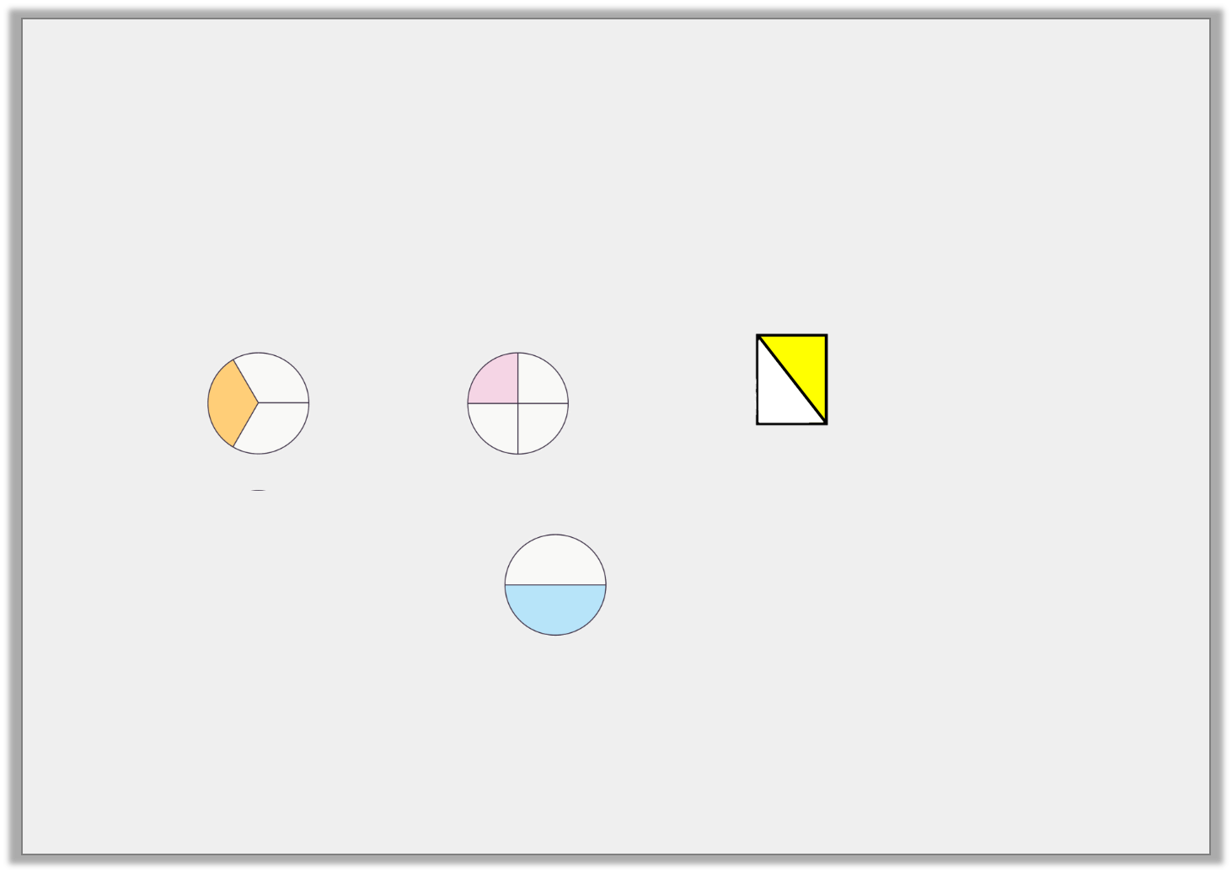
Introduction
Look at the fractions below… do you think any of them are the same?
1
2
1
4
1
3

Slide 3
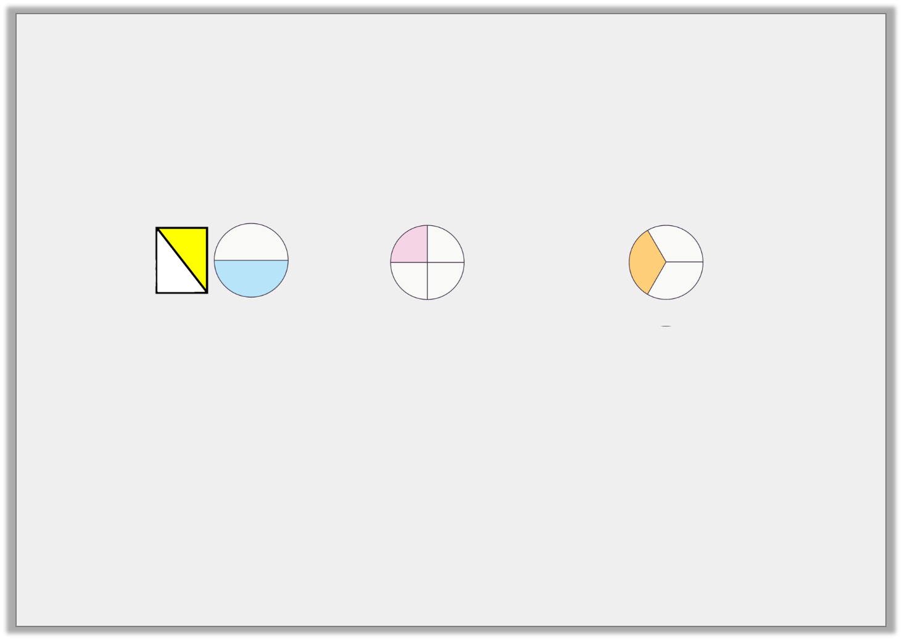
Introduction
Do they all match up? Explain why/why not.
This shape does not match as it has not been split into 2 equal parts.
1
2
1
4
1
3

Slide 4
Varied Fluency 1
I have shown you what the images represent…
1 | = | 2 | = | 3
3 |  | 6 |  | 9

Slide 5
Varied Fluency 2
Which shapes show equivalent fifths?
Equivalent means the same.
Shape A
Shape B
Shape C

Slide 6
Varied Fluency 2
Which shapes show equivalent fifths?
Shape A
Shape B
Shape C

Slide 7
Varied Fluency 3
Which 2 fractions are equivalent. If it helps… you could draw them in your book.
1 |  | 1 |  | 3 |  | 2
5 |  | 8 |  | 15 |  | 4

Slide 8
Varied Fluency 3
These two fractions are the same.
1 |  | 1 |  | 3 |  | 2
5 |  | 8 |  | 15 |  | 4

Slide 9
Varied Fluency 4
Complete the statements.
1 | =
6 |  | 24
1 | =
10 |  | 30

Slide 10
Varied Fluency 4
Complete the statements.
1 | = | 4
6 |  | 24
1 | = | 3
10 |  | 30

