Slide 1
Monday 1st June
Grammar recap

Slide 2
For the next 2 days we are going to be revising and practising our Year 3 Grammar skills. Each day, we will go over the skills in our Powerpoint and then you will have a mixed bag of grammar questions to answer as your activity.

Slide 3
Year 3 Spellings This week I would like you to practise these 10 spellings. Let’s explore a few in more detail.
Year 3 statutory spelling words
believe
strength
possible
remember
circle
weight
gym
naughty
potatoes
breathe

Slide 4
Week 20: Friday
breathe
Click on the word to see the meaning
Syllables: 1 (breathe)
Definition: To take air into the lungs and then expel it.
Surface Scribe
Write this word with your finger on as many different surfaces as possible.
Ink Instructor
Can you write a short set of instructions including this word?

Slide 5
Week 11: Wednesday
remember
Click on the word to see the meaning
Syllables: 3 (re-mem-ber)
Definition: To think about something or someone from the past.
Mix and Match
How many different types of handwriting can you use to write this word?
Headline Homework
Write one or more newspaper headlines using this word.

Slide 6
Week 11: Monday
circle
Click on the word to see the meaning
Syllables: 2 (cir-cle)
Definition: A round shape with no vertices, where the edge is always an equal distance from the centre.
Question Time
Write a question using the word.
Crossword Conundrum
Write a clue which could be used for this word if it was an answer in a crossword.

Slide 7
Week 21: Friday
naughty
Click on the word to see the meaning
Syllables: 2 (naugh-ty)
Definition: Badly behaved or disobedient.
Wrong Handed!
Can you write this word with the hand you do not normally write with? How neat can you make it?

Slide 8
Year 3 Grammar Plurals Adverbs Past and Present perfect tense Subordinating conjunctions Direct speech

Slide 9
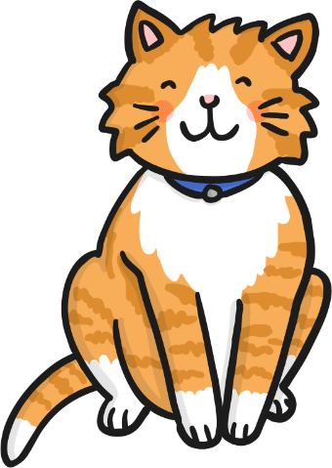
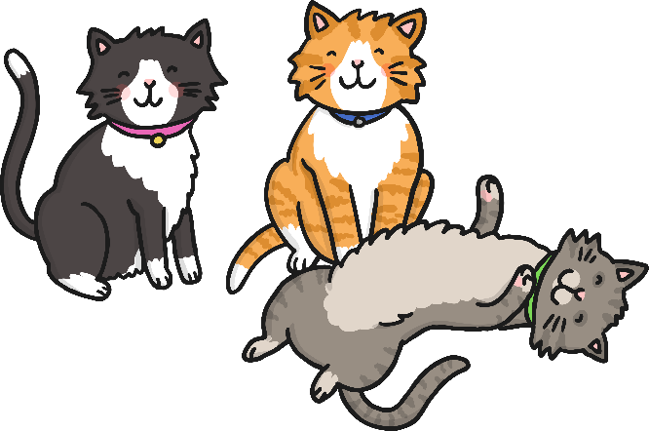
What is a plural?
Plural means ‘more than one’.
one cat
three cats

Slide 10
Singular = 1
Plural = more than 1
One dog
Lots of dogs
One door
Lots of doors
One pencil
Lots of pencils
One lamp
Lots of lamps

Slide 11
If the word ends with one of these sounds…
sh
ch
ss
s
x
z
…then add ‘es’

Slide 12
To change these words in to plurals, add ‘es’.
one brush
two brushes
box
boxes
dish
dishes
glass
glasses
church
churches

Slide 13
Some plurals are irregular and do not fit either pattern… man – men child – children woman – women person - people
Can you work out these irregular plurals?
Tooth
Foot
mouse

Slide 14
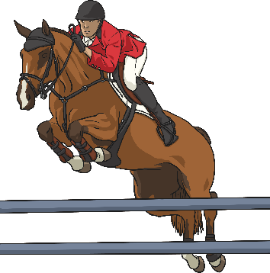
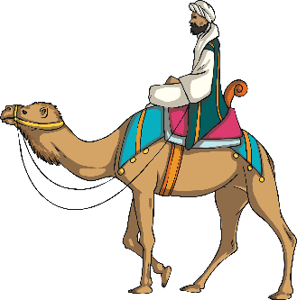
What is an Adverb?
An adverb is something that tells you where, why or how something is done. For example:
Camilla crossed the road safely.
Saffie’s horse bravely jumped over the hurdle.
The Moroccan man rode his camel everywhere.
Many adverbs end in –ly but not all of them. Similarly, not all words which end in –ly are adverbs.

Slide 15
When we are writing instructions we can use adverbs of time at the front of each step like this.. First, Next, After that, Finally,

Slide 16
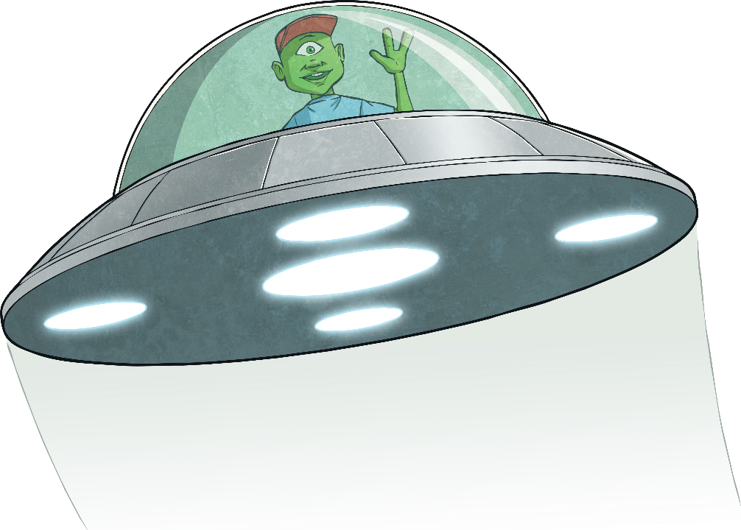
Past tense
The sentence below is written in the past tense.
Timmy was in his spaceship for twenty years.
It is in the past because it has already happened.
A majority of past tense verbs end in ed. Jumped skipped
Some have their own pattern. Ran sang

Slide 17
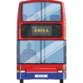
What Is a Subordinating Conjunction?
A subordinating conjunction is a word which still links two clauses together in a sentence, but the subordinate clause it adds does not make sense on its own.
Let’s look at a few examples:
I will be late if I don’t get on the next bus.
Main Clause
Subordinating Conjunction
Subordinate Clause
‘I will be late’ is the main clause. This clause makes sense on its own.
The subordinating conjunction in this sentence is ‘if’. It starts the subordinate clause.
‘if I don’t get on the next bus’ is the subordinate clause. This doesn’t make sense on its own but does add extra information to the main clause.

Slide 18
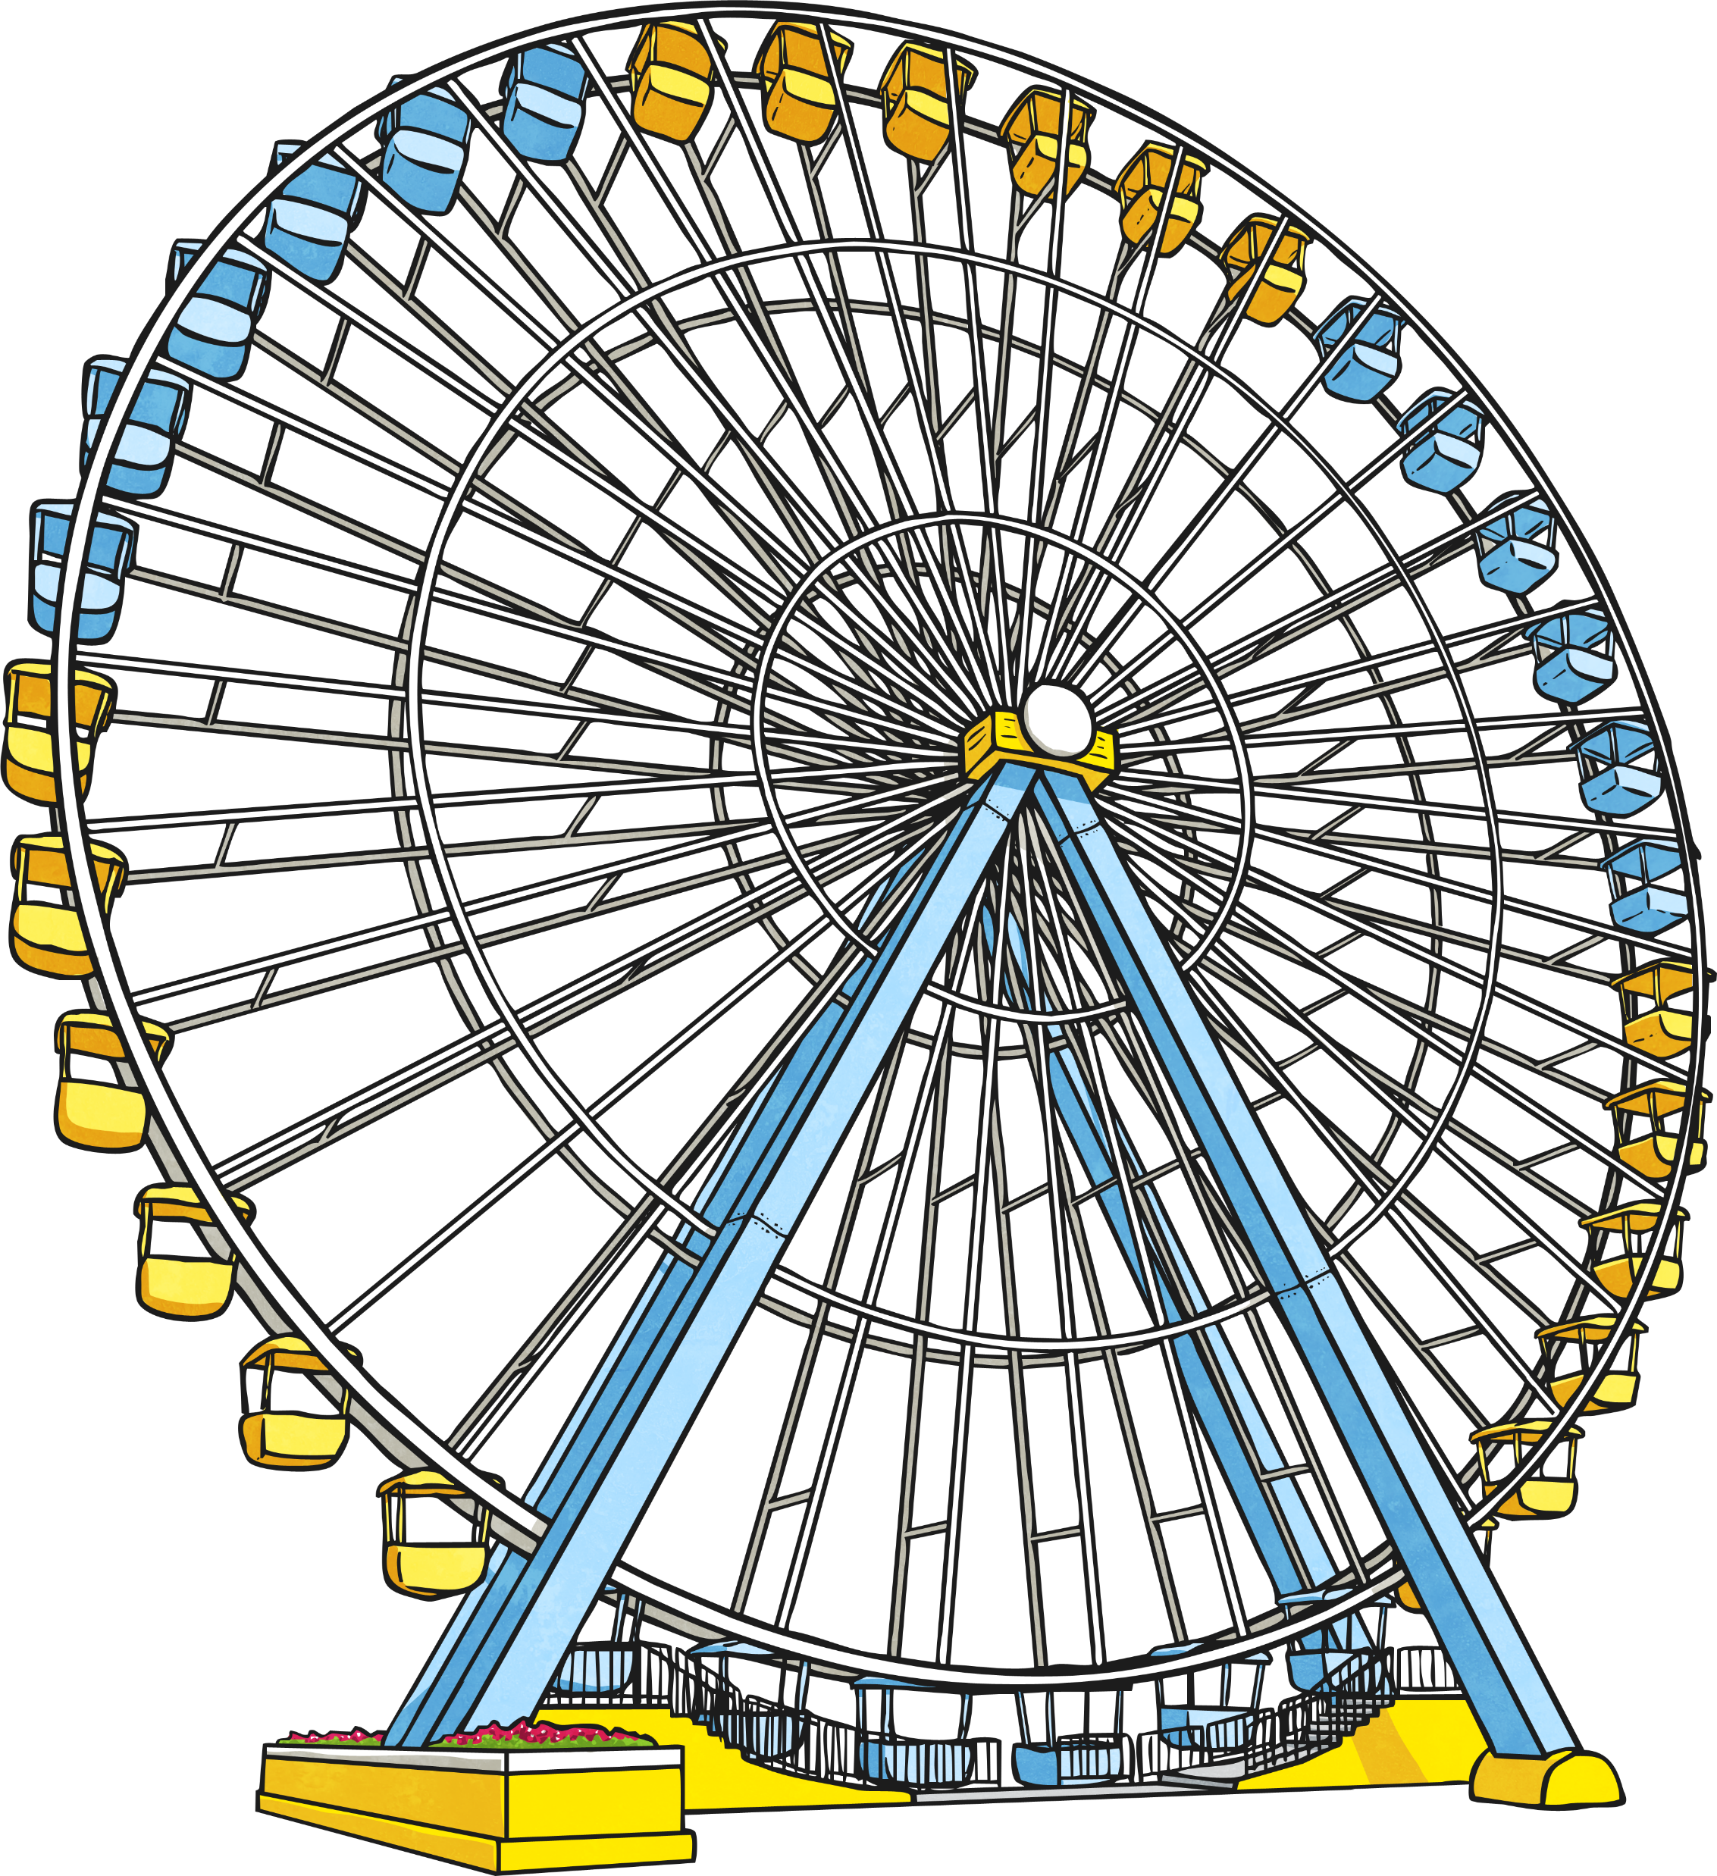
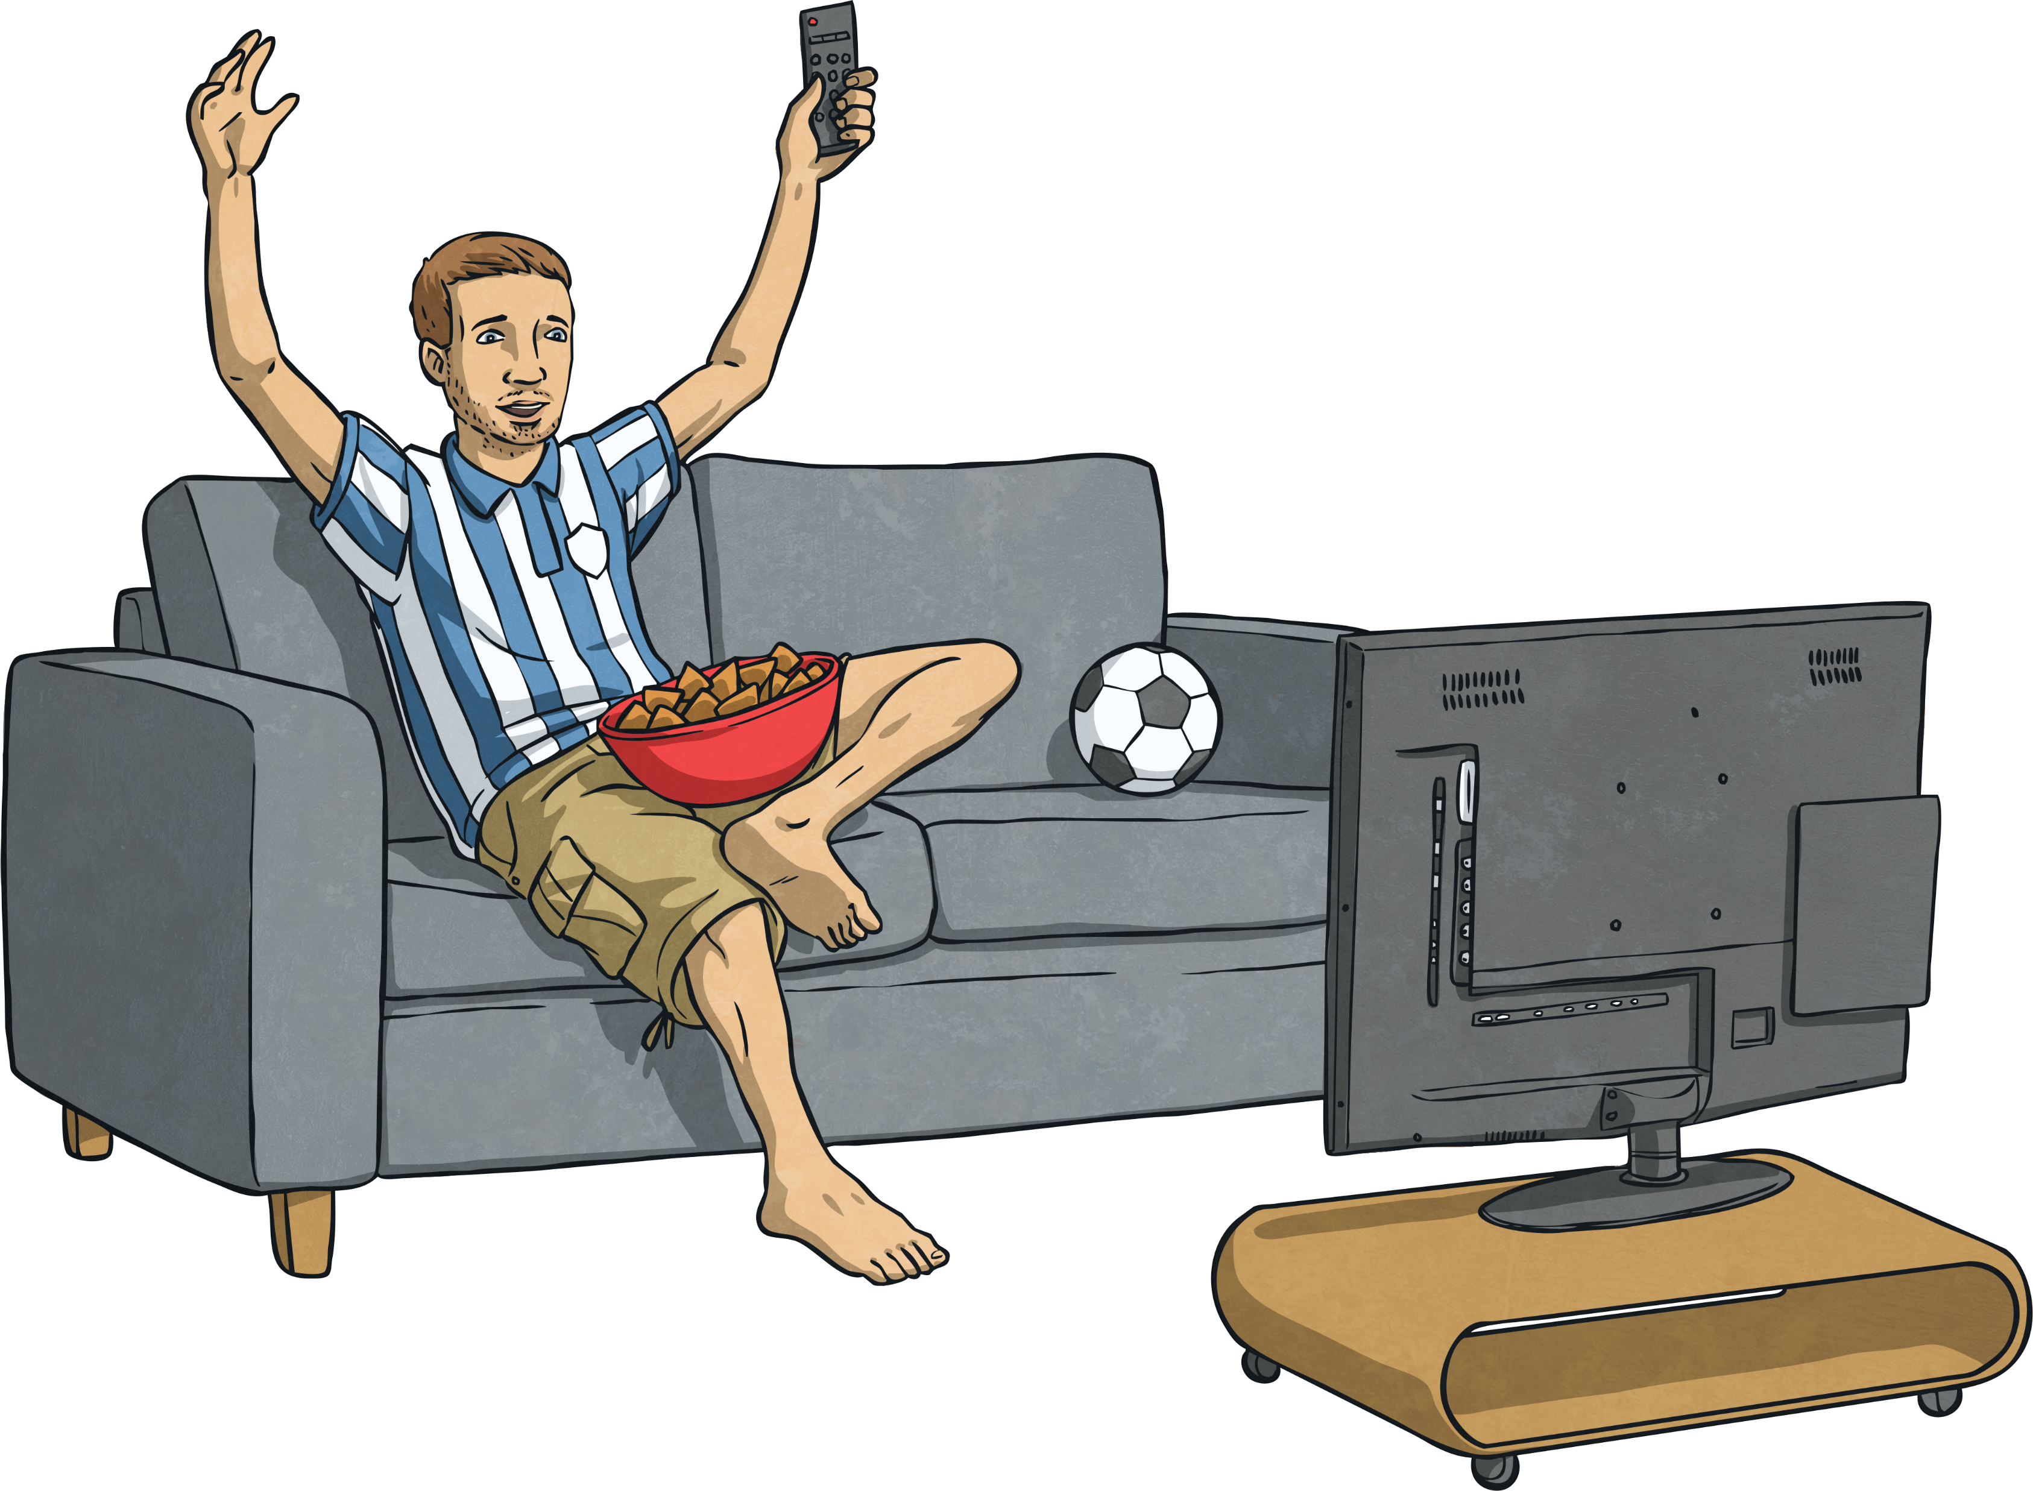
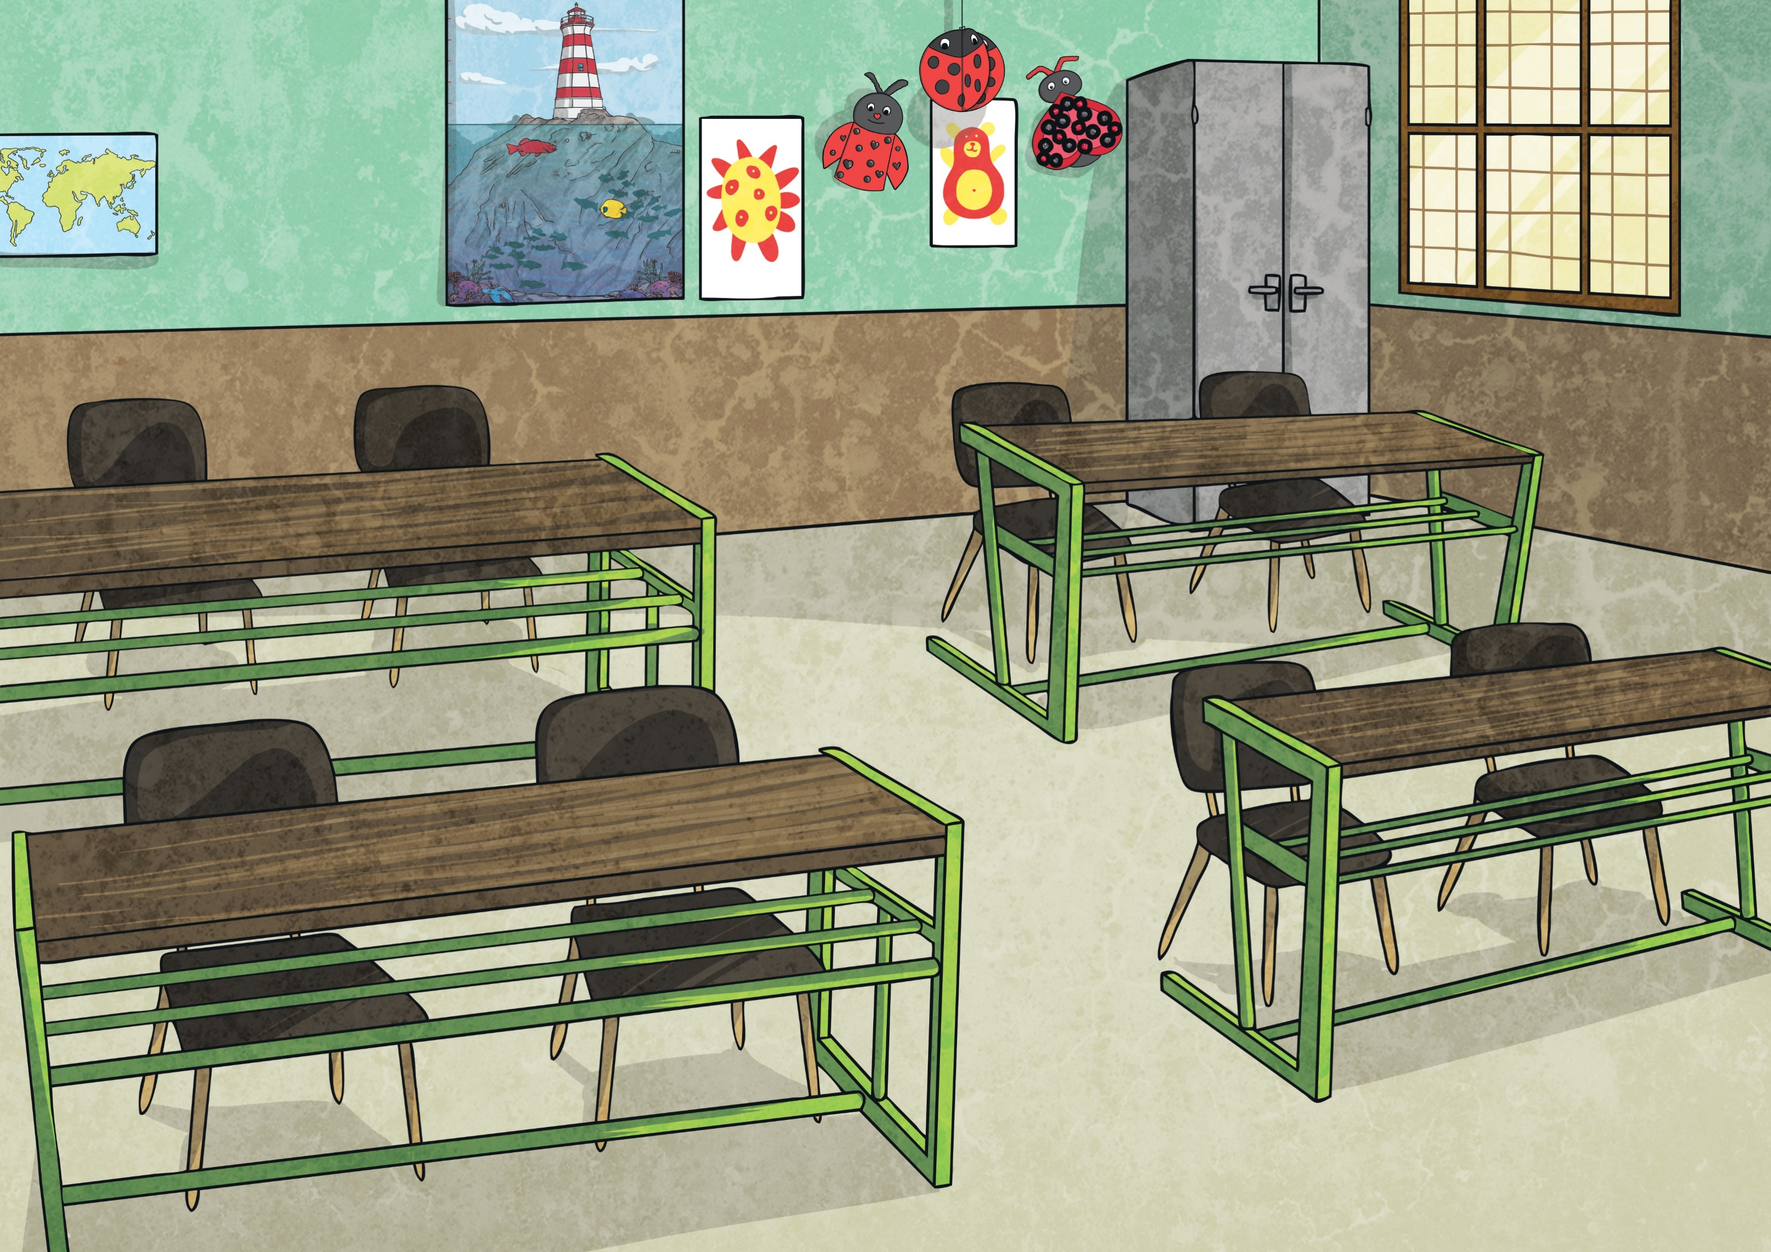
Which Conjunction Makes Sense?
Read the main and subordinate clauses below and decide which subordinating conjunction would make the most sense.
Beth was a little bit scared the ride was spinning quickly.
Hazim cheered loudly his favourite player scored a goal.
I didn’t go to school it was closed for the summer holidays.
If Since As When Although While After Before Until Because

Slide 19
Direct speech
There are two places where inverted commas are needed when writing direct speech:
“What’s the matter, Dina?” said Sid.
Inverted Commas
Inverted Commas
You need to open your inverted commas with a “ (66) before the first word which is
being spoken.
You need to close your inverted commas with a ” (99) after the last word which is being spoken.
Imagine that inverted commas are like hands;
They hold within them only the words which are being spoken.
“What’s the matter, Dina?” said Sid.
Back

Slide 20
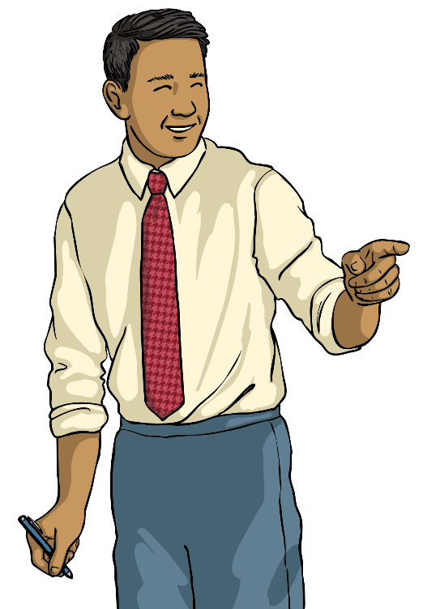
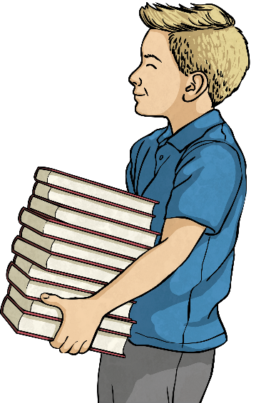
It’s Your Turn…
Here is a conversation between Mr. Miller and Max. Write the direct speech on a whiteboard using inverted commas and the correct punctuation.
Where more than one person is talking, remember to start new line for each new speaker.
Mr Miller
Please could you take those to Jessica’s classroom?
No problem, sir.
Max

Slide 21
Now that we’ve had a quick recap… Can you complete your activity mat?

