Slide 1
Maths Week 4 Lesson 3
Find start and end times

Slide 2
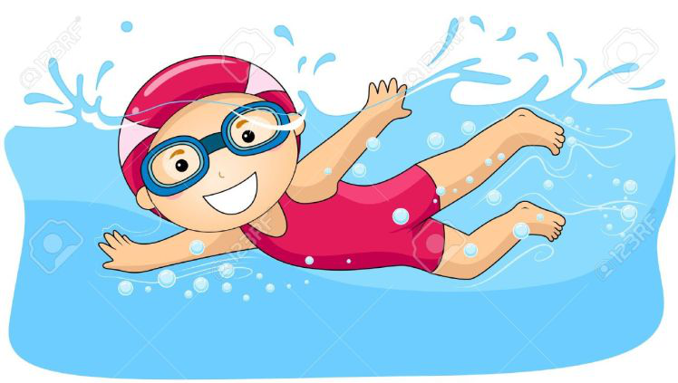
Let’s recap yesterday’s lesson….
On Saturday Daisy swam her mile challenge. She started at 12:30 and finished at 14:05.
On Wednesday Daisy swam her mile challenge again. She started at 11:00 and finished at 13:35.
Which day did Daisy swim her challenge the quickest? Saturday or Wednesday?

Slide 3
Let’s recap yesterday’s lesson….
On Saturday Daisy swam her mile challenge in 1 hour and 35 minutes.
On Wednesday Daisy swam her mile challenge in 2 hours and 35 minutes.
She was quicker on Saturday because on the Wednesday she was on hour slower.

Slide 4
You can use a time line to help find the end times.
Start at 14:00 lasts 50 minutes
+ 50 minutes
Start 14:00
End: 14:50
Start 18:45 lasts 30 minutes
+ 15 min
+ 15 min
Start 18:45
19:00
19:15
Count to the next hour
We’ve added 15 minutes but we wanted to add 30. We need to add an extra 15 minutes

Slide 5
TV Timetable Quiz!

Slide 11
Answers!

Slide 12
15:35

Slide 13
16:55

Slide 14
12:53

Slide 15
13:15

Slide 16
16:57

