Slide 1
Week 11 Maths 1 and 2

Slide 2
A right angle
This is a right angle
What do we notice about the lines?
How can we describe the lines?
Are they following a pattern?
Do they go in a particular direction for each right angle?

Slide 3
A right angle
For a right angle we need 2 lines
One goes from top to bottom
It is a called a vertical line
The other goes from side to side
It is called horizontal

Slide 4
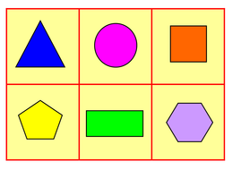
Identifying lines
Look at the following shapes.
How many vertical or horizontal lines can we spot?

Slide 5
Parallel and Perpendicular Lines
Lines are parallel if they never intersect and are always the same distance apart (equidistant).
B
D
We show lines are parallel using arrows.
A
C
Lines are perpendicular if they join at right angles.
C
A
We use this symbol to show a right angle.
B
D

Slide 6
Let us look at these shapes again.
Do nay of them have parallel or perpendicular lines?

