Slide 1
Week 11 English 2
The Girl and the Robot

Slide 2
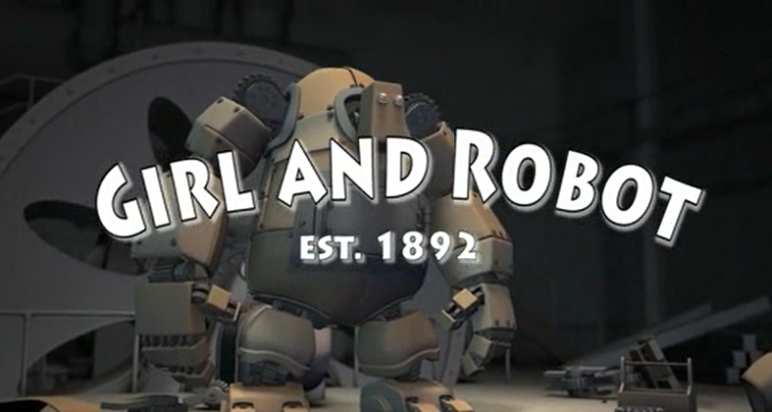
Re watch the clip from yesterday….
https://www.literacyshed.com/girlandrobot.html

Slide 3
Your task…
Use the story plan to plan your own version of the Girl and the Robot
Think about:
Characters/ Settings
How does it start?
What is the problem?
How is it resolved?

Slide 4
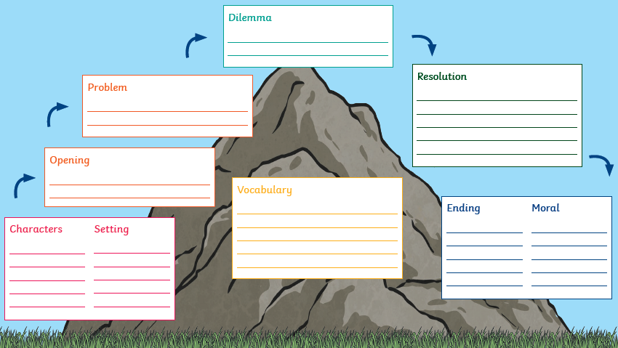
Use the story map to plan your version:

