Slide 1
Week 8 Maths Lesson 1 & 2
Non Unit Fractions

Slide 2

Introduction
Match the fractions below.
One half
Three quarters
One third
One quarter
3
4
1
2
1
4
1
3

Slide 3
Introduction
Match the fractions below.
One half
Three quarters
One third
One quarter
1
2
=
=
=
3
4
=
1
3
=
=
=
1
4
=

Slide 4
Varied Fluency 1
Circle the fraction represented below.
3
4
4
9
5
4

Slide 5
Varied Fluency 1
Circle the fraction represented below.
3
4
4
9
5
4

Slide 6
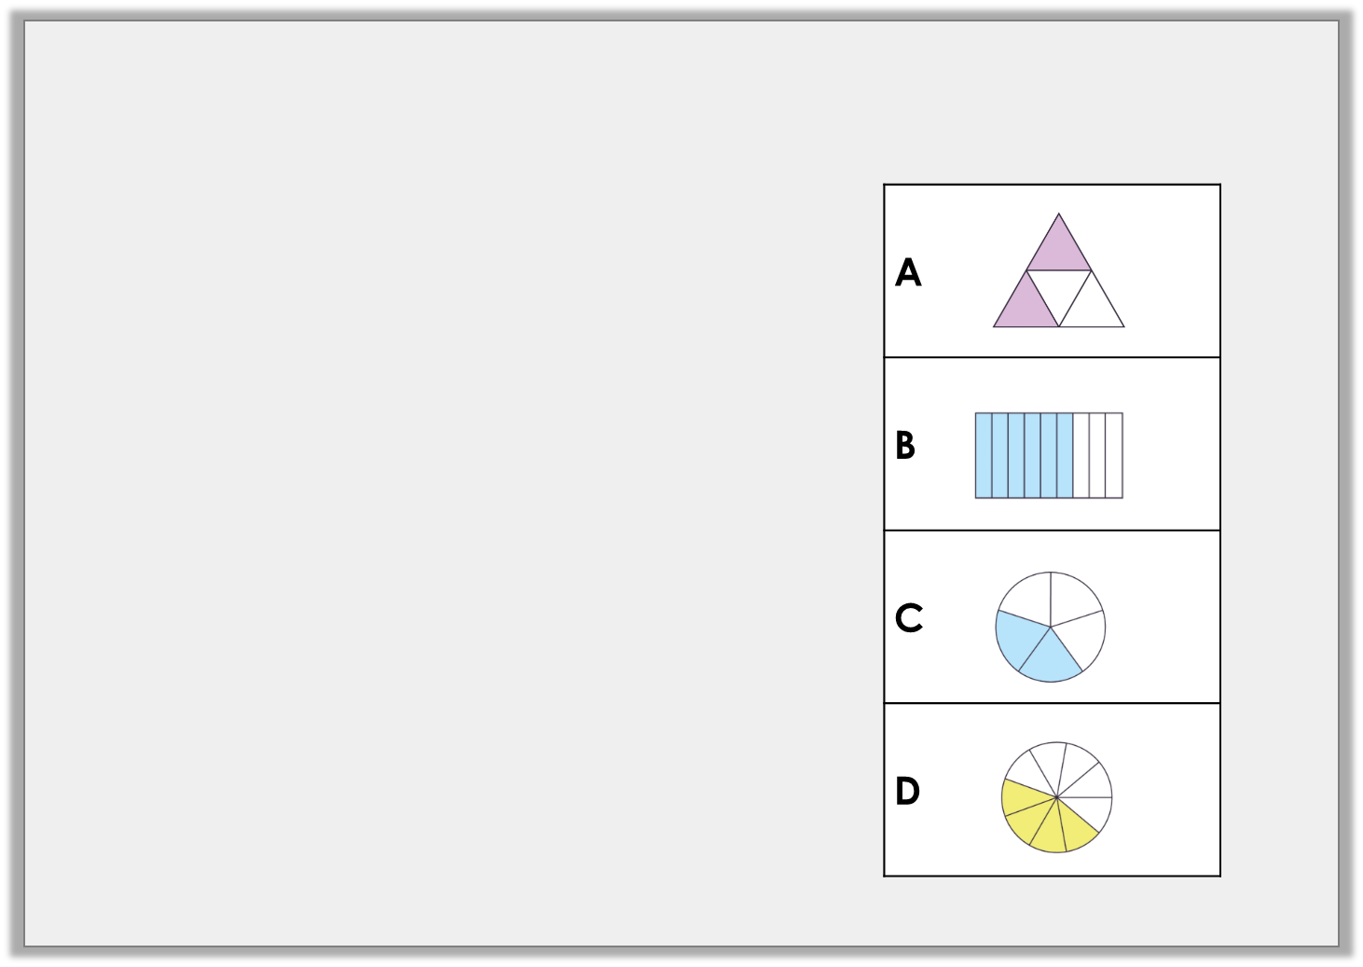
Varied Fluency 2
Match the fraction to its representation.
Four out of nine equal parts
Six ninths
2
4
.
.
2
5
.
.

Slide 7
Varied Fluency 2
Match the fraction to its representation.
Four out of nine equal parts
Six ninths
2
4
.
.
2
5
.
.

Slide 8
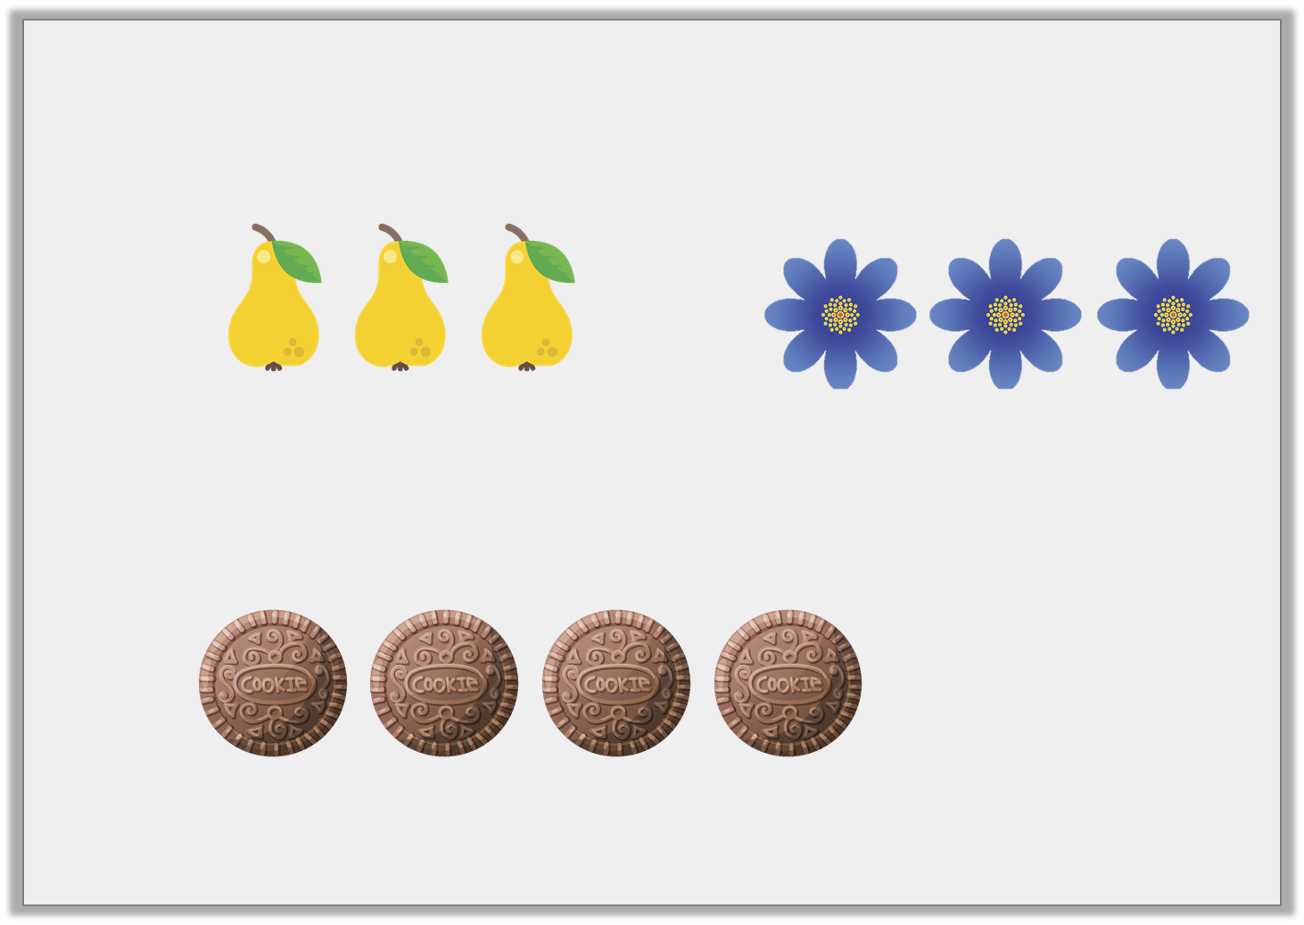
Varied Fluency 3
Find the odd one out in the fractions below.
A. |  | B.
C.

Slide 9
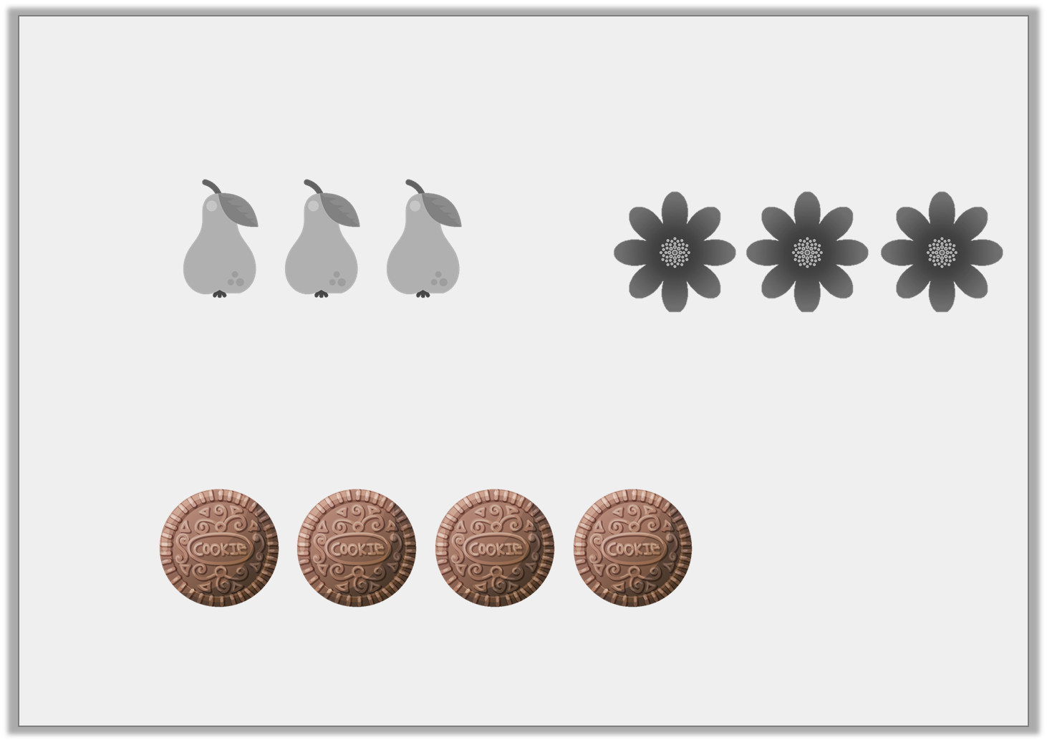
Varied Fluency 3
Find the odd one out in the fractions below.
A. |  | B.
C.

Slide 10
Varied Fluency 4
Sort the fractions below.
Unit fractions | Non-unit fractions
9
10
Four sevenths
5
9

Slide 11
Varied Fluency 4
Sort the fractions below.
Unit fractions | Non-unit fractions
Four sevenths
9
10
5
9

Slide 12

Reasoning 1
True or false? All the fractions can all be matched to a representation below. Explain your answer.
1
11
1
9
Three out of seven
2
5
A. |  | B. |  | C.

Slide 13
Reasoning 1
True or false? All the fractions can all be matched to a representation below. Explain your answer.
False, cannot be matched to any of the representations, because there are no representations split into eleven equal parts.
1
11
1
9
Three out of seven
2
5
A. |  | B. |  | C.
1
11

Slide 14
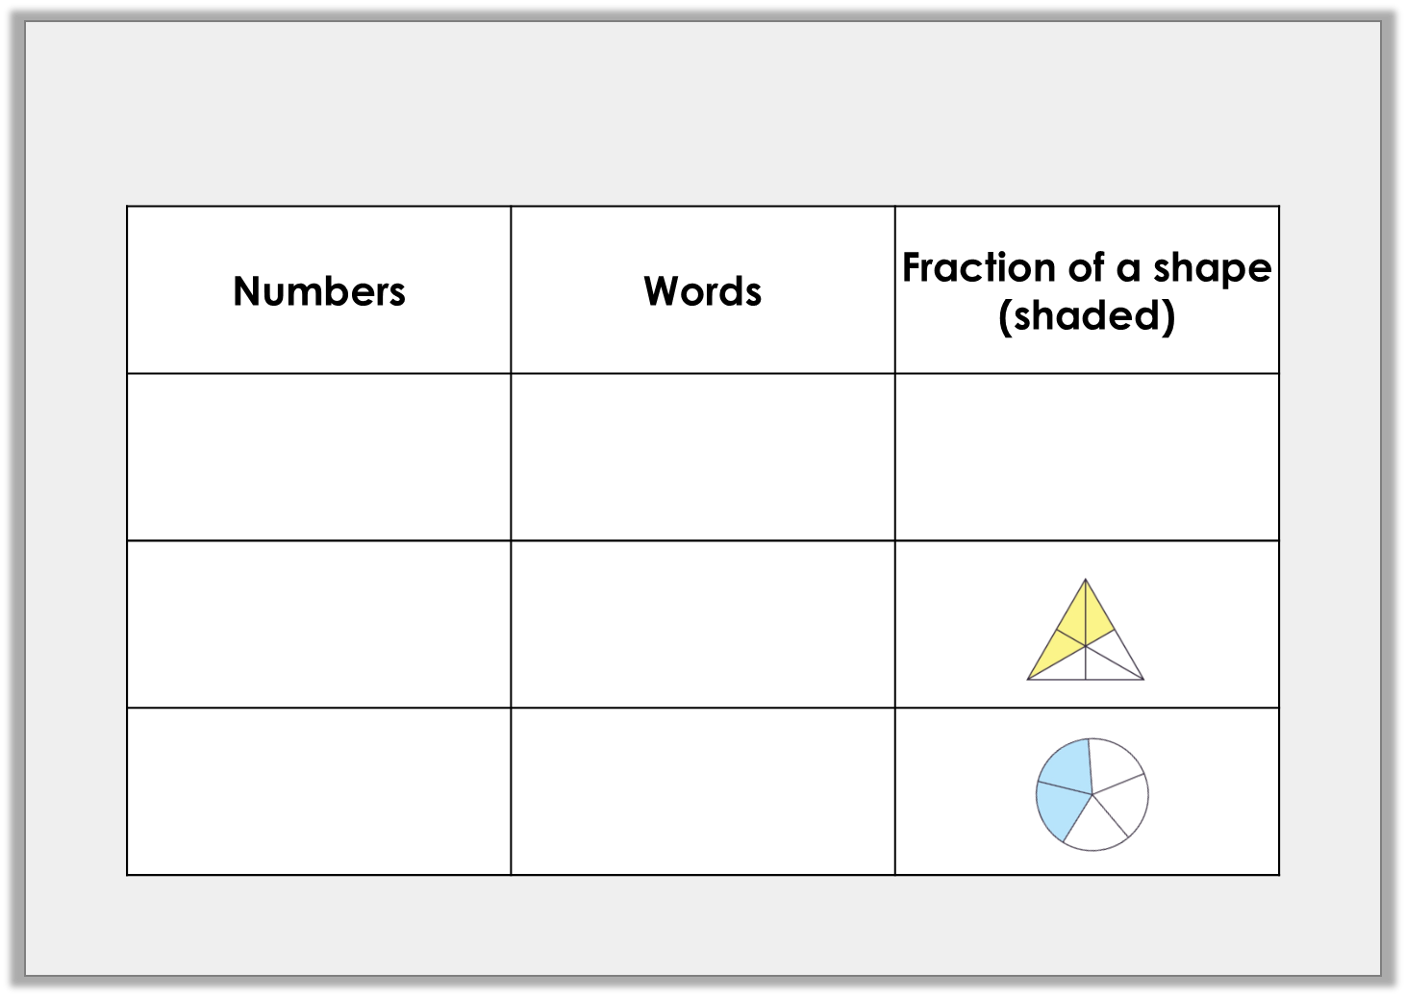
Problem Solving 1
Complete the table.
9
10

Slide 15
Problem Solving 1
Complete the table.
9
10
Nine tenths
3
Three sixths
6
2
Two fifths
5

Slide 16
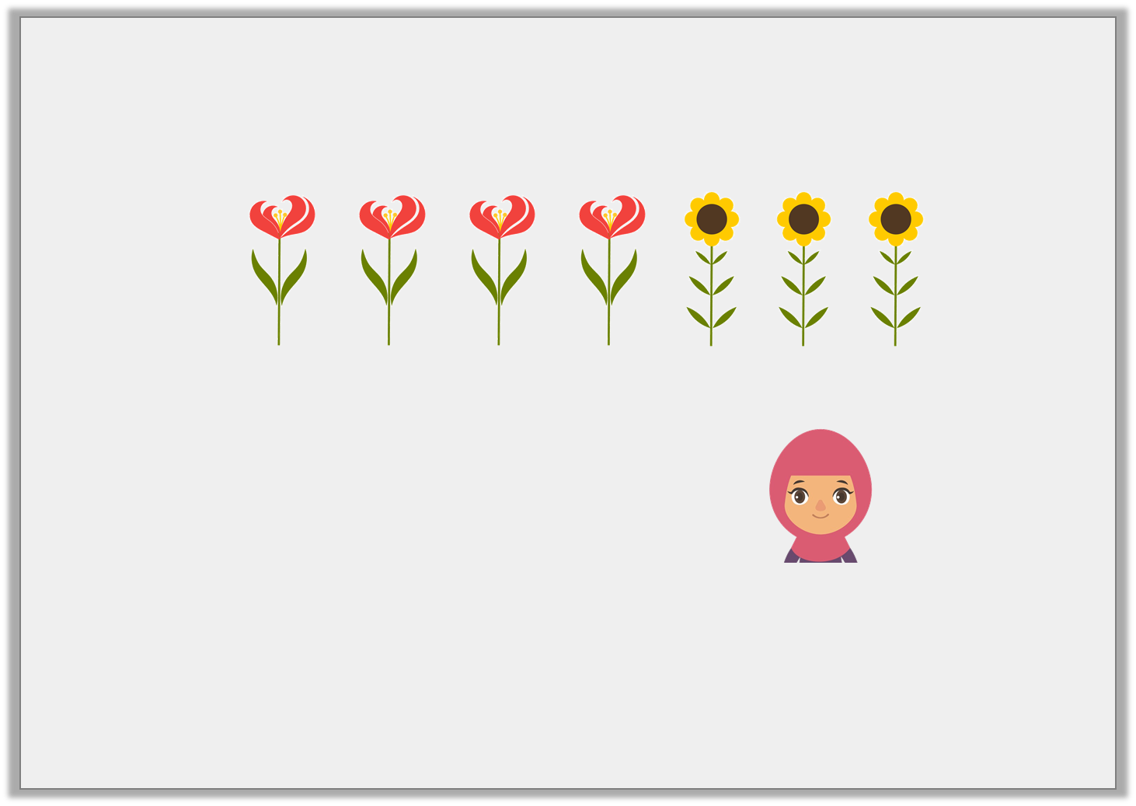
Reasoning 2
Sally has picked some flowers.
She says,
Do you agree? Explain your reasoning.
I can use a unit fraction to describe the sunflowers.

Slide 17
Reasoning 2
Sally has picked some flowers.
She says,
Do you agree? Explain your reasoning.
No because…
I can use a unit fraction to describe the sunflowers.

Slide 18
Reasoning 2
Sally has picked some flowers.
She says,
Do you agree? Explain your reasoning.
No because of the flowers are sunflowers which is a non-unit fraction.
I can use a unit fraction to describe the sunflowers.
3
7

