Slide 1
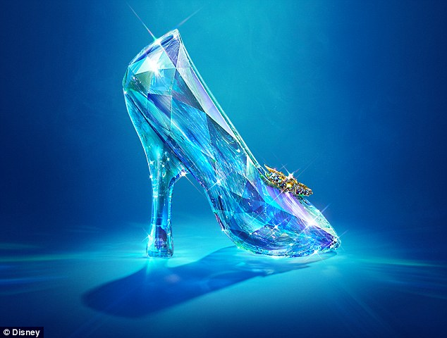
You are going to watch a short clip the Cinderella trailer. When you have finished watching you will ask three questions.
https://www.youtube.com/watch?v=_wppM8ycod0

Slide 2
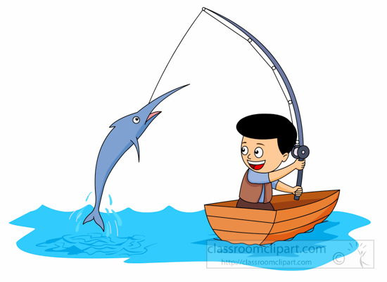
RETRIEVE
Can you find information in the text?
What do certain words mean? (Dictionary)
Look through the text carefully and highlight or underline the words which answer the questions.

Slide 3

INFER
How are the characters feeling?
Why did they do or say that?
What might happen next?
Unlock information from the clues given in the text.

Slide 4

CHOICE
Which words help you understand what is happening?
What techniques has the author used to describe?
How has the author organised or presented the text?
Think carefully about the author’s choice and what they have done to make the text interesting and enjoyable to read.

Slide 5
Retrieve:
What colour is the butterfly?
Infer:
What was this video for? What hints in the clip tell us this?
Choice:
Why has the producer chosen to use this music?

