Slide 1
Week 8 Lesson 3
Preposition of Place Writing

Slide 2
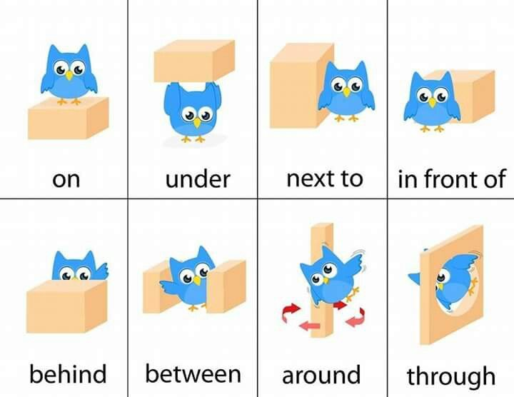
You have just been working with prepositions of place
Prepositions of place are words that tell the reader where something is.
When we are writing, we can use prepositions to:
Make our work clear
Improve our work
Vary or change our sentence openers

Slide 3
SC: report on what I saw and where I saw it.
Action (what happens)
Preposition of place
Notes:
Visual summary

Slide 4
Next to the river, the people sat to eat their lunch.
Notes:
Modelled writing – encourage the comma after preposition of place (remind how it’s a MUST in Y4 so why not start now)?
Chn can think of the action first if they’re struggling.
I.E. Next to the river, Romans were practising with swords.
Far from my tent, there were lots of shields.

Slide 5
Behind the bench, birds were eating the crumbs.

Slide 6
Preposition of place
You are going to finish the sentences to make the preposition of place make sense.

