Slide 1
Maths Week 9 Lesson 4
Ordering Fractions 2

Slide 2
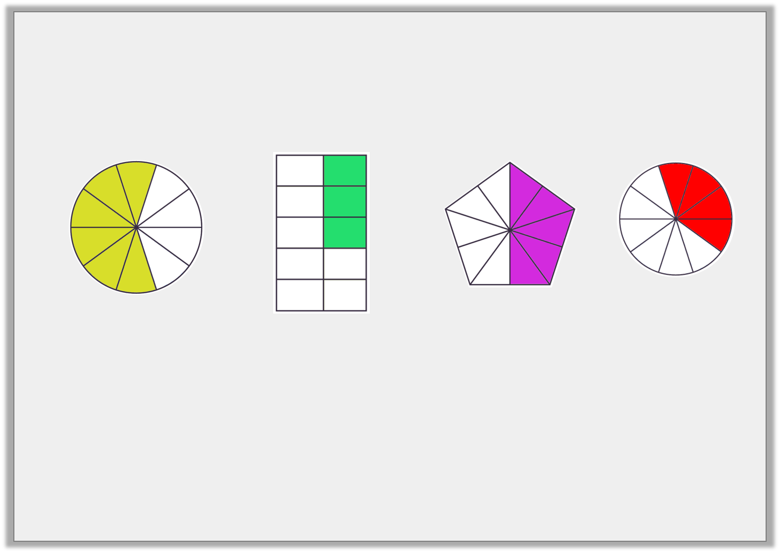
Reasoning 1
Sally has put these fractions in order from smallest to largest. Is she correct?
Explain your answer.
1
2
3
4
© Classroom Secrets Limited 2019

Slide 3
Reasoning 1
Sally has put these fractions in order from smallest to largest. Is she correct?
Explain your answer.
Sally is incorrect because…
1
2
3
4
© Classroom Secrets Limited 2019

Slide 4
Reasoning 1
Sally has put these fractions in order from smallest to largest. Is she correct?
Explain your answer.
Sally is incorrect because 1 is larger than 2 and 3, and 4 is smaller than 1 and 3.
1
2
3
4
© Classroom Secrets Limited 2019

Slide 5
Problem Solving 1
Use the images to help you complete the fractions.
What is the next fraction in this sequence?
© Classroom Secrets Limited 2019

Slide 6
Problem Solving 1
Use the images to help you complete the fractions.
What is the next fraction in this sequence?
6
11
© Classroom Secrets Limited 2019

Slide 7
Problem Solving 2
Which is the incorrect fraction in this sequence?
1
2
3
4
5
© Classroom Secrets Limited 2019

Slide 8
Problem Solving 2
Which is the incorrect fraction in this sequence?
1
2
3
4
5
© Classroom Secrets Limited 2019

