Slide 1
Year 3 – Money
Session 6 – problem solving
Note: in Year 3 money is written as pounds and pence. Children learn the decimal point for money in Year 4 when they learn decimals.

Slide 2
Sophie bought a comb for £2 and 60p and some crayons for £4. How much did she spend altogether?
The key word is altogether. We want to find a total.
£2 and 60p + £4
Add the pence first.
Then the pounds
There is just 60p.
£2 + £4 = £6
Altogether = £6 and 60p

Slide 3
Tom bought a game for £4 and 40p and some chocolate for £1 and 75p. How much money did he spend altogether?
The key word is altogether. We want to find a total.
£4 and 40p + £1 and 75p
Add the pence first.
Then the pounds
40p + 75p = £1 and 15p
£4 + £1 = £5
Altogether = £6 and 15p

Slide 6
Add together the two shirts.
£20 and 50p + £27 and 90p =
Add the pence first.
Then the pounds
50p + 90p = £1 and 40p
£20 +£27 = £47
Altogether = £48 and 40p

Slide 7
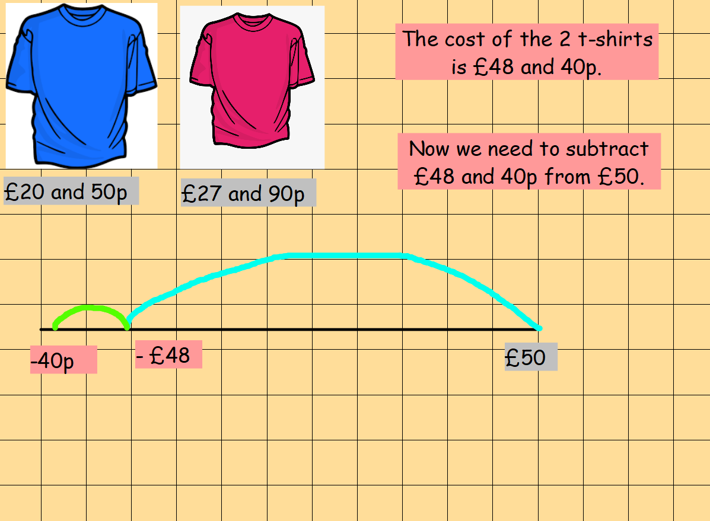
We can use a number line to then take this away from the amount of money we had to start.
We could use a number line to subtract.

Slide 8
We could count up to find out how much is left over.
Start at £48 and 40p and count up to £50.
£48 and 40p
+60p
Count how many pence to get to the next pound - £49.
£49
Count how many pounds to get to £50.
+ £1
£50
Altogether we have added £1 and 60p.

Slide 9
Sophie bought a colouring book for £2 and30p and some crayons for £3 and 80p.
How much change did she have from £5.
We first of all need to find out how much money she spent.
£2 and 20p + £3 and 80 p =
Then the pounds
Add the pence first.
30p + 80p = £1 and 10 p
£2 + £3 = £5
Altogether = £6 and 10p.

Slide 10
Now we know she spent £6 and 10p we can find out how much change she gets from £10.
Start at £6 and 10p and count up to £10
£6 and 10p
+90p
Count how many pence to get to the next pound - £7.
£7
Count how many pounds to get to £10.
+ £3
£10
Altogether we have added £3 and 90p/

