Slide 1
Maths Week 3 Lesson 2
Telling the time to a minute

Slide 2
Before you start… Warm up with your times tables.
1 x 5 =
2 x 5 =
3 x 5 =
4 x 5 =
5 x 5 =
6 x 5 =
7 x 5 =
8 x 5 =
9 x 5 =
10 x 5 =
11 x 5 =
12 x 5 =
1 x 4 =
2 x 4 =
3 x 4 =
4 x 4 =
5 x 4 =
6 x 4 =
7 x 4 =
8 x 4 =
9 x 4 =
10 x 4 =
11 x 4 =
12 x 4 =
1 x 3 =
2 x 3 =
3 x 3 =
4 x 3 =
5 x 3 =
6 x 3 =
7 x 3 =
8 x 3 =
9 x 3 =
10 x 3 =
11 x 3 =
12 x 3 =
Use our rolling number song to help you….
https://www.youtube.com/watch?v=jf2BHuSbt_Y

Slide 3
Before you start… Warm up with your times tables.
1 x 5 =5
2 x 5 =10
3 x 5 = 15
4 x 5 =20
5 x 5 =25
6 x 5 = 30
7 x 5 =35
8 x 5 =40
9 x 5 =45
10 x 5 =50
11 x 5 =55
12 x 5 =60
1 x 4 =4
2 x 4 =8
3 x 4 = 12
4 x 4 =16
5 x 4 =20
6 x 4 = 24
7 x 4 =28
8 x 4 =32
9 x 4 =26
10 x 4 =40
11 x 4 =44
12 x 4 =48
1 x 3 =3
2 x 3 =6
3 x 3 = 9
4 x 3 =12
5 x 3 =15
6 x 3 = 18
7 x 3 =21
8 x 3 =24
9 x 3 =27
10 x 3 =30
11 x 3 =33
12 x 3 =36

Slide 4
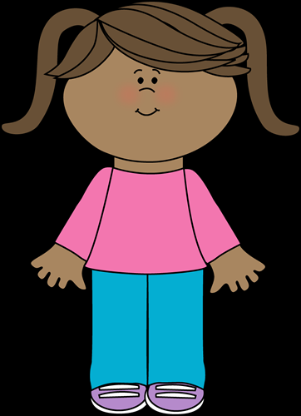
Holly says that 12:24 will look the same as 12:25. I will show you why she is wrong…

Slide 5
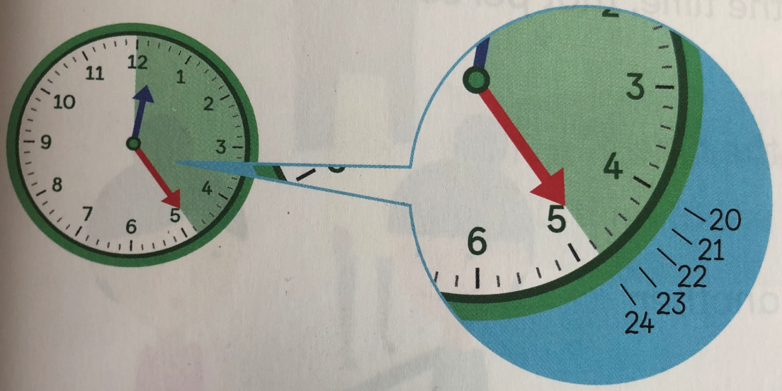
Between each 5 minute interval there at 4 lines. Each line represents one minute. So 12:24 would come one minute before 12:25. Do you agree?

Slide 6
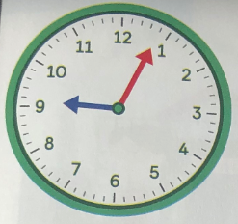
This clock shows the minute hand pointing to the 4. The hour hand is just past the 9. The time shown on the clock is 9:04. We can also say this as 4 minutes past 9.
See if you can help Jack on the next slide…

Slide 7
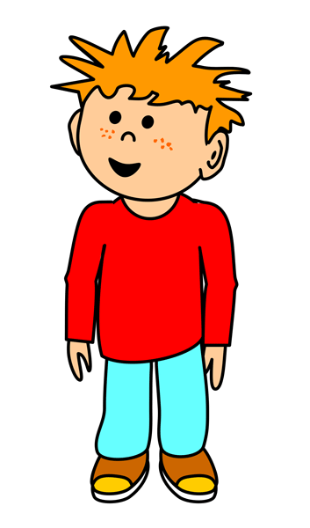
Jack says his plane takes of at 5 past 9. Is he right? Try to explain your answer.
Jack is………… because……….

Slide 8
Jack says his plane takes of at 5 past 9. Is he right? Try to explain your answer.
Jack is wrong because the minute hand is pointed to the 4. His plane takes off at 4 minutes past 9, which is one minute before five past 9.

Slide 9
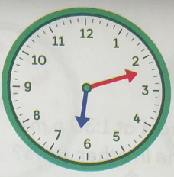
This clock shows the minute hand pointing at the 12th minute. This comes after 10 past 6, but before quarter past 6.
Count each minute to help you.
Start at the 2, you know that means 10 minutes.
See if you can help Lottie on the next slide…

Slide 10
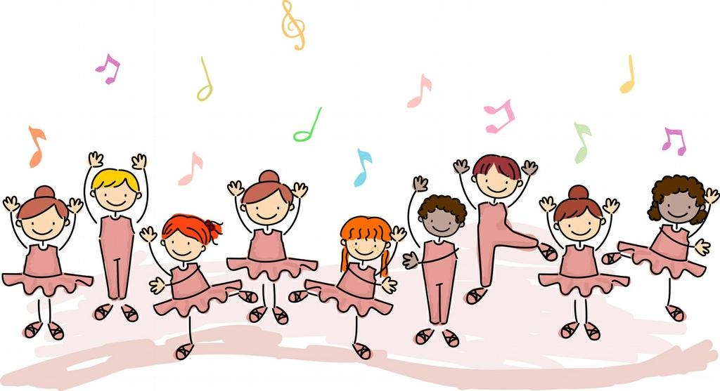
Lottie says her dance lesson starts at 6:15pm. Is Lottie right? Can you explain to Lottie your answer.
Lottie is………… because……….

Slide 11
Lottie says her dance lesson starts at 6:15pm. Is Lottie right? Can you explain to Lottie your answer.
Lottie is wrong because the minute hand is pointing at the 12th minute. If Lottie arrived at her dance lesson at 6:15pm she would be 3 minutes late.

Slide 12
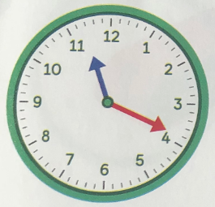
This clock shows one minute before 20 past 11. So, the minute hand is pointing at the 19th minute.
Count each minute to help you.
Remember each number equals 5 minutes.
See if you can help Freddie on the next slide…

Slide 13
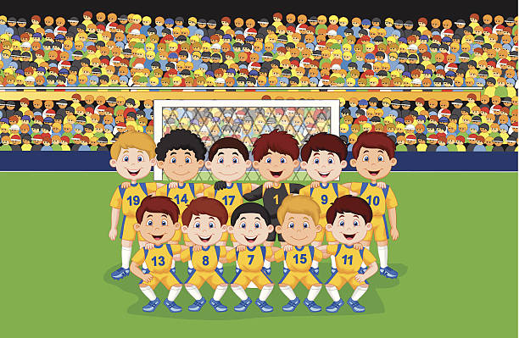
Freddie says he needs to arrive at Football 11:21. Can you help him explain his mistake.
Freddie is………… because……….

Slide 14
Freddie says he needs to arrive at Football 11:21. Can you help him explain his mistake.
Freddie is wrong because he has counted one minute after 20 past 11, instead of one minute before. If he got to Football at 11:21 he would be 2 minutes late.

