Slide 1
Week 5 English 4
Writing Activity

Slide 2
Re-read the information slides about the animals.

Slide 3
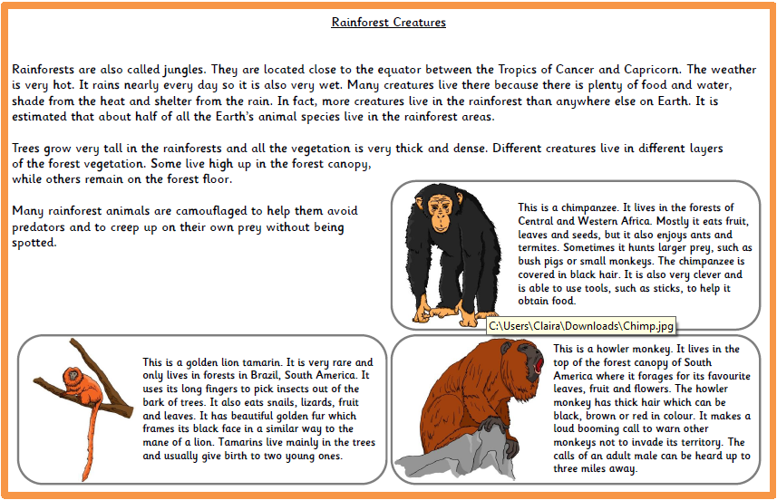

Slide 4
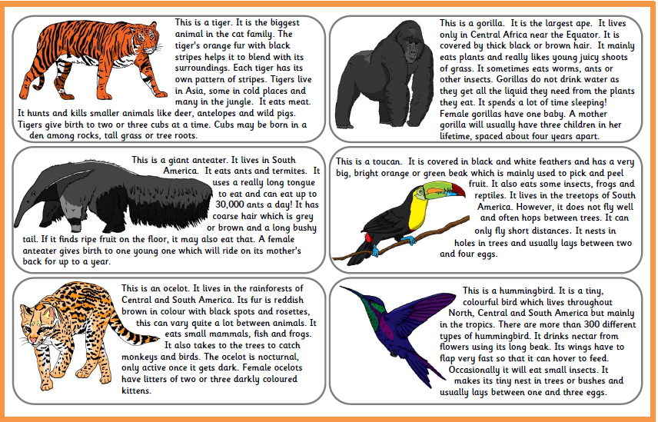

Slide 5
You need to choose 1 animal to research further.
Write down all your facts and present your information in any way you choose.
You then need to present it clearly to your family.
Think about all of the work we have done this year on the intonation in your voice and presenting to an audience.

