Slide 1

Week 7 Maths Lesson 2
Fractions
Counting in tenths

Slide 2
Introduction
Match the image or words to the fraction.
Which is the odd one out?
6
10
● | ● | ● | ● | ●
● | ● | ● | ● | ●
10 tenths
3
10
8
10

Slide 3
Introduction
Match the image or words to the fraction.
Which is the odd one out?
6
10
● | ● | ● | ● | ●
● | ● | ● | ● | ●
10 tenths
3
10
8
10

Slide 4
Varied Fluency 1
Sanjay is using counters to show tenths.
Write the next tenth in the sequence.
● | ● | ● | ●
● | ● | ●
● | ●

Slide 5
Varied Fluency 1
Sanjay is using counters to show tenths.
Write the next tenth in the sequence.
● | ● | ● | ●
● | ● | ●
● | ●
 | 1
 | 10

Slide 6
Varied Fluency 2
Write the fraction shown below.
What will the next tenth be?

Slide 7
Varied Fluency 2
Write the fraction shown below.
What will the next tenth be?
 | 7
 | 10
 | 8
 | 10

Slide 8
Varied Fluency 3
Count in tenths to complete the sequence.
Use the ten frames to help you.
5 |  | 6 |  |  |  | 8 |  | 9 |  | 10 |  |  |  | 12
10 |  | 10 |  |  |  | 10 |  | 10 |  | 10 |  |  |  | 10

Slide 9
Varied Fluency 3
Count in tenths to complete the sequence.
Use the ten frames to help you.
7
10
11
10
5 |  | 6 |  |  |  | 8 |  | 9 |  | 10 |  |  |  | 12
10 |  | 10 |  |  |  | 10 |  | 10 |  | 10 |  |  |  | 10
● | ● | ● | ● | ●
● | ● | ● | ● | ●
● | ●

Slide 10
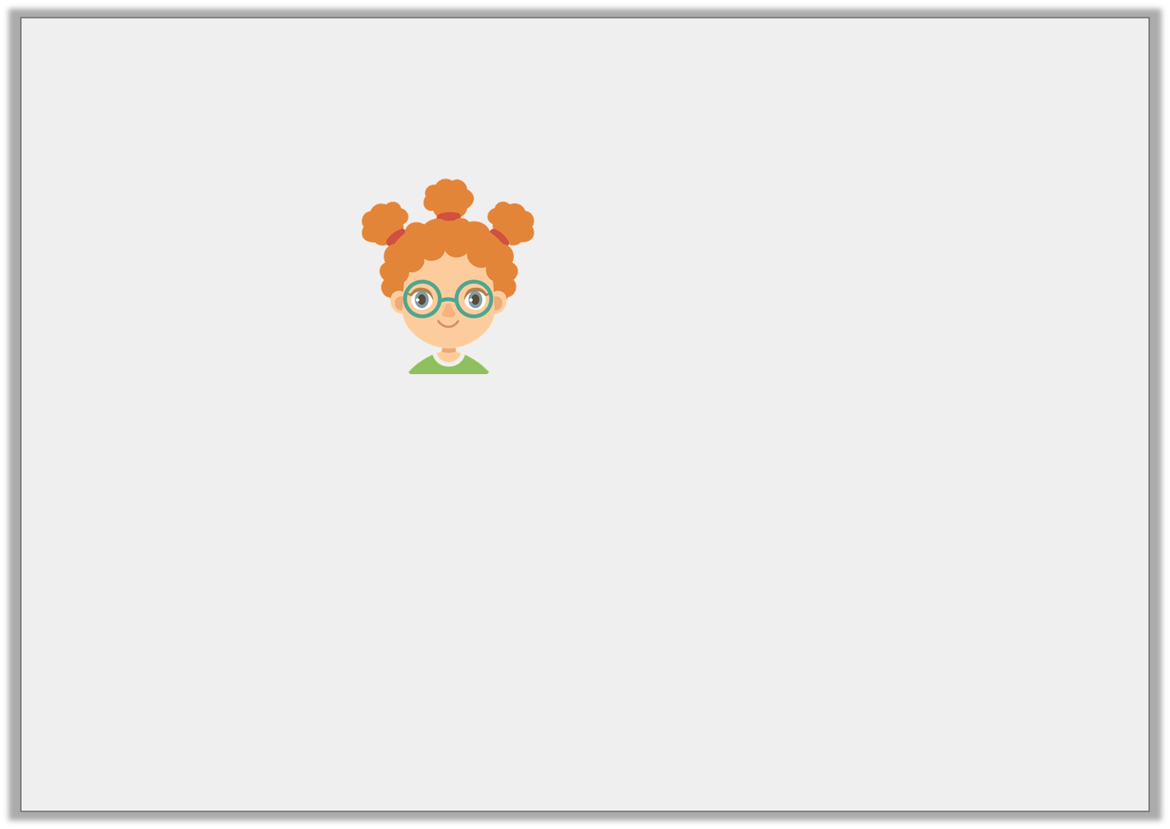
Varied Fluency 4
Georgia says,
Is she correct?
Two tenths more than
ten tenths is .
12
10

Slide 11
Varied Fluency 4
Georgia says,
Is she correct?
Yes, she is correct.
Two tenths more than
ten tenths is .
12
10

Slide 12
Problem Solving 1
Use the clues given to find the missing fraction.
I count backwards five tenths.
My answer is .
What fraction did I start with?
5
10

Slide 13
Problem Solving 1
Use the clues given to find the missing fraction.
I count backwards five tenths.
My answer is .
What fraction did I start with?
5
10
10 | or 1
10

Slide 14
Reasoning 1
Amir is using counters to show tenths.
He thinks that if he takes away one counter, he will have four tenths altogether.
Is he correct? Explain how you know.
● | ● | ●

Slide 15
Reasoning 1
Amir is using counters to show tenths.
He thinks that if he takes away one counter, he will have four tenths altogether.
Is he correct? Explain how you know.
Amir is incorrect because…
● | ● | ●

Slide 16
Reasoning 1
Amir is using counters to show tenths.
He thinks that if he takes away one counter, he will have four tenths altogether.
Is he correct? Explain how you know.
Amir is incorrect because he would need to add one counter to have four tenths. If he takes one away, he will have two tenths.
● | ● | ●

Slide 17
Reasoning 2
Ben and Charlie are looking at two statements.
Which statement is true? Explain why.
A. Four tenths less than is .
12
10
18
10
B. less than is nine tenths.
2
10
11
10

Slide 18
Reasoning 2
Ben and Charlie are looking at two statements.
Which statement is true? Explain why.
Statement B is true because…
A. Four tenths less than is .
12
10
18
10
B. less than is nine tenths.
2
10
11
10

Slide 19
Reasoning 2
Ben and Charlie are looking at two statements.
Which statement is true? Explain why.
Statement B is true because is two tenths more than nine tenths.
A. Four tenths less than is .
12
10
18
10
B. less than is nine tenths.
2
10
11
10
11
10

