Slide 1
Year 3– Money
Session 1 – recognising pounds and pence

Slide 2
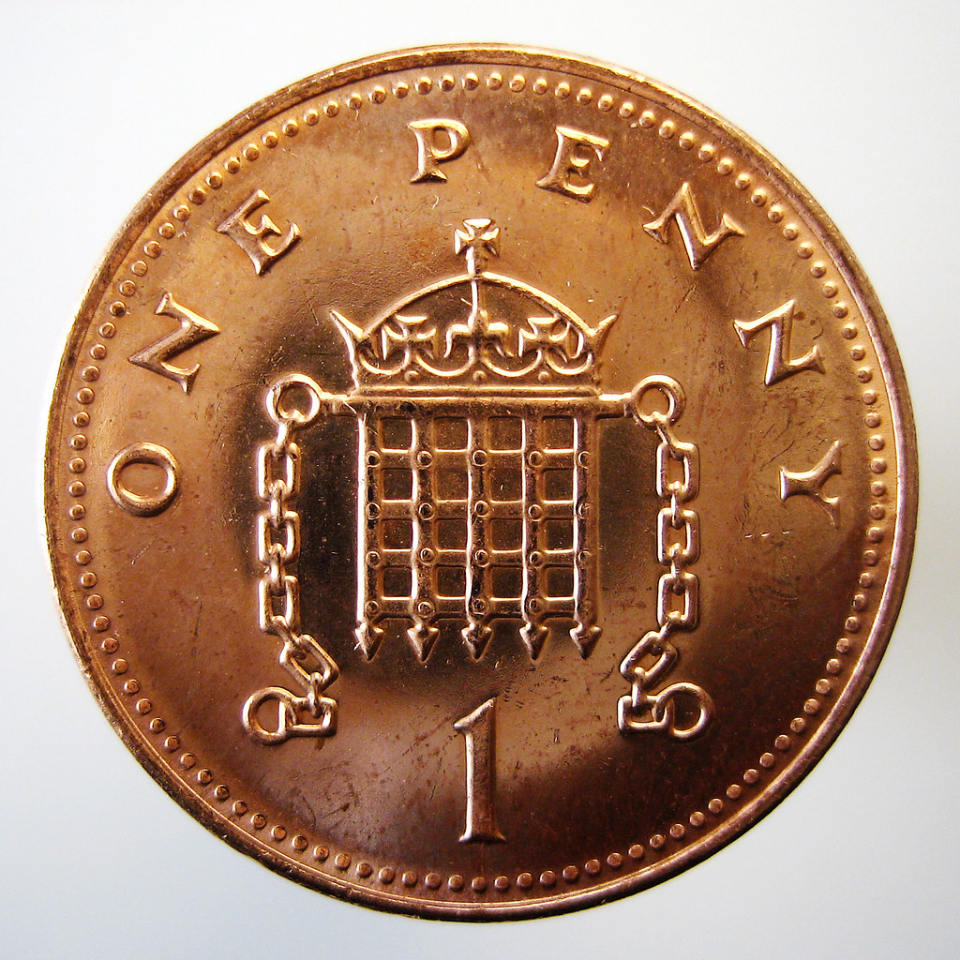
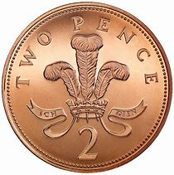
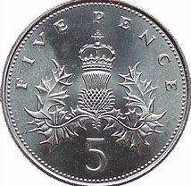
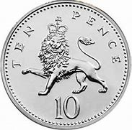
Can you recognise these coins?
1p
2p
You can make 2p with two 1p coins.
5p
10p
What other coins can you use to make 10p?

Slide 3
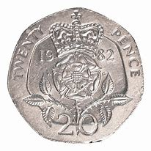
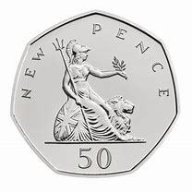
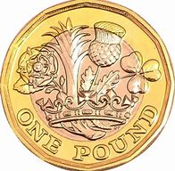
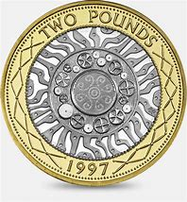
Can you recognise these coins?
20p
What other coins can you use to make 20p?
50p
What other coins can you use to make 50p?
£1
What other coins can you use to make £1?
£2
What other coins can you use to make £2?

Slide 4
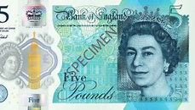
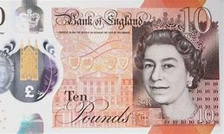
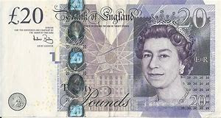
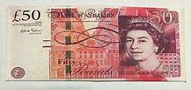
Can you recognise these notes?
£5
£10
£20
£50

Slide 5
How much money is here?
First label the coins
2p
5p
5p
50p
Then add them together. Start with the largest coin
50p + 5p + 5p + 2p =
62p

Slide 6
How much money is here?
First label the coins
20p
10p
50p
£1
£5
Add together the pence first (just in case you can make a new pound)
Then add together the pounds
50p + 20p + 10p =80p
£5 + £1 = £6
Altogether £6 and 80p.

Slide 7
How much money is here?
First label the coins
20p
20p
10p
£20
5p
50p
Add together the pence first (just in case you can make a new pound)
Then add together the pounds
50p + 20p + 20p +10p +5p = 105p
£20
This is £1 and 5p
Altogether £21 and 5p.

