Slide 1
Maths Week 3 Lesson 3
Telling the time on a 24 hour clock Pt 1

Slide 2
Before you start… Warm up with your times tables. I have added your 8s in today too!
1 x 5 =
2 x 5 =
3 x 5 =
4 x 5 =
5 x 5 =
6 x 5 =
7 x 5 =
8 x 5 =
9 x 5 =
10 x 5 =
11 x 5 =
12 x 5 =
1 x 4 =
2 x 4 =
3 x 4 =
4 x 4 =
5 x 4 =
6 x 4 =
7 x 4 =
8 x 4 =
9 x 4 =
10 x 4 =
11 x 4 =
12 x 4 =
1 x 3 =
2 x 3 =
3 x 3 =
4 x 3 =
5 x 3 =
6 x 3 =
7 x 3 =
8 x 3 =
9 x 3 =
10 x 3 =
11 x 3 =
12 x 3 =
1 x 8 =
2 x 8 =
3 x 8 =
4 x 8 =
5 x 8 =
6 x 8 =
7 x 8 =
8 x 8 =
9 x 8 =
10 x 8 =
11 x 8 =
12 x 8 =
Use our rolling number song to help you….
https://www.youtube.com/watch?v=jf2BHuSbt_Y

Slide 3
Before you start… Warm up with your times tables. I have added your 8s in today too!
1 x 5 =5
2 x 5 =10
3 x 5 = 15
4 x 5 =20
5 x 5 =25
6 x 5 = 30
7 x 5 =35
8 x 5 =40
9 x 5 =45
10 x 5 =50
11 x 5 =55
12 x 5 =60
1 x 4 =4
2 x 4 =8
3 x 4 = 12
4 x 4 =16
5 x 4 =20
6 x 4 = 24
7 x 4 =28
8 x 4 =32
9 x 4 =36
10 x 4 =40
11 x 4 =44
12 x 4 =48
1 x 3 =3
2 x 3 =6
3 x 3 = 9
4 x 3 =12
5 x 3 =15
6 x 3 = 18
7 x 3 =21
8 x 3 =24
9 x 3 =27
10 x 3 =30
11 x 3 =33
12 x 3 =36
1 x 8 =8
2 x 8 =16
3 x 8 = 24
4 x 8 =32
5 x 8 =40
6 x 8 = 48
7 x 8 =56
8 x 8 =64
9 x 8 =72
10 x 8 =80
11 x 8 =88
12 x 8 =96
Use our rolling number song to help you….
https://www.youtube.com/watch?v=jf2BHuSbt_Y

Slide 4
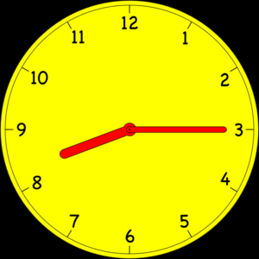
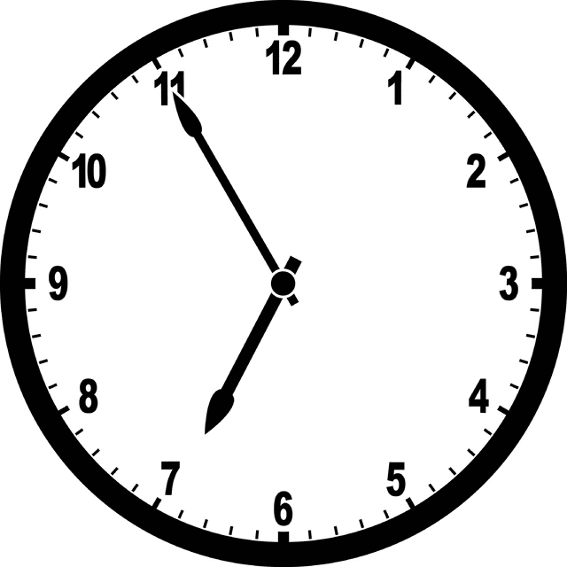
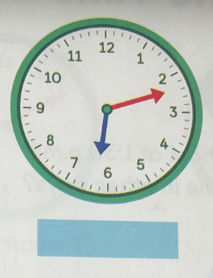
Yesterday you looked at telling the time to a minute. Can you carefully look at the time on these clocks.

Slide 5
Yesterday you looked at telling the time to a minute. Can you carefully look at the time on these clocks.
8:15
6:55
6:12

Slide 6
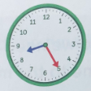
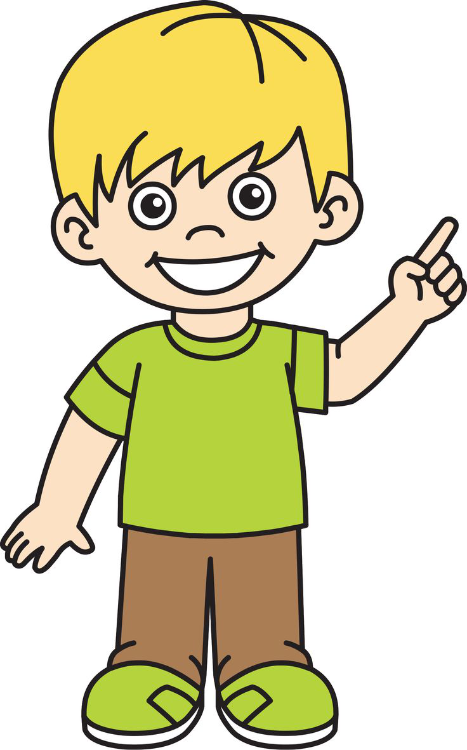
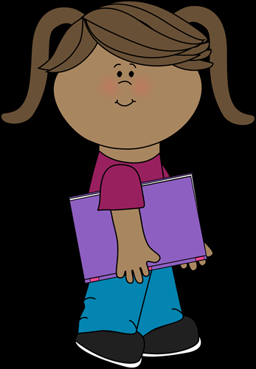
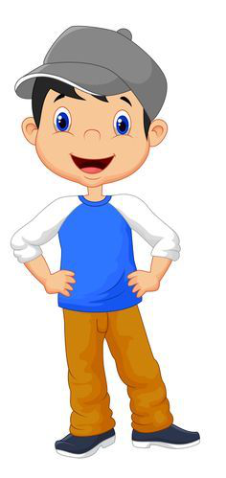
There are different ways of telling the same time.
Joe says 8:25 in the morning.
Lottie says this time as 25 past 8.
Charlie says 8:25am.

Slide 7
Charlie arrives at school at 8:25 in the morning.
Joe says 8:25 in the morning.
Lottie says this time as 25 past 8.
Charlie says 8:25am.
Are all children telling the correct time?

Slide 8
We say a.m in the morning. A.m is a latin word meaning before noon. (12)
We say p.m in the afternoon. P.M is a latin word meaning after noon. (12)

Slide 9
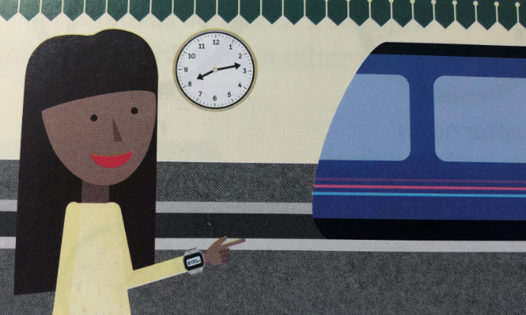
Poppy is waiting for her train in the evening.
Her train arrives before 8:15, but after 8:10.
What time will her train arrive?

Slide 10
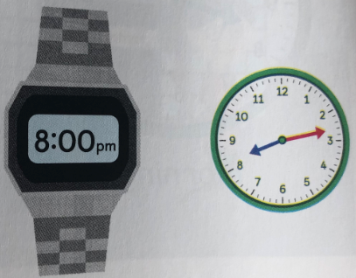
Her train arrives at 8:15. Does her watch display the correct time?

Slide 11
Let’s look more closely at the two times.
The clock at the train station shows it is 13 minutes past 8. We write it as 8:13pm.
Poppy's watch shows 8 o'clock at night. We write it as 8:00pm. The watch displays p.m because it is after noon.

Slide 12
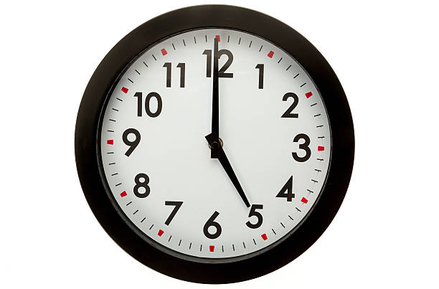
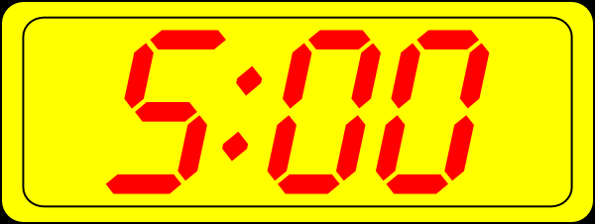

Tom plays football at 5 o clock In the evening. We can write it like this…
Tom’s Mom texted Tom and said “Your football training starts at 5pm. Don’t be late!”
She has said pm because it is in the evening. 5am in the morning Tom would be asleep!

Slide 13
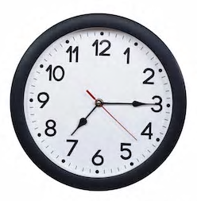
Ben goes to his tutor every Tuesday at quarter past 7.
His Mom writes this in her diary at 7:15pm.

Slide 14
Can you write on your pad 3 things you do a.m

Slide 15
Can you write on your pad 3 things you do p.m

Slide 16
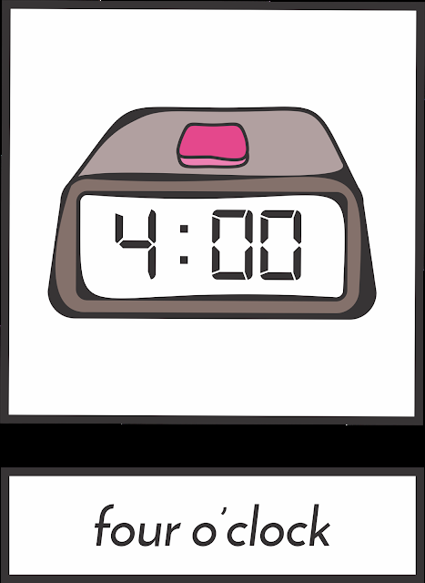
Maggie goes dancing at 4pm. Sally says she goes dancing at 4 o clock. Will the girls be there at the same time or different times?

